Slide 1
Database Technologies - MySQL
A day without new knowledge is a lost day.
Before we start DBT module.
Which module(s) you have completed?
If A and a, B and b, C and c etc. are treated in the same way then it is case-insensitive. MySQL is case-insensitive
In this module we are going to learn SQL, PL/SQL and NoSQL(MongoDB)

Slide 2

DIKW Model describes how the data can be processed and transformed into information, knowledge, and wisdom.
The DIKW pyramid
the quality of having experience, knowledge, and good judgement.
now you decide when to use and how to use(wisdom)
skills acquired through education, it can be theoretical or practical understanding of a subject.
SELECT potential (knowledge)
learned about something or someone.
as SELECT (symbol: σ) (information)
Sigma(σ) (data)
Let’s take another example.
I give you a number (data)
and tell you it’s the quantity of nuclear warheads (information)
and now you know the potential of nuclear warheads (knowledge)
and you decide not to use them or to make them more (wisdom).

Slide 3

wisdom
Our employees Ben, Jo, and Tom are young.
Our employees Ben, Jo, and Tom are in 20’s
Toy is going to retire next year.
….
knowledge
Age of employees:
R = { Ben is 25 yrs. Old, Jo is 29 yrs. Old, Kim is 45 yrs. Old, Tom is 23 yrs. Old, Toy is 60 yrs. Old , …. }
Information
Now we arrange the data and make some sense and create information.
set A is Age, set B is Name
Age – { 25, 29, 45, 23, 60, 51, 35, …. }
Name – { Ben, Jo, Kim, Tom, Toy, Sam, Don, …. }
The DIKW pyramid
data
set A – { 25, 29, 45, 23, 60, 51, 35, …. }
set B – { Ben, Jo, Kim, Tom, Toy, Sam, Don, …. }

Slide 4
Class Room
Session 1

Slide 5

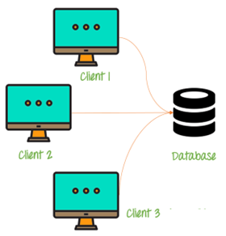
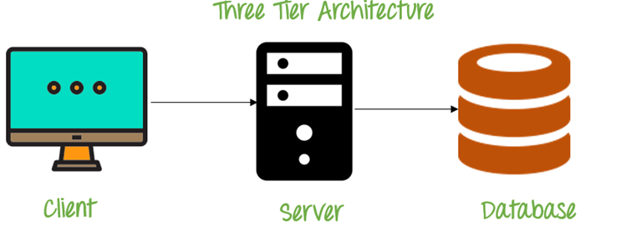
Introduction
If anyone who wants to develop a good application
then he should have the knowledge three major components.
They are . . . . .
Presentation Layer [ UI ]
Application Layer [ Server Application and Client Application ]
Data Layer [ Data Access Object (DAO) / Data Access Layer (DAL) ] { Flat Files | RDBMS | NoSQL }

Slide 6
Introduction
A layer refers to pieces of software that are logically separated, but typically live within the same process and machine.
A tier, instead, refers to pieces of software that live in distinct processes or AppDomains or machines.
A tier refers to physical separation; a layer is about logical separation.

Slide 7
Introduction
Why do we need databases (Use Case)?
We need databases because they organize data in a manner which allows us to store, query, sort, and manipulate data in various ways. Databases allow us to do all this things.
Many companies collects data from different resource (like Weather data, Geographical data, Finance data, Scientific data, Transport data, Cultural data, etc.)

Slide 8
Introduction
4 Important Roles of Database in Industry.
It is needed for data access within the company.
It is needed to maintain strong relationships between data.
This system allows newer(latest) and better updates.
It helps to search data in a better manner.

Slide 9
What is Relation and Relationship?
Remember:
A reference is a relationship between two tables where the values in one table refer to the values in another table.
A referential key is a column or set of columns in a table that refers to the primary key of another table. It establishes a relationship between two tables, where one table is called the parent table, and the other is called the child table.

Slide 10
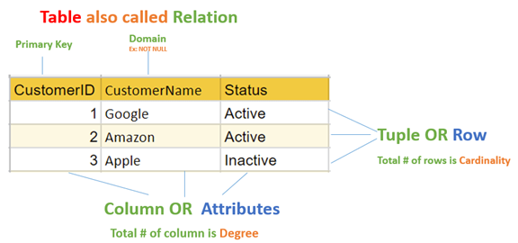
relation and relationship?
Relation (in Relational Algebra "R" stands for relation): In Database, a relation represents a table or an entity than contain attributes.
Relationship: In database, relationship is that how the two entities are connected to each other, i.e. what kind of relationship type they hold between them.
Primary/Foreign key is used to specify this relationship.
Remember:
Foreign Key is also know as
referential constraint
referential integrity constraint.
Note:
Table - The physical instantiation of a relation in the database schema.
Relation - A logical construct that organizes data into rows and columns.

Slide 11
File Systems is the traditional way to keep your data organized.
File System
vs
DBMS

Slide 12
file-oriented system
struct Employee {
int emp_no;
char emp_name[50];
int salary;
} emp[1000];
struct Employee {
int emp_no;
char emp_name[50];
int salary;
};
struct Employee emp[1000];
File Anomalies
c:\employee.txt
c:\employee.txt
c:\employee.txt
c:\employee.txt
c:\employee.txt
1 suraj 4000
2 ramesh 6000
3 rajan 4500
. |
. |
. |
500 sam 3500
. |
. |
. |
1000 amit 2300
1 suraj 4000
2 ramesh 6000
3 rajan 4500
. |
. |
. |
500 sam 3500
. |
. |
1000 amit 2300
. |
. |
. |
2000 jerry 4500
. |
. |
1 suraj 4000
2 ramesh 6000
3 rajan 4500
. |
. |
500 sam 3500
. |
3 rajan 4500
. |
sam 3500
. |
. |
1000 amit 2300
1 suraj 4000
2 ramesh 6000
3 rajan 4500
. |
. |
sam 500 3500
. |
ram 550 5000
. |
1000 amit 2300
1 suraj 4000
2 ramesh 6000
3 rajan 4500
. |
500 sam 3500
. |
1250 neel 4500

Slide 13
Create/Open an existing file
Reading from file
Writing to a file
Closing a file
file-oriented system
File Anomalies
c:\employee.txt
file attributes
file permissions
search empl ID=1
search emp_name
1 suraj 4000
2 ramesh 6000
3 rajan 4500
. |
. |
. |
500 sam 3500
. |
. |
. |
1000 amit 2300
File Name
Type
Location
File permissions
Share permissions
1 suraj 4000
2 ramesh 6000
3 rajan 4500
. |
. |
. |
500 sam 3500
. |
. |
. |
1000 amit 2300
1 suraj 4000
2 ramesh 6000
3 rajan 4500
. |
. |
. |
500 sam 3500
. |
. |
. |
1000 amit 2300

Slide 14
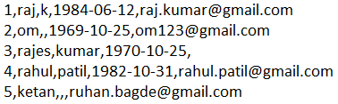
file-oriented system
A flat file database is a database that stores data in a plain text file (e.g. *.txt, *.csv format). Each line of the text file holds one record, with fields separated by delimiters, such as commas or tabs.
1 rajan MG Road Pune MH 34500
2 rahul patil SSG Lane Pune MH 54000
3 suraj raj k Deccan Gymkhana Pune MH 22000
4, S M Kumar, Mg Road Pune MH, 32000
5, S M Kumar, Mg Road, Pune, MH, 32000
The Zen of Python,
Beautiful is better than ugly.
Explicit is better than implicit.
Simple is better than complex.
Complex is better than complicated.
Flat is better than nested.
Sparse is better than dense.
Readability counts.
Special cases aren't special enough to break the rules.
Although practicality beats purity.
Errors should never pass silently.
Unless explicitly silenced.
In the face of ambiguity, refuse the temptation to guess.
There should be one-- and preferably only one --obvious way to do it.
Although that way may not be obvious at first unless you're Dutch.
Now is better than never.
Although never is often better than *right* now.
If the implementation is hard to explain, it's a bad idea.
If the implementation is easy to explain, it may be a good idea.
Namespaces are one honking great idea -- let's do more of those!

Slide 15
advantages of file-oriented system
The biggest advantage of file-based storage is that anyone can understand the system.
Advantage of File-oriented system
Backup: It is possible to take faster and automatic back-up of database stored in files of computer-based systems.
Data retrieval: It is possible to retrieve data stored in files in easy and efficient way.
Editing: It is easy to edit any information stored in computers in form of files.
Remote access: It is possible to access data remote location.
Sharing: The files stored in systems can be shared among multiple users at a same time.

Slide 16
disadvantage of file-oriented system
The biggest disadvantage of file-based storage is as follows.
Disadvantage of File-oriented system
Data redundancy: It is possible that the same information may be duplicated in different files. This leads to data redundancy results in memory wastage.
(Suppose a customer having both kind of accounts- saving and current account. In such a situation a customers detail are stored in both the file, saving.txt- file and current.txt- file , which leads to Data Redundancy.)
Data inconsistency: Because of data redundancy, it is possible that data may not be in consistent state.
(Suppose customer changed his/her address. There might be a possibility that address is changed in only one file (saving.txt) and other (current.txt) remain unchanged.)
Limited data sharing: Data are scattered in various files and also different files may have different formats (for example: .txt, .csv, .tsv and .xml) and these files may be stored in different folders so, due to this it is difficult to share data among different applications.
Data Isolation: Because data are scattered in various files, and files may be in different formats (for example: .txt, .csv, .tsv and .xml), writing new application programs to retrieve the appropriate data is difficult.
Data security: Data should be secured from unauthorized access, for example a account holder in a bank should not be able to see the account details of another account holder, such kind of security constraints are difficult to apply in file processing systems.

Slide 17

A database application is a computer program whose primary purpose is entering and retrieving information.
What is database?
A major purpose of a database system is to provide users with an abstract view of the data.
abstract means existing in thought or as an idea but not having a physical or concrete existence.

Slide 18

what is database?
A database is a system to organize, store and retrieve large amounts of data easily, which is stored in one or more data files by one or more users.
Each database is a collection of tables, which are called relations, hence the name "relational database".
Index Page

Slide 19

Relation Schema:
e.g. student (roll_no int, name varchar, address varchar, phone varchar and age int) is relation schema for STUDENT
A relation schema represents name of the relation with its attributes.
DBMS
The database management system (DBMS) is the software that interacts with end users, applications, and the database itself to store and analyze the data.
database: Is the collection of related data which is organized, database can store and retrieve large amount of data easily, which is stored in one or more data files by one or more users, it is called as structured data.
management system: it is a software, designed to define, manipulate, retrieve and manage data in a database.

Slide 20
Difference between File System and DBMS
File Management System | Database Management System
File System is easy-to-use system to store data which require less security and constraints. | Database Management System is used when security constraints are high.
Data Redundancy is more in File System. | Data Redundancy is less in Database Management System.
Data Inconsistency is more in File System. | Data Inconsistency is less in Database Management System.
Centralization is hard to get when it comes to File System. | Centralization is achieved in Database Management System.
User locates the physical address of the files to access data in File System. | In Database Management System, user is unaware of physical address where data is stored.
Security is low in File System. | Security is high in Database Management System.
File System stores unstructured data. "unstructured data" may include documents, audio, video, images, etc. | Database Management System stores structured data.

Slide 21



relational database management system?
A RDBMS is a database management system (DBMS) that is based on the relational model introduced by Edgar Frank Codd at IBM in 1970.
RDBMS supports
client/server Technology
Highly Secured
Relationship (PK/FK)
A server is a computer program or device that provides a service to another computer program and its user, also known as the client.
In the client/server programming model, a server program awaits and fulfills requests from client programs, which might be running in the same, or other computers.

Slide 22
object relational database management system?
An object database is a database management system in which information is represented in the form of objects.
PostgreSQL is the most popular pure ORDBMS. Some popular databases including Microsoft SQL Server, Oracle, and IBM DB2 also support objects and can be considered as ORDBMS.

Slide 23
difference between dbms and rdbms
DBMS | RDBMS
Data is stored as file. | Data is stored as tables.
There is no relationship between data in DBMS. | Data is present in multiple tables which can be related to each other.
DBMS has no support for distributed databases. | RDBMS supports distributed databases.
Normalization cannot be achieved. | Normalization can be achieved.
DBMS supports single user at a time. | RDBMS supports multiple users at a time.
Data Redundancy is common in DBMS. | Data Redundancy can be reduced in RDBMS.
DBMS provides low level of security during data manipulation. | RDBMS has high level of security during data manipulation.

Slide 24
relational model concepts
and
properties of relational table

Slide 25
relational model concepts
Relational model organizes data into one or more tables (or "relations") of columns and rows. Rows are also called records or tuples. Columns are also called attributes.
Tables − In relational model, relations are saved in the form of Tables. A table has rows and columns.
Attribute − Attributes are the properties that define a relation. e.g. (roll_no, name, address, phone and age)
Tuple − A single row of a table, which contains a single record for that relation is called a tuple.
Relation schema − A relation schema describes the relation name (table name) with its attribute (columns) names.
Attribute domain − An attribute domain specifies the data type, format, and constraints of a column, and defines the range of values that are valid for that column.
Relation key − Each row has one or more attributes, known as relation key, which can identify the row in the relation (table) uniquely.
e.g. student(prn, name, address, phone, DoB, age, hobby, email, status) is relation schema for student relation.
Remember:
In database management systems, null is used to represent missing or unknown data in a table column.

Slide 26
properties of relational table
ID | job | firstName | DoB | salary
1 | manager | Saleel Bagde | yyyy-mm-dd | ●●●●●●
3 | salesman | Sharmin | yyyy-mm-dd | ●●●●●●
4 | accountant | Vrushali | yyyy-mm-dd | ●●●●●●
2 | salesman | Ruhan | yyyy-mm-dd | ●●●●●●
5 | 9500 | manager | yyyy-mm-dd | ●●●●●●
5 | Salesman | Rahul Patil | yyyy-mm-dd | ●●●●●●
Relational tables have six properties:
Values are atomic.
Column values are of the same kind. (Attribute Domain: Every attribute has some pre-defined datatypes, format, and constraints of a column, and defines the range of values that are valid for that column known as attribute domain.)
Each row is unique.
The sequence of columns is insignificant – (unimportant).
The sequence of rows is insignificant – (unimportant).
Each attribute/column must have a unique name.

Slide 27

What is data?

Slide 28

what is data?
Data is any facts that can be stored and that can be processed by a computer.
Data can be in the form of Text or Multimedia
e.g.
number, characters, or symbol
images, audio, video, or signal

Slide 29
What is Entity Relationship Diagram?

Slide 30
Entity Relationship Diagram (ER Diagram)
Use E-R model to get a high-level graphical view to describe the "ENTITIES" and their "RELATIONSHIP"
The basic constructs/components of ER Model are
Entity, Attributes and Relationships.

Slide 31
An entity can be a real-world object.
What is Entity?

Slide 32
entity
In relation to a database , an entity is a
Person(student, teacher, employee, department, …)
Place(classroom, building, …) --a particular position or area
Thing(computer, lab equipment, …) --an object that is not named
Concept(course, batch, student’s attendance, …) -- an idea,
about which data can be stored. All these entities have some attributes or properties that give them their identity.
Every entity has its own characteristics.

Slide 33
When you are designing attributes for your entities, you will sometimes find that an attribute does not have a value. For example, you might want an attribute for a person's middle name, but you can't require a value because some people have no middle name. For these, you can define the attribute so that it can contain null values.
In database management systems, null is used to represent missing or unknown data in a table column.
What is an Attribute?
Attributes are the properties that define a relation.
e.g. student(ID, firstName, middleName, lastName, city)
In some cases, you might not want a specific attribute to contain a null value, but you don't want to require that the user or program always provide a value. In this case, a default value might be appropriate. A default value is a value that applies to an attribute if no other valid value is available.
Entity
a₁
a₂
a₃
a₄
…
v₁
v₂
v₃
v₄
…

Slide 34
attributes
A table has rows and columns
In RDBMS, a table organizes data in rows and columns. The COLUMNS are known as ATTRIBUTES / FIELDS whereas the ROWS are known as RECORDS / TUPLE.
In Relation: EMP
Attributes
ID | EmployeeName | Job | Hiredate | Salary
1 | KING | PRESIDENT | 2017-02-15 | 5000
… | … | … | … | …
… | … | … | … | …
… | … | … | … | …
Rows

Slide 35
attributes
In Entity Relationship(ER) Model attributes can be classified into the following types.
Simple/Atomic and Composite Attribute
Single Valued and Multi Valued attribute
Stored and Derived Attributes
Complex Attribute
Remember:
In SQL, the same name can be used for two (or more) attributes as long as the attributes are in different relations.

Slide 36
attributes
Simple / Atomic Attribute --VS-- Composite Attribute
(Can’t be divided further) (Can be divided further)
Single Value Attribute --VS-- Multi Valued Attribute
(Only One value) (Multiple values)
Stored Attribute --VS-- Derived Attribute
(Only One value) (Virtual)
Complex Attribute
(Composite & Multivalued)
Employee ID: An employee ID can be a composite attribute, which is composed of sub-attributes such as department code, job code, and employee number.
Atomic Attribute: An attribute that cannot be divided into smaller independent attribute is known as atomic attribute.
e.g. ID’s, PRN, age, gender, zip, marital status cannot further divide.
Single Value Attribute: An attribute that has only single value is known as single valued attribute.
e.g. manufactured part can have only one serial number, voter card, blood group, price, quantity, branch can have only one value.
Stored Attribute: The stored attribute are such attributes which are already stored in the database and from which the value of another attribute is derived.
e.g. (HRA, DA…) can be derive from salary, age can be derived from DoB, total marks or average marks of a student can be derived from marks.

Slide 37
Composite VS Multi Valued Attribute

Slide 38

composite / multi valued attributes
Composite Attribute
Person Entity
Name attribute: ( firstName, middleName, and lastName )
PhoneNumber attribute: ( countryCode, cityCode, and phoneNumber )
Multi Valued Attribute
Person Entity
Hobbies attribute: [ reading, hiking, hockey, skiing, photography, . . . ]
SpokenLanguages attribute: [ Hindi, Marathi, Gujarati, English, . . . ]
Degrees attribute: [ 10th , 12th, BE, ME, PhD, . . . ]
emailID attribute: [ saleel@gmail.com, salil@yahoomail.com, . . . ]

Slide 39
What is an Prime, Non-Prime Attribute?

Slide 40
attributes
Prime attribute (Entity integrity)
An attribute, which is a part of the prime-key (candidate key), is known as a prime attribute.
Non-prime attribute
An attribute, which is not a part of the prime-key (candidate key), is said to be a non-prime attribute.

Slide 41
Entity Relationship Diagram Symbols

Slide 42
erdplus.com
www.draw.io
entity relationship diagram symbols
Attribute
Composite Attribute
Key Attribute
Strong Entity
Weak Entity
Derived Attribute
Weak Relationship
Relationship
Multivalued Attribute

Slide 43
strong and weak entity
An entity may participate in a relation either totally or partially.
Strong Entity: A strong entity is not dependent on any other entity in the schema. A strong entity will always have a primary key. Strong entities are represented by a single rectangle.
Weak Entity: A weak entity is dependent on a strong entity to ensure its existence. Unlike a strong entity, a weak entity does not have any primary key. A weak entity is represented by a double rectangle. The relation between one strong and one weak entity is represented by a double diamond. This relationship is also known as identifying relationship.
Example 1 – A loan entity can not be created for a customer if the customer doesn’t exist
Example 2 – A payment entity can not be created for a loan if the loan doesn’t exist
Example 3 – A dependents list entity can not be created if the employee doesn’t exist
Example 4 – A prescription entity can not be created for a patient if the patient doesn’t exist

Slide 44
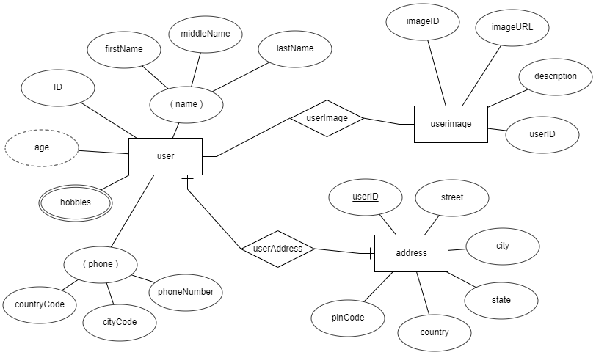
entity relationship diagram
DoB

Slide 45
What is a degree, cardinality, domain and union in database?

Slide 46
What is a degree, cardinality, domain and union in database?
Degree d(R) / Arity: Total number of attributes/columns present in a relation/table is called degree of the relation and is denoted by d(R).
Cardinality |R|: Total number of tuples/rows present in a relation/table, is called cardinality of a relation and is denoted by |R|.
Domain: Total range of accepted values for an attribute of the relation is called the domain of the attribute. (Data Type(size))
Union Compatibility: Two relations R and S are set to be Union Compatible to each other if and only if:
They have the same degree d(R).
Domains of the respective attributes should also be same.

Slide 47
What is domain constraint and types of data integrity constraints?

Slide 48
Data integrity refers to the correctness and completeness of data.
A domain constraint and types of data integrity constraints
Domain Constraint = data type + Constraints (not null/unique/primary key/foreign key/check/default)
e.g. custID INT, constraint pk_custid PRIMARY KEY(custID)
Three types of integrity constraints: entity integrity, referential integrity and domain integrity:
Entity integrity: Entity Integrity Constraint is used to ensure the uniqueness of each record the table. There are primarily two types of integrity constraints that help us in ensuring the uniqueness of each row, namely, UNIQUE constraint and PRIMARY KEY constraint.
Referential integrity: Referential Integrity Constraint ensures that there always exists a valid relationship between two tables. This makes sure that if a foreign key exists in a table relationship then it should always reference a corresponding value in the second table t₁[FK] = t₂[PK] or it should be null.
Domain integrity: A domain is a set of values of the same type. For example, we can specify if a particular column can hold null values or not, if the values have to be unique or not, the data type or size of values that can be entered in the column, the default values for the column, etc..

Slide 49
types of Keys?

Slide 50
Keys are used to establish relationships between tables and also to uniquely identify any record in the table.
types of Keys?
r = Employee(EmployeeID, FullName, job, salary, PAN, DateOfBirth, emailID, deptno)
Candidate Key: are individual columns in a table that qualifies for uniqueness of all the rows. Here in Employee table EmployeeID, PAN or emailID are Candidate keys.
Primary Key: is the columns you choose to maintain uniqueness in a table. Here in Employee table you can choose either EmployeeID, PAN or emailID columns, EmployeeID is preferable choice.
Alternate Key: Candidate column other the primary key column, like if EmployeeID is primary key then , PAN or emailID columns would be the Alternate key.
Super Key: If you add any other column to a primary key then it become a super key, like EmployeeID + FullName is a Super Key.
Composite Key: If a table do not have any single column that qualifies for a Candidate key, then you have to select 2 or more columns to make a row unique. Like if there is no EmployeeID, PAN or emailID columns, then you can make FullName + DateOfBirth as Composite key. But still there can be a narrow chance of duplicate row.

Slide 51
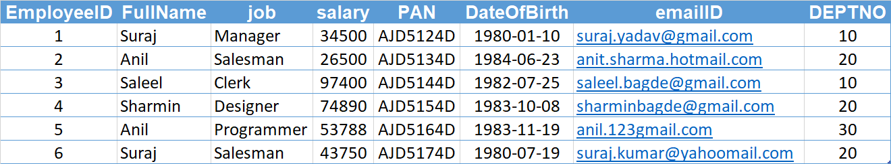
Candidate Key
Primary Key
Composite Key
Alternate Key

Slide 52
Degrees of relationship
The degree of relationship can be defined as the number of occurrences in one entity that is associated with the number of occurrences in another entity.

Slide 53

relationships - binary
The three most common relationships in ER models are Binary, Unary, and Ternary
A binary relationship is when two entities participate and is the most common relationship.

Slide 54
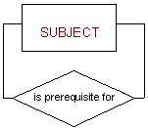
relationships - unary
The three most common relationships in ER models are Binary, Unary, and Ternary
A unary relationship is when both participants in the relationship are the same entity.

Slide 55
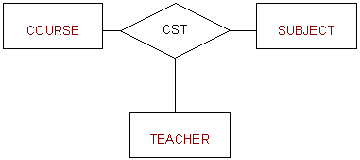
relationships - ternary
The three most common relationships in ER models are Binary, Unary, and Ternary
A ternary relationship is when three entities participate in the relationship.

Slide 56
Common relationships

Slide 57

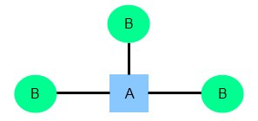
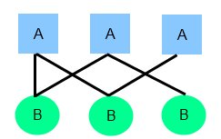
relationships
Common relationship
one-to-one (1:1)
one-to-many (1:M)
many-to-many (M:N)

Slide 58
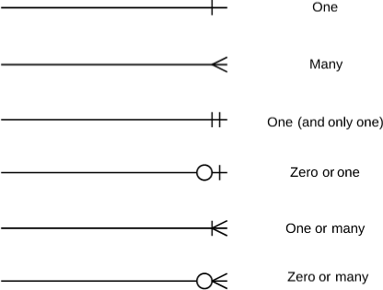
relationships

Slide 59
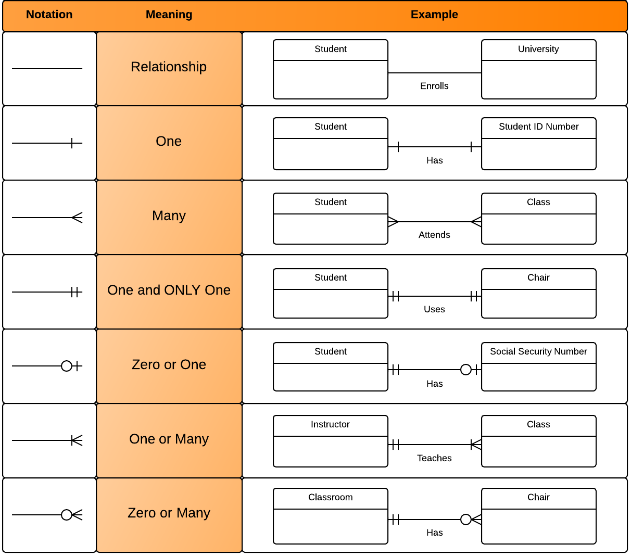
relationships

Slide 60
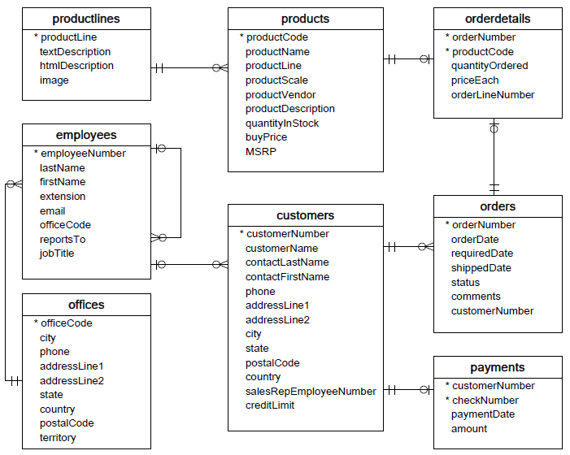

Slide 61
one-to-one relationship

Slide 62
one-to-one relationship
A one-to-one relationship between two tables means that a row in one table can only relate to zero/one row in the table on the other side of their relationship. This is the least common database relationship.
A one-to-one relationship is a type of cardinality that refers to the relationship between two entities R and S in which one element of entity R may only be linked to zero/one element of entity S, and vice versa.
Country
Capital
Country
Capital
Country
one-to-one relationship
Capital
Country
Capital
=
Country
Capital
Country
Capital

Slide 63
one-to-one relationship
A one-to-one relationship between two tables means that a row in one table can only relate to zero/one row in the table on the other side of their relationship. This is the least common database relationship.
A one-to-one relationship is a type of cardinality that refers to the relationship between two entities R and S in which one element of entity R may only be linked to zero/one element of entity S, and vice versa.
Person-1
Passport-1
Person-1
Passport-1
Person-2
Passport-1
Person-2
Passport-1
one-to-one relationship
=
Person-3
Passport-1
Person-4
Passport-1
Person-4

Slide 64
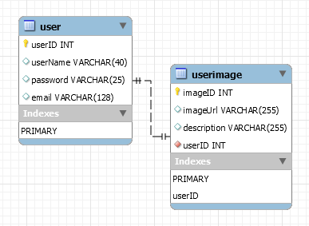
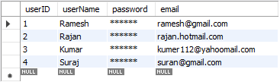
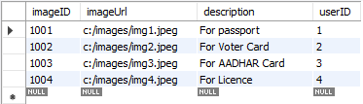
how to create one-to-one relationship
CREATE TABLE user (
userID INT PRIMARY KEY,
userName VARCHAR(40),
password VARCHAR(25),
email VARCHAR(128)
) ;
CREATE TABLE userImage (
imageID INT PRIMARY KEY,
imageUrl VARCHAR(255),
description VARCHAR(255),
userID INT NOT NULL UNIQUE,
FOREIGN KEY(userID) REFERENCES user(userID)
) ;

Slide 65
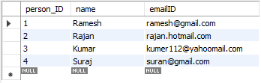

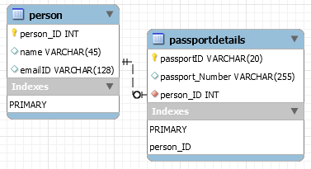
how to create one-to-one relationship
CREATE TABLE person (
person_ID INT PRIMARY KEY ,
name VARCHAR(45),
emailID VARCHAR(128)
);
CREATE TABLE passportDetails (
passportID VARCHAR(20) PRIMARY KEY,
passport_Number VARCHAR(255),
person_ID INT UNIQUE,
FOREIGN KEY(person_ID) REFERENCES person(person_ID)
);

Slide 66
one-to-many relationship

Slide 67
one-to-many relationship
A one-to-many relationship between two tables means that a row in one table can have zero or more row in the table on the other side of their relationship.
a one-to-many relationship is a type of cardinality that refers to the relationship between two entities R and S in which an element of R may be linked to many elements of S, but a member of S is linked to only one element of R.
Customer-1
Order-1
Customer-1
Order-1
Customer-2
Order-1
Customer-2
Order-1
one-to-many relationship
Customer-3
Order-2
=
Customer-2
Order-2
Customer-4
Order-1
Customer-3
Order-1
Customer-5
Order-2
Customer-3
Order-2
Order-3
Customer-3
Order-3
Order-1
Customer-4
Order-1

Slide 68
one-to-many relationship
A one-to-many relationship between two tables means that a row in one table can have one or more row in the table on the other side of their relationship.
a one-to-many relationship is a type of cardinality that refers to the relationship between two entities R and S in which an element of R may be linked to many elements of S, but a member of S is linked to only one element of R.
Invoice-1
Invoice_Item-1
Invoice-1
Invoice_Item-1
Invoice-2
Invoice_Item-1
Invoice-2
Invoice_Item-1
one-to-many relationship
Invoice-3
Invoice_Item-2
=
Invoice-2
Invoice_Item-2
Invoice-4
Invoice_Item-1
Invoice-3
Invoice_Item-1
Invoice_Item-2
Invoice-3
Invoice_Item-2
Invoice_Item-2
Invoice-3
Invoice_Item-3
Invoice_Item-1
Invoice-4
Invoice_Item-1

Slide 69
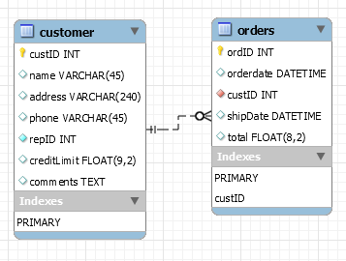
how to create one-to-many relationship
CREATE TABLE customer (
custID INT PRIMARY KEY,
name VARCHAR(45),
address VARCHAR(240),
phone VARCHAR(45),
repID INT NOT NULL,
creditLimit FLOAT(9,2),
comments TEXT,
constraint custid_zero CHECK(custID > 0)
);
CREATE TABLE orders (
ordID INT PRIMARY KEY,
orderdate DATETIME,
custID INT,
shipDate DATETIME,
total FLOAT(8,2),
FOREIGN KEY(custID) REFERENCES customer(custID),
constraint total_greater_zero CHECK(total >= 0)
);

Slide 70
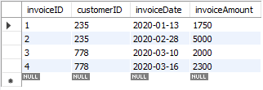
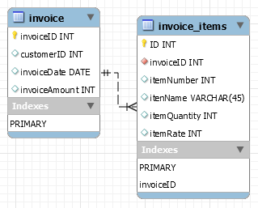
how to create one-to-many relationship
CREATE TABLE invoice (
invoiceID INT PRIMARY KEY,
customerID INT,
invoiceDate DATE,
invoiceAmount INT
);
CREATE TABLE invoice_items (
invoiceID INT,
itemID INT,
itenName VARCHAR(45),
itemQuantity INT,
itemRate INT,
PRIMARY KEY(invoiceID, itemID),
FOREIGN KEY(invoiceID) REFERENCES invoice(invoiceID)
);
CREATE TABLE invoice_items (
invoiceID INT NOT NULL,
itemID INT NOT NULL,
itenName VARCHAR(45),
itemQuantity INT,
itemRate INT,
UNIQUE(invoiceID, itemID),
FOREIGN KEY(invoiceID) REFERENCES invoice(invoiceID)
);

Slide 71
many-to-one relationship

Slide 72
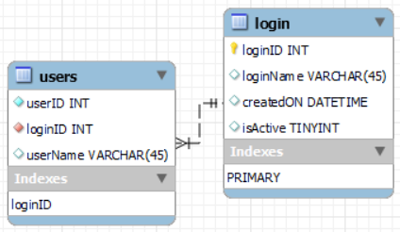
many-to-one relationship
CREATE TABLE users (
userID INT,
loginID INT,
userName VARCHAR(45),
PRIMARY KEY(loginID, userID),
constraint fk_users_login_loginID1 FOREIGN KEY(loginID)
REFERENCES login(loginID)
);
CREATE TABLE users (
userID INT NOT NULL,
loginID INT NOT NULL,
userName VARCHAR(45),
UNIQUE(loginID, userID),
constraint fk_users_login_loginID2 FOREIGN KEY(loginID)
REFERENCES login(loginID)
);
CREATE TABLE login (
loginID INT,
loginName VARCHAR(45),
createdON DATETIME,
isActive TINYINT,
PRIMARY KEY(loginID)
);

Slide 73
many-to-many relationship

Slide 74
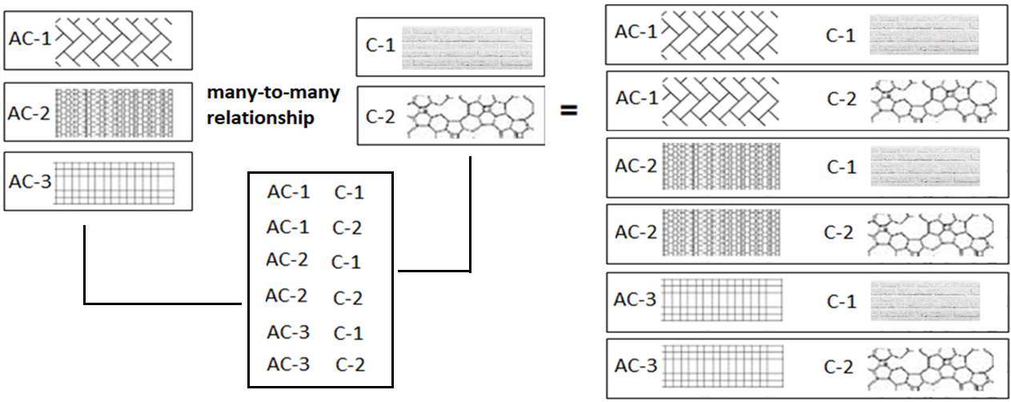
many-to-many relationship
A many-to-many relationship is a type of cardinality that refers to the relationship between two entities R and S in which R may contain a parent instance for which there are many children in S and vice versa.
=
=

Slide 75
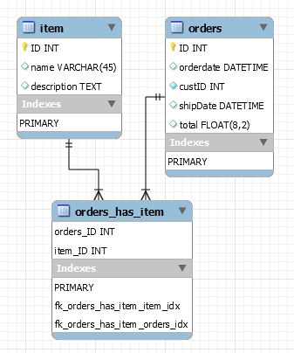
how to create many-to-many relationship
CREATE TABLE item (
ID INT PRIMARY KEY,
name VARCHAR(45),
description TEXT
);
CREATE TABLE orders (
ID INT PRIMARY KEY,
orderdate DATETIME,
custID INT NOT NULL,
shipDate DATETIME,
total FLOAT(8,2),
constraint total_greater_zero CHECK(total >= 0)
);
CREATE TABLE orders_has_item (
orders_ID INT NOT NULL,
item_ID INT NOT NULL,
PRIMARY KEY(orders_ID, item_ID),
constraint fk_orders_has_item_orders FOREIGN KEY(orders_ID)
REFERENCES orders(ID),
constraint fk_orders_has_item_item1 FOREIGN KEY(item_ID)
REFERENCES item(ID)
);

Slide 76
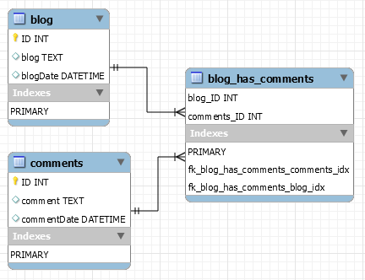
how to create many-to-many relationship
CREATE TABLE blog (
ID INT PRIMARY KEY,
blog TEXT,
blogDate DATETIME
);
CREATE TABLE comments (
ID INT PRIMARY KEY,
comment TEXT,
commentDate DATETIME
);
CREATE TABLE blog_has_comments (
blog_ID INT,
comments_ID INT,
PRIMARY KEY(blog_ID, comments_ID),
constraint fk_blog_has_comments_blog FOREIGN KEY(blog_ID) REFERENCES blog(ID),
constraint fk_blog_has_comments_comments FOREIGN KEY(comments_ID) REFERENCES comments(ID)
);

Slide 77

MySQL
MySQL is the most popular Open Source
Relational Database Management System.
MySQL was created by a Swedish company - MySQL AB that was founded in 1995. It was acquired by Sun Microsystems in 2008; Sun was in turn acquired by Oracle Corporation in 2010.
When you use MySQL, you’re actually using at least two programmes. One program is the MySQL server (mysqld.exe) and other program is MySQL client program (mysql.exe) that connects to the database server.

Slide 78
What is SQL?

Slide 79

what is sql?
Remember:
EXPLICIT or IMPLICIT commit will commit the data.
SQL (Structured Query Language) is a database language designed and developed for managing data in relational database management systems (RDBMS). SQL is common language for all Relational Databases.

Slide 80
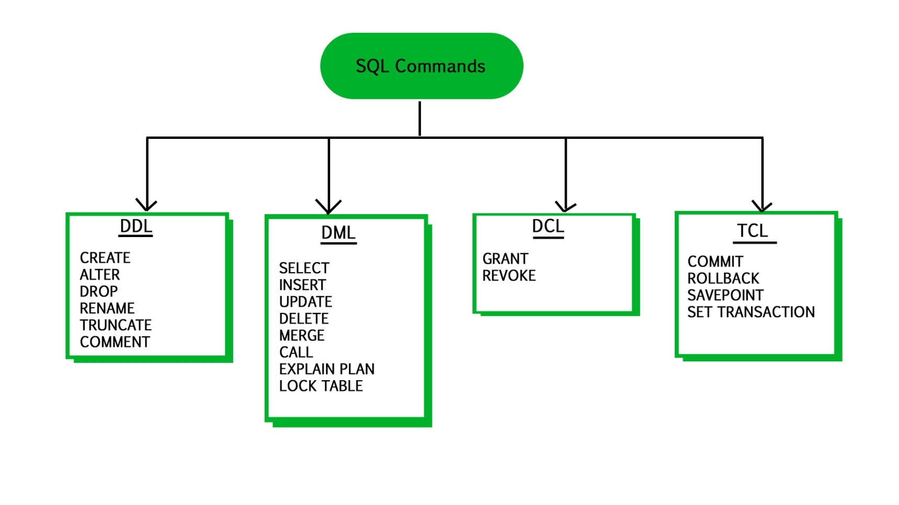
what is sql?
Remember:
An EXPLICIT commit happens when we execute an SQL "COMMIT" command.
An IMPLICIT commits occur without running a "COMMIT" command.
Remember:
A NULL value is not treated as a blank or 0. Null or NULL is a special marker used in Structured Query Language to indicate that a data value does not exist or missing or unknown in the database.
Degree d(R): Total no. of attributes/columns present in a relation/table is called degree of the relation and is denoted by d(R).
Cardinality |R|: Total no. of tuples present in a relation or Rows present in a table, is called cardinality of a relation and is denoted by |R|.

Slide 81
comments in mysql
From a # character to the end of the line.
From a -- sequence to the end of the line.
From a /* sequence to the following */ sequence.
Reconnect to the server | \r
Execute a system shell command | \!
Exit mysql | \q
Change your mysql prompt. | prompt str or \R str

Slide 82
Login to MySQL

Slide 83
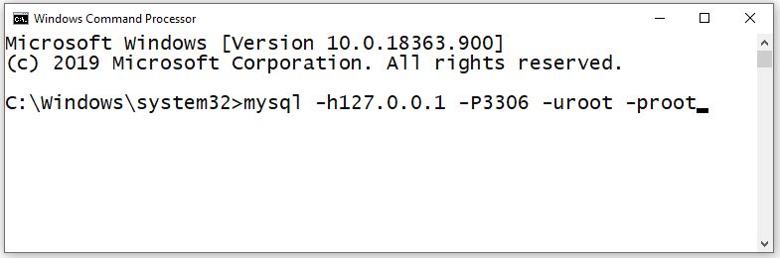
login
Default port for MySQL Server: 3306
C:\> mysql -hlocalhost -P3307 -uroot -p
C:\> mysql -h127.0.0.1 -P3307 -uroot -p [database_name]
C:\> mysql -h192.168.100.14 -P3307 -uroot -psaleel [database_name]
C:\> mysql --host localhost --port 3306 --user root --password=ROOT [database_name]
C:\> mysql --host=localhost --port=3306 --user=root --password=ROOT [database_name]

Slide 84
SHOW DATABASES

Slide 85
SHOW DATABASES Syntax
SHOW {DATABASES | SCHEMAS} [LIKE 'pattern' | WHERE expr]
SHOW SCHEMAS is a synonym for SHOW DATABASES.
SHOW DATABASES;
SHOW SCHEMAS;
SHOW DATABASES LIKE 'U%';
SHOW SCHEMAS LIKE 'U%';
NULL means “no database is selected”. Issue the USE dbName command to select the database.

Slide 86
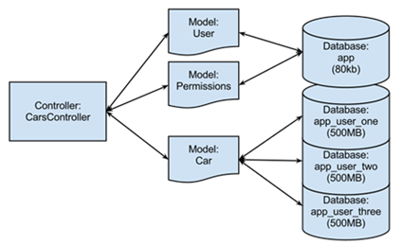
USE DATABASES
The USE db_name statement tells MySQL to use the db_name database as the default (current) database for subsequent statements. The database remains the default until the end of the session or another USE statement is issued.

Slide 87
USE DATABASES Syntax
USE db_name
\U db_name
Note:
USE, does not require a semicolon.
USE must be followed by a database name.
USE db1
\U db1

Slide 88
CREATE DATABASE
ALTER DATABASE

Slide 89
create / alter database
CREATE DATABASE creates a database with the given name. To use this statement, you need the CREATE privilege for the database.
CREATE {DATABASE | SCHEMA} [IF NOT EXISTS] db_name
ALTER {DATABASE | SCHEMA} [db_name] READ ONLY [=] { 0 | 1}
CREATE SCHEMA is a synonym for CREATE DATABASE.
CREATE DATABASE db1;
CREATE DATABASE IF NOT EXISTS db1;
ALTER DATABASE db1 READ ONLY = 0; // is in read write mode.
ALTER DATABASE db1 READ ONLY = 1; // is in read only mode.
Note:
It is not possible to Create, Alter, Drop any object, and Write (Insert, Update, and Delete rows) in a read-only database.
TEMPORARY tables; it is possible to create, alter, drop, and write (Insert, Update, and Delete rows) to TEMPORARY tables in a read-only database.

Slide 90
DROP DATABASE
If the default database is dropped, the default database is unset (the DATABASE() function returns NULL).

Slide 91
drop database
DROP DATABASE drops all tables in the database and deletes the database. Be very careful with this statement! To use DROP DATABASE, you need the DROP privilege on the database.
DROP {DATABASE | SCHEMA} [IF EXISTS] db_name
DROP SCHEMA is a synonym for DROP DATABASE.
DROP DATABASE db1;
DROP DATABASE IF EXISTS db1;

Slide 92
Source Command

Slide 93
source command
You can execute an SQL script file using the source command or \. command
\. file_name
source file_name
\. 'D:\mysqldemobld7.sql'
SOURCE 'D:\mysqldemobld7.sql'
SOURCE //infoserver1/infodomain1/Everyone/DBT/mysqldemobld7.sql

Slide 94
SHOW TABLES

Slide 95
SHOW TABLES Syntax
SHOW [FULL] TABLES [{FROM | IN} db_name] [LIKE 'pattern' | WHERE expr]
SHOW TABLES;
SHOW FULL TABLES; // WITH TABLE TYPE
SHOW TABLES FROM USER01;
SHOW TABLES WHERE TABLES_IN_USER01 LIKE 'E%' OR TABLES_IN_USER01 LIKE 'B%';
SHOW TABLES WHERE TABLES_IN_USER01 IN ('EMP');

Slide 96
The char is a fixed-length character data type,
The varchar is a variable-length character data type.
CREATE TABLE temp (c1 CHAR(10), c2 VARCHAR(10));
INSERT INTO temp VALUES('SALEEL', 'SALEEL');
SELECT * FROM temp WHERE c1 LIKE 'SALEEL';
datatypes
ENAME CHAR (10) | S | A | L | E | E | L |  |  |  |  | LENGTH -> 10
ENAME VARCHAR2(10) | S | A | L | E | E | L |  |  |  |  | LENGTH -> 6
When CHAR values are retrieved, the trailing spaces are removed (unless the PAD_CHAR_TO_FULL_LENGTH SQL mode is enabled)
In MySQL
ENAME CHAR (10) | S | A | L | E | E | L |  |  |  |  | LENGTH -> 6
ENAME VARCHAR(10) | S | A | L | E | E | L |  |  |  |  | LENGTH -> 6
Note:
The BINARY and VARBINARY types are similar to CHAR and VARCHAR, except that they store binary strings rather than nonbinary strings. That is, they store byte strings rather than character strings.

Slide 97
datatype - string
Datatypes | Size | Description
CHAR [(length)] | 0-255
VARCHAR (length) | 0 to 65,535 | The maximum row size (65,535 bytes, which is shared among all columns.
TINYTEXT [(length)] | (2⁸ − 1) bytes
TEXT [(length)] | (2¹⁶ -1) bytes | 65,535 bytes ~ 64kb
MEDIUMTEXT [(length)] | (2²⁴ -1) bytes | 16,777,215 bytes ~16MB
LONGTEXT [(length)] | (2³² -1) bytes | 4,294,967,295 bytes ~4GB
ENUM('value1', 'value2',...) | 65,535 members
SET('value1', 'value2',...) | 64 members
BINARY[(length)] | 255
VARBINARY(length)
By default, trailing spaces are trimmed from CHAR column values on retrieval. If PAD_CHAR_TO_FULL_LENGTH is enabled, trimming does not occur and retrieved CHAR values are padded to their full length.
SET sql_mode = '';
SET sql_mode = 'PAD_CHAR_TO_FULL_LENGTH';

Slide 98
example of char and varchar
Datatypes | Size | Description
CHAR [(length)] | 0-255
VARCHAR (length) | 0 to 65,535 | The maximum row size (65,535 bytes, which is shared among all columns.
In CHAR, if a table contains value 'a', an attempt to store 'a ' causes a duplicate-key error.
Try Out
CREATE TABLE x (x1 CHAR(4), x2 VARCHAR(4));
INSERT INTO x VALUE('', '');
INSERT INTO x VALUE('ab', 'ab');
INSERT INTO x VALUE('abcd', 'abcd');
SELECT x1, LENGTH(x1), x2, LENGTH(x2) FROM x;
SET sql_mode = 'PAD_CHAR_TO_FULL_LENGTH';
SELECT x1, LENGTH(x1), x2, LENGTH(x2) FROM x;
SET sql_mode = '';
SELECT x1, LENGTH(x1), x2, LENGTH(x2) FROM x;
CREATE TABLE x (x1 CHAR(4) PRIMARY KEY, x2 VARCHAR(4));
INSERT INTO x VALUE('a', 'a');
INSERT INTO x VALUE('a ', 'a ');
CREATE TABLE x (x1 CHAR(4), x2 VARCHAR(4) PRIMARY KEY);
INSERT INTO x VALUE('a', 'a');
INSERT INTO x VALUE('a ', 'a ');

Slide 99
datatype - numeric
Datatypes | Size | Description
TINYINT | 1 byte | -128 to +127 (The unsigned range is 0 to 255).
SMALLINT [(length)] | 2 bytes | -32768 to 32767. (The unsigned range is 0 to 65535).
MEDIUMINT [(length)] | 3 bytes | -8388608 to 8388607. (The unsigned range is 0 to 16777215).
INT, INTEGER [(length)] | 4 bytes | -2147483648 to 2147483647. (The unsigned range is 0 to 4294967295).
BIGINT [(length)] | 8 bytes | -9,223,372,036,854,775,808 to 9,223,372,036,854,775,807
FLOAT [(length[,decimals])] | 4 bytes | FLOAT(255,30)
DOUBLE [PRECISION] [(length[,decimals])], REAL [(length[,decimals])] | 8 bytes | REAL(255,30) / DOUBLE(255,30) REAL will get converted to DOUBLE
DECIMAL [(length[,decimals])], NUMERIC [(length[,decimals])] |  | DECIMAL(65,30) / NUMERIC(65,30) NUMERIC will get converted in DECIMAL
For: float(M,D), double(M,D) or decimal(M,D), M must be >= D
Here, (M,D) means than values can be stored with up to M digits in total, of which D digits may be after the decimal point.
UNSIGNED prohibits negative values.

Slide 100
datatype – date and time
Datatypes | Size | Description
YEAR | 1 byte | YYYY
DATE | 3 bytes | YYYY-MM-DD
TIME | 3 bytes | HH:MM:SS
DATETIME | 8 bytes | YYYY-MM-DD hh:mm:ss

Slide 101
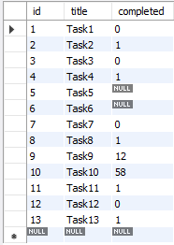
datatype – boolean
CREATE TABLE temp (col1 INT ,col2 BOOL, col3 BOOLEAN);
CREATE TABLE tasks ( id INT AUTO_INCREMENT PRIMARY KEY, title VARCHAR(255) NOT NULL, completed BOOLEAN);
INSERT INTO tasks VALUE(default, 'Task1', 0);
INSERT INTO tasks VALUE(default, 'Task2', 1);
INSERT INTO tasks VALUE(default, 'Task3', False);
INSERT INTO tasks VALUE(default, 'Task4', True);
INSERT INTO tasks VALUE(default, 'Task5', null);
INSERT INTO tasks VALUE(default, 'Task6', default);
INSERT INTO tasks VALUE(default, 'Task7’, 1 > 2);
INSERT INTO tasks VALUE(default, 'Task8’, 1 < 2);
INSERT INTO tasks VALUE(default, 'Task9', 12);
INSERT INTO tasks VALUE(default, 'Task10', 58);
INSERT INTO tasks VALUE(default, 'Task11', .75);
INSERT INTO tasks VALUE(default, 'Task12', .15);
INSERT INTO tasks VALUE(default, 'Task13', 'a' = 'a');
Note:
BOOL and BOOLEAN are synonym of TINYINT(1)

Slide 102
datatype – enum
An ENUM column can have a maximum of 65,535 distinct elements.
ENUM values are sorted based on their index numbers, which depend on the order in which the enumeration members were listed in the column specification.
Default value, NULL if the column can be NULL, first enumeration value if NOT NULL
CREATE TABLE temp (col1 INT, COL2 ENUM('A','B','C'));
INSERT INTO temp (col1, col2) VALUES(1, 1);
INSERT INTO temp(col1) VALUES (1); // NULL
CREATE TABLE temp (col1 INT, col2 ENUM('A','B','C') NOT NULL);
INSERT INTO temp(col1) VALUES (1); // First element from the ENUM datatype
CREATE TABLE temp (col1 INT, col2 ENUM('') NOT NULL);
INSERT INTO temp (col1, col2) VALUES (1,'This is the test'); // NULL
CREATE TABLE temp (col1 INT, COL2 ENUM('A','B','C') default 'D' ); // Invalid default value for 'COL2'
IMP:
MySQL maps [ membership ENUM('Silver', 'Gold', 'Diamond', 'Platinum') ] these enumeration member to a numeric index where Silver=1, Gold=2, Diamond=3, Platinum=4 respectively.

Slide 103
datatype – enum
An ENUM column can have a maximum of 65,535 distinct elements.
size ENUM('small', 'medium', 'large', 'x-large')
membership ENUM('Silver', 'Gold', 'Diamond', 'Platinum')
interest ENUM('Movie', 'Music', 'Concert')
zone ENUM('North', 'South', 'East', 'West')
season ENUM('Winter', 'Summer', 'Monsoon', 'Autumn')
sortby ENUM('Popularity', 'Price -- Low to High', 'Price -- High to Low', 'Newest First')
status ENUM('active', 'inactive', 'pending', 'expired', 'shipped', 'in-process', 'resolved', 'on-hold', 'cancelled', 'disputed')
Note:
You cannot use user variable as an enumeration value. This pair of statements do not work:
SET @mysize = 'medium';
CREATE TABLE sizes ( size ENUM('small', @mysize, 'large')); // error

Slide 104
datatype – set
A SET column can have a maximum of 64 distinct members.
A SET is a string object that can have zero or more values, each of which must be chosen from a list of permitted values specified when the table is created.
SET column values that consist of multiple set members are specified with members separated by commas (,) without leaving a spaces.
CREATE TABLE clients(
id INT AUTO_INCREMENT PRIMARY KEY,
name VARCHAR(10),
membership ENUM('Silver', 'Gold', 'Diamond'),
interest SET('Movie', 'Music', 'Concert'));
INSERT INTO clients (name, membership, interest) VALUES('Saleel', 'Gold', 'Music');
INSERT INTO clients (name, membership, interest) VALUES('Saleel', 'Premium', 'Movie, Concert');
IMP:
The SET data type allows you to specify a list of values to be inserted in the column, like ENUM. But, unlike the ENUM data type, which lets you choose only one value, the SET data type allows you to choose multiple values from the list of specified values.

Slide 105
Use a CREATE TABLE statement to specify the layout of your table.
CREATE TABLE `123` (c1 INT, c2 VARCHAR(10));
Remember:
Max 4096 columns per table provided the row size <= 65,535 Bytes
create table
Use a CREATE TABLE statement to specify the layout of your table.
Note:
USER TABLES: This is a collection of tables created and maintained by the user. Contain USER information.
DATA DICTIONARY: This is a collection of tables created and maintained by the MySQL Server. It contains database information. All data dictionary tables are owned by the SYS user.

Slide 106
create table
Use a CREATE TABLE statement to specify the layout of your table.
Remember:
by default, tables are created in the default database, using the InnoDB storage engine.
table name should not begin with a number or special symbols.
table name can start with _table_name (underscore) or $table_name (dollar sign)
table name and column name can have max 64 char.
multiple words as table_name is invalid, if you want to give multiple words as table_name then give it in `table_name` (backtick)
error occurs if the table exists.
error occurs if there is no default database.
error occurs if the database does not exist.
Note:
Table names are stored in lowercase on disk. MySQL converts all table names to lowercase on storage. This behavior also applies to database names and table aliases.
e.g. show variables like 'lower_case_table_names';

Slide 107
create table
syntax
e.g.
CREATE TABLE student (
ID INT,
firstName VARCHAR(45),
lastName VARCHAR(45),
DoB DATE,
emailID VARCHAR(128)
);
CREATE [TEMPORARY] TABLE [IF NOT EXISTS] tbl_name
(create_defineation, . . .)
[table_options]
[partition_options]
create_definition:
col_name column_definition
column_definition:
data_type [NOT NULL | NULL] [DEFAULT default_value]
[AUTO_INCREMENT] [UNIQUE [KEY] | [PRIMARY] KEY]
[reference_definition]
| data_type [GENERATED ALWAYS] AS (expression) [VIRTUAL]
[VISIBLE | INVISIBLE]
table_options:
ENGINE [=] engine_name
show engines;
set default_storage_engine = memory;

Slide 108
default value
The DEFAULT specifies a default value for the column.

Slide 109

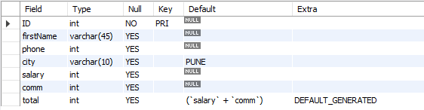
default value
col_name data_type DEFAULT value
The DEFAULT specifies a default value for the column.
CREATE TABLE posts (
postID INT,
postTitle VARCHAR(255),
postDate DATETIME DEFAULT NOW(),
deleted INT
);
# version 8.0 and above.
CREATE TABLE empl (
ID INT PRIMARY KEY,
firstName VARCHAR(45),
phone INT,
city VARCHAR(10) DEFAULT 'PUNE',
salary INT,
comm INT,
total INT DEFAULT(salary + comm)
);

Slide 110

default value - insert
The DEFAULT example.
CREATE TABLE t (
c1 INT,
c2 INT DEFAULT 1,
c3 INT DEFAULT 3,
);
INSERT INTO t VALUES();
INSERT INTO t VALUES(-1, DEFAULT, DEFAULT);
INSERT INTO t VALUES(-2, DEFAULT(c2), DEFAULT(c3));
INSERT INTO t VALUES(-3, DEFAULT(c3), DEFAULT(c2));

Slide 111
default value - update
The DEFAULT example.
CREATE TABLE temp (
c1 INT,
c2 INT,
c3 INT DEFAULT(c1 + c2),
c4 INT DEFAULT(c1 * c2 )
);
INSERT INTO temp(c1, c2, c3, c4) VALUES(1, 1, 1, 1);
INSERT INTO temp(c1, c2, c3, c4) VALUES(2, 2, 2, 2);
UPDATE temp SET c3 = DEFAULT;
UPDATE temp SET c4 = DEFAULT;

Slide 112
insert rows
INSERT is used to add a single or multiple tuple to a relation. We must specify the relation name and a list of values for the tuple. The values should be listed in the same order in which the corresponding attributes were specified in the CREATE TABLE command.
You can insert data using following methods:
INSERT ... VALUES
INSERT ... SET
INSERT ... SELECT

Slide 113
INSERT is used to add a single or multiple tuple to a relation. We must specify the relation name and a list of values for the tuple. The values should be listed in the same order in which the corresponding attributes were specified in the CREATE TABLE command.
A second form of the INSERT statement allows the user to specify explicit attribute names that correspond to the values provided in the INSERT command. This is useful if a relation has many attributes but only a few of those attributes are assigned values in the new tuple. However, the values must include all attributes with NOT NULL specification and no default value. Attributes with NULL allowed or DEFAULT values are the ones that can be left out.
insert rows using values

Slide 114
dml- insert … values
INSERT inserts new row(s) into an existing table. The INSERT ... VALUES
INSERT [IGNORE] [INTO] tbl_name [PARTITION (partition_name [, partition_name] ...)] [ (col_name, . . .) ] { VALUES | VALU E } ( { expr | DEFAULT }, . . .), (. . .), . . . [ ON DUPLICATE KEY UPDATE assignment_list ]
The affected-rows value for an INSERT can be obtained using the ROW_COUNT() function.
Column Values
Column List
Inserting multiple rows

Slide 115
dml- insert … values
INSERT inserts new rows into an existing table. The INSERT ... VALUES
INSERT [IGNORE] [INTO] tbl_name [PARTITION (partition_name [, partition_name] ...)] [ (col_name, . . .) ] { VALUES | VALUE } [ROW] ( { expr | DEFAULT }, . . .), [ROW] (. . .), [ROW] . . . [ ON DUPLICATE KEY UPDATE assignment_list ]
CREATE TABLE student (
ID INT PRIMARY KEY,
nameFirst VARCHAR(45),
nameLast VARCHAR(45),
DoB DATE ,
emailID VARCHAR(128)
);
e.g.
INSERT INTO student VALUES (29, 'sharmin', 'patil', '1999-11-10', 'sharmin.patil@gmail.com’);
INSERT INTO student (ID, nameFirst, nameLast, DOB, emailID) VALUES (30, 'john', 'thomas', '1983-11-10', 'john.thomas@gmail.com’);
INSERT INTO student (ID, nameFirst, emailID) VALUES (31, 'jack', 'jack.thorn@gmail.com’);
INSERT INTO student (ID, nameFirst) VALUES (32, 'james'), (33, 'jr. james'), (34, 'sr. james');

Slide 116
insert rows using select

Slide 117
insert ... select
With INSERT ... SELECT, you can quickly insert many rows into a table from one or many tables.
INSERT [INTO] tbl_name [(col_name, . . .)] SELECT . . .
INSERT INTO dept(deptno) SELECT 1 + 1;
INSERT INTO dept(deptno) SELECT deptno FROM dept;
INSERT INTO dept SELECT * FROM dept;
INSERT INTO dept(SELECT MAX(deptno) + 1, 'HRD', 'BARODA', 'r57px33px' FROM dept);
set @x := 40;
INSERT INTO dept VALUES (@x := @x + 1 , 'HRD', 'BARODA', 'r57px33px');
set @x := (SELECT MAX(deptno) FROM dept);
INSERT INTO dept VALUES (@x := @x + 1 , 'HRD', 'BARODA', 'r57px33px');

Slide 118
Do not use the * operator in your SELECT statements. Instead, use column names. Reason is that in MySQL Server scans for all column names and replaces the * with all the column names of the table(s) in the SELECT statement. Providing column names avoids this search-and-replace, and enhances performance.
SELECT statement…
SELECT what_to_select
FROM which_table
WHERE conditions_to_satisfy;

Slide 119
SELECT CLAUSE
The SELECT statement retrieves or extracts data from tables in the database.
You can use one or more tables separated by comma to extract data.
You can fetch one or more fields/columns in a single SELECT command.
You can specify star (*) in place of fields. In this case, SELECT will return all the fields.
SELECT can also be used to retrieve rows computed without reference to any table e.g. SELECT 1 + 2;

Slide 120
Capabilities of SELECT Statement
SELECTION
PROJECTION
JOINING

Slide 121
Capabilities of SELECT Statement
SELECTION
Selection capability in SQL is to choose the record’s/row’s/tuple’s in a table that you want to return by a query.
R
EMPNO | ENAME | JOB | HIREDATE | DEPTNO
1 | Saleel | Manager | 1995-01-01 | 10
2 | Janhavi | Sales | 1994-12-20 | 20
3 | Snehal | Manager | 1997-05-21 | 10
4 | Rahul | Account | 1997-07-30 | 10
5 | Ketan | Sales | 1994-01-01 | 30

Slide 122
Capabilities of SELECT Statement
PROJECTION
Projection capability in SQL to choose the column’s/attribute’s/field’s in a table that you want to return by your query.
R
EMPNO | ENAME | JOB | HIREDATE | DEPTNO
1 | Saleel | Manager | 1995-01-01 | 10
2 | Janhavi | Sales | 1994-12-20 | 20
3 | Snehal | Manager | 1997-05-21 | 10
4 | Rahul | Account | 1997-07-30 | 10
5 | Ketan | Sales | 1994-01-01 | 30

Slide 123
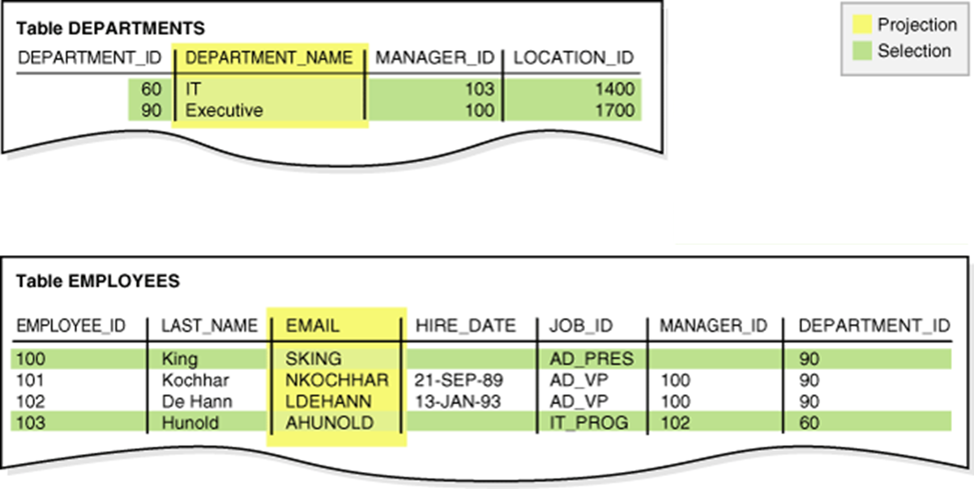

Slide 124

Capabilities of SELECT Statement
JOINING
Join capability in SQL to bring together data that is stored in different tables by creating a link between them.
R
S
EMPNO | ENAME | JOB | HIREDATE | DEPTNO
1 | Saleel | Manager | 1995-01-01 | 20
2 | Janhavi | Sales | 1994-12-20 | 10
3 | Snehal | Manager | 1997-05-21 | 10
4 | Rahul | Account | 1997-07-30 | 20
5 | Ketan | Sales | 1994-01-01 | 30
DEPTNO | DNAME | LOC
10 | HRD | PUNE
20 | SALES | BARODA
40 | PURCHASE | SURAT

Slide 125
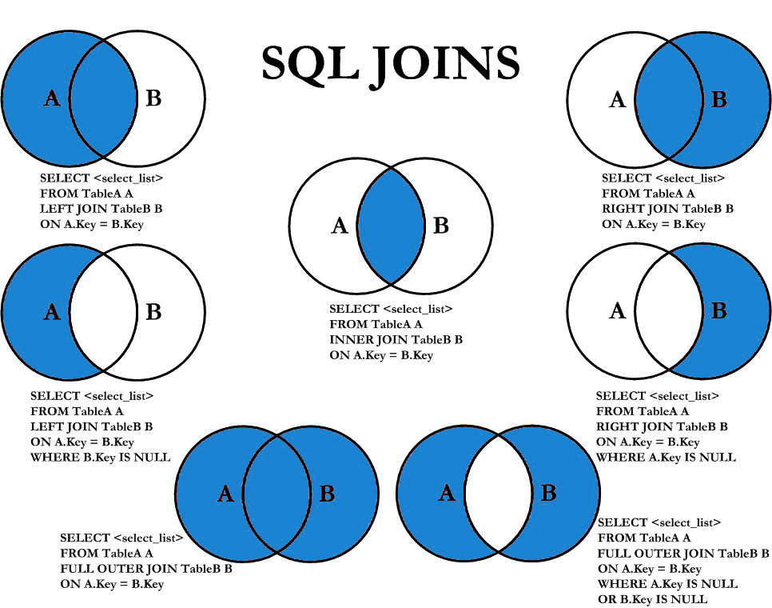

Slide 126
select statement
SELECTION Process
SELECT * FROM <table_references>
selection-list | field-list | column-list
Remember:
Here, " * " is known as metacharacter (all columns)
PROJECTION Process
SELECT column-list FROM <table_references>
selection-list | field-list | column-list
Remember:
Position of columns in SELECT statement will determine the position of columns in the output (as per user requirements)

Slide 127
In a SET statement, = is treated identically to :=
single-table update
UPDATE is used to change/modify the values of some attributes of one or more selected tuples.

Slide 128
single-table update
UPDATE tbl_name SET col_name1 = { expr1 | DEFAULT } [, col_name2 = { expr2 | DEFAULT } ] . . .
[WHERE where_condition]
[ORDER BY . . .]
[LIMIT row_count]

Slide 129
single-table delete
DELETE is used to delete tuples from a relation.

Slide 130
single-table delete
DELETE FROM tbl_name
[WHERE where_condition]
[ORDER BY . . .]
[LIMIT row_count]

Slide 131
auto_increment column
The AUTO_INCREMENT attribute can be used to generate a unique number/identity for new rows.

Slide 132
auto_increment
IDENTITY is a synonym to the LAST_INSERT_ID variable.
col_name data_type AUTO_INCREMENT [UNIQUE [KEY] | [PRIMARY] KEY]
Remember:
There can be only one AUTO_INCREMENT column per table.
it must be indexed.
it cannot have a DEFAULT value.
it works properly only if it contains only positive values.
It applies only to integer and floating-point types.
when you insert a value of NULL or 0 into AUTO_INCREMENT column, it generates next value.
use LAST_INSERT_ID() function to find the row that contains the most recent AUTO_INCREMENT value.
SELECT @@IDENTITY
SELECT LAST_INSERT_ID()
SET INSERT_ID = 7
CREATE TABLE posts (
c1 INT UNIQUE KEY AUTO_INCREMENT,
c2 VARCHAR(20)
) AUTO_INCREMENT = 2; // auto_number will start with value 2.

Slide 133
CREATE TABLE . . . LIKE . . ., the destination table preserves generated column information from the original table.
CREATE TABLE . . . SELECT . . ., the destination table does not preserves generated column information from the original table.
generated column
Remember:
Stored functions and user-defined functions are not permitted.
Stored procedure and function parameters are not permitted.
Variables (system variables, user-defined variables, and stored program local variables) are not permitted.
Subqueries are not permitted.
The AUTO_INCREMENT attribute cannot be used in a generated column definition.
Triggers cannot use NEW.COL_NAME or use OLD.COL_NAME to refer to generated columns.
Stored column cannot be converted to virtual column and virtual column cannot be converted to stored column.
Generated column can be made as invisible column.
Note:
The expression can contain literals, built-in functions with no parameters, operators, or references to any column within the same table. If you use a function, it must be scalar and deterministic.

Slide 134
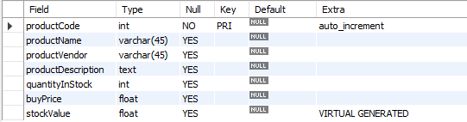
virtual column - generated always
col_name data_type [GENERATED ALWAYS] AS (expression) [VIRTUAL | STORED]
VIRTUAL: Column values are not stored, but are evaluated when rows are read, immediately after any BEFORE triggers. A virtual column takes no storage.
STORED: Column values are evaluated and stored when rows are inserted or updated. A stored column does require storage space and can be indexed.
Note:
The default is VIRTUAL if neither keyword is specified.
CREATE TABLE product(
productCode INT AUTO_INCREMENT PRIMARY KEY,
productName VARCHAR(45),
productVendor VARCHAR(45),
productDescription TEXT,
quantityInStock INT,
buyPrice FLOAT,
stockValue FLOAT GENERATED ALWAYS AS(quantityInStock * buyPrice) VIRTUAL
);

Slide 135
visible / invisible columns
Columns are visible by default. To explicitly specify visibility for a new column, use a VISIBLE or INVISIBLE keyword as part of the column definition for CREATE TABLE or ALTER TABLE.
Note:
An invisible column is normally hidden to queries, but can be accessed if explicitly referenced. Prior to MySQL 8.0.23, all columns are visible.
A table must have at least one visible column. Attempting to make all columns invisible produces an error.
SELECT * does not include invisible columns.

Slide 136
invisible column
col_name data_type INVISIBLE
CREATE TABLE employee (
ID INT AUTO_INCREMENT PRIMARY KEY,
firstName VARCHAR(40),
salary INT,
commission INT,
total INT DEFAULT(salary + commission) INVISIBLE
tax INT GENERATED ALWAYS AS (total * .25) VIRTUAL INVISIBLE
) ;
CREATE TABLE employee (
ID INT PRIMARY KEY AUTO_INCREMENT INVISIBLE ,
firstName VARCHAR(40)
) ;
INSERT INTO employee(firstName, salary, commission) VALUES('ram', 4700, -700);
INSERT INTO employee(firstName, salary, commission) VALUES('pankaj', 3400, NULL);
INSERT INTO employee(firstName, salary, commission) VALUES('rajan', 3200, 250);
INSERT INTO employee(firstName, salary, commission) VALUES('ninad', 2600, 0);
INSERT INTO employee(firstName, salary, commission) VALUES('omkar', 4500, 300);
SELECT * FROM employee;
ALTER TABLE employee MODIFY total INT VISIBLE;
ALTER TABLE employee MODIFY total INT INVISIBLE;

Slide 137
varbinary column
TODO
Note:
TODO
TODO
TODO

Slide 138
varbinary column
col_name VARBINARY
CREATE TABLE login (
ID INT AUTO_INCREMENT PRIMARY KEY,
userName VARCHAR(40),
password VARBINARY(40) INVISIBLE
) ;
INSERT INTO login(userName, password) VALUES('ram', 'ram@123');
INSERT INTO login(userName, password) VALUES('pankaj', 'pankaj');
INSERT INTO login(userName, password) VALUES('rajan', 'rajan');
INSERT INTO login(userName, password) VALUES('ninad', 'ninad');
INSERT INTO login(userName, password) VALUES('omkar', 'omkar');
SELECT * FROM login;
SELECT username, CAST(password as CHAR) FROM login;

Slide 139
constraints
CONSTRAINT is used to define rules to allow or restrict what values can be stored in columns. The purpose of inducing constraints is to enforce the integrity of a database.
CONSTRAINTS can be classified into two types –
Column Level
Table Level
The column level constraints can apply only to one column where as table level constraints are applied to the entire table.

Slide 140
Remember:
PRI => primary key
UNI => unique key
MUL=> is basically an index that is neither a primary key nor a unique key. The name comes from
"multiple" because multiple occurrences of the same value are allowed.
constraints
To limit or to restrict or to check or to control.
Note:
a table with a foreign key that references another table's primary key is MUL.
If more than one of the Key values applies to a given column of a table, Key displays the one with the highest priority, in the order PRI, UNI, and MUL.

Slide 141
Remember:
A primary key cannot be NULL.
A primary key value must be unique.
A table has only one primary key.
The primary key values cannot be changed, if it is referred by some other column.
The primary key must be given a value when a new record is inserted.
An index can consist of 16 columns, at maximum. Since a PRIMARY KEY constraint automatically adds an index, it can't have more than 16 columns.
PRIMARY KEY constraint
Choosing a primary key is one of the most important steps in good database design. A primary key is a column that serves a special purpose. A primary key is a special column (or set of combined columns) in a relational database table, that is used to uniquely identify each record. Each database table needs a primary key.
Note:
Primary key in a relation is always associated with an INDEX object.
If, we give on a column a combination of NOT NULL & UNIQUE key then it behaves like a PRIMARY key.
If, we give on a column a combination of UNIQUE key & AUTO_INCREMENT then also it behaves like a PRIMARY key.
Stability: The value of the primary key should be stable over time and not change frequently.

Slide 142
clustered and non-clustered index
Indexing in MySQL is a process that helps us to return the requested data from the table very fast. If the table does not have an index, it scans the whole table for the requested data.
MySQL allows two different types of Indexing:
Clustered Index
Non-Clustered Index
Clustered Index:- The InnoDB table uses a clustered index for optimizing the speed of most common lookups ( SELECT statement) and DML operations like INSERT, UPDATE, and DELETE command. Clustered indexes sort and store the data rows in the table based on their key values that can be sorted in only one way. If the table column contains a primary key or unique key, MySQL creates a clustered index named PRIMARY based on that specific column.
Non-Clustered Index:- The indexes other than PRIMARY indexes (i.e. clustered indexes) called a non-clustered index. The non-clustered indexes are also known as secondary indexes. The non-clustered index and table data are both stored in different places. It is not sorted (ordering) the table data.
CREATE TABLE test(c1 INT, c2 INT, c3 INT, c4 INT,c5 INT, c6 INT, c7 INT, c8 INT, c9 INT, c10 INT, c11 INT, c12 INT, c13 INT, c14 INT, c15 INT, c16 INT, c17 INT, c18 INT, c19 INT, c20 INT, PRIMARY KEY (c1, c2, c3, c4, c5, c6, c7, c8, c9, c10, c11, c12, c13, c14, c15, c16, c17, c18 )); // error

Slide 143
constraints – add primary key
col_name data_type PRIMARY KEY
The following example creates tables with PRIMARY KEY column.
CREATE TABLE users (
ID INT PRIMARY KEY,
userName VARCHAR(25),
password VARCHAR(25),
email VARCHAR(255)
) ;
CREATE TABLE purchase_orders (
po_number INT,
vendor_id INT NOT NULL,
po_status INT NOT NULL,
PRIMARY KEY(po_number)
);
CREATE TABLE supplier (
supplier_id INT,
supplier_name VARCHAR(50),
contact_name VARCHAR(50),
constraint pk_supplier_id PRIMARY KEY(supplier_id)
);
CREATE TABLE person (
ID INT NOT NULL UNIQUE,
lastName VARCHAR(45),
firstName VARCHAR(45),
age INT,
email VARCHAR(255)
);

Slide 144
ALTER TABLE table_name
ADD [ CONSTRAINT constraint_name ]
PRIMARY KEY (column1, column2, . . . column_n)
Add Primary Key using Alter

Slide 145
constraints – add primary key using alter
You can use the ALTER TABLE statement to ADD PRIMARY KEY on existing column.
ALTER TABLE table_name
ADD [ CONSTRAINT constraint_name ]
PRIMARY KEY (column1, column2, . . . column_n)
CREATE TABLE vendors (
vendor_id INT,
vendor_name VARCHAR(25),
address VARCHAR(255)
);
ALTER TABLE vendors ADD PRIMARY KEY(vendor_id);
ALTER TABLE vendors ADD constraint pk_vendor_id PRIMARY KEY(vendor_id);

Slide 146
ALTER TABLE table_name
DROP PRIMARY KEY
Drop Primary Key

Slide 147
constraints – drop primary key
You can use the ALTER TABLE statement to DROP PRIMARY KEY.
ALTER TABLE table_name
DROP PRIMARY KEY
CREATE TABLE vendors (
vendor_id INT,
vendor_name VARCHAR(25),
address VARCHAR(255)
);
ALTER TABLE vendors DROP PRIMARY KEY;

Slide 148
Remember:
A unique key can be NULL.
A unique key value must be unique.
A table can have multiple unique key.
A column can have unique key as well as a primary key.
UNIQUE KEY constraint
A UNIQUE key constraint is a set of one or more than one fields/columns of a table that uniquely identify a record in a database table.
Note:
Unique key in a relation is always associated with an INDEX object.

Slide 149
constraints – add unique key
col_name data_type UNIQUE KEY
The following example creates table with UNIQUE KEY column.
CREATE TABLE clients (
client_id INT,
first_name VARCHAR(50),
last_name VARCHAR(50),
company_name VARCHAR(255),
email VARCHAR(255) UNIQUE
);
CREATE TABLE contacts (
ID INT,
first_name VARCHAR(50),
last_name VARCHAR(50),
phone VARCHAR(15),
UNIQUE(phone)
);
CREATE TABLE brands (
ID INT,
brandName VARCHAR(30),
constraint uni_brandName UNIQUE(brandName)
);
SHOW INDEX FROM clients;

Slide 150
ALTER TABLE table_name
ADD [ CONSTRAINT constraint_name ]
UNIQUE (column1, column2, . . . column_n)
Add Unique Key using Alter

Slide 151
constraints – add unique key using alter
You can use the ALTER TABLE statement to ADD UNIQUE KEY on existing column.
ALTER TABLE table_name
ADD [ CONSTRAINT constraint_name ]
UNIQUE (column1, column2, . . . column_n)
CREATE TABLE shop (
ID INT,
shop_name VARCHAR(30)
);
ALTER TABLE shop ADD UNIQUE(shop_name);
ALTER TABLE shop ADD constraint uni_shop_name UNIQUE(shop_name);

Slide 152
ALTER TABLE table_name
DROP INDEX constraint_name;
Drop Unique Key

Slide 153
constraints – drop unique key
You can use the ALTER TABLE statement to DROP UNIQUE KEY.
ALTER TABLE table_name
DROP INDEX constraint_name;
SELECT table_name, constraint_name, constraint_type FROM information_schema.table_constraints WHERE constraint_schema = 'z' AND table_name IN ('A', 'B');
ALTER TABLE users DROP INDEX <COLUMN_NAME>;
ALTER TABLE users DROP INDEX U_USER_ID; #CONSTRAINT NAME
CREATE TABLE users (
ID INT PRIMARY KEY,
userName VARCHAR(40),
password VARCHAR(255),
email VARCHAR(255) UNIQUE KEY
) ;
CREATE TABLE users (
ID INT PRIMARY KEY,
userName VARCHAR(40),
password VARCHAR(255),
email VARCHAR(255),
constraint uni_email UNIQUE KEY(email)
) ;
ALTER TABLE users DROP INDEX email;
ALTER TABLE users DROP INDEX uni_email;

Slide 154
FOREIGN KEY constraint
A FOREIGN KEY is a key used to link two tables together. A FOREIGN KEY is a field (or collection of fields) in one table that refers to the PRIMARY KEY in another table. The table containing the foreign key is called the child table, and the table containing the candidate key is called the referenced or parent table.

Slide 155
constraints – foreign key
Remember:
A foreign key can have a different column name from its primary key.
DataType of primary key and foreign key column must be same.
It ensures rows in one table have corresponding rows in another.
Unlike the Primary key, they do not have to be unique.
Foreign keys can be null even though primary keys can not.
Note:
The table containing the FOREIGN KEY is referred to as the child table, and the table containing the PRIMARY KEY (referenced key) is the parent table.
PARENT and CHILD tables must use the same storage engine,
and they cannot be defined as temporary tables.

Slide 156
insert, update, & delete – (primary key/foreign key)
A referential constraint could be violated in following cases.
An INSERT attempt to add a row to a child table that has a value in its foreign key columns that does not match a value in the corresponding parent table's column.
An UPDATE attempt to change the value in a child table's foreign key columns to a value that has no matching value in the corresponding parent table's parent key.
An UPDATE attempt to change the value in a parent table's parent key to a value that does not have a matching value in a child table's foreign key columns.
A DELETE attempt to remove a record from a parent table that has a matching value in a child table's foreign key columns.
Note:
PARENT and CHILD tables must use the same storage engine,
and they cannot be defined as temporary tables.
If we don’t give constraint name. System will automatically generated the constraint name and will assign to foreign key constraint. e.g. login_ibfk_1, login_ibfk_2, …..

Slide 157
anomaly – (primary key/foreign key)
Remember:
Student (parent) Table
student_course (child) Table
RollNo | Name | Mobile | City | State | isActive
1 | Ramesh | ●●●● | Pune | MH | 1
2 | Amit | ●●●● | Baroda | GJ | 1
3 | Rajan | ●●●● | Surat | GJ | 1
4 | Bhavin | ●●●● | Baroda | GJ | 1
5 | Pankaj | ●●●● | Surat | GJ | 1
RollNo | CourceDuration | CourceName
1 | 1.5 month | RDBMS
2 | 1.2 month | NoSQL
3 | 2 month | Networking
1 | 2 month | Java
2 | 2 month | .NET
Insertion anomaly:
If we try to insert a record in Student_Course (child) table with RollNo = 7, it will not allow.
Updation and Deletion anomaly:
If you try to chance the RollNo from Student (parent) table with RollNo = 6 whose RollNo = 1 , it will not allow.
If you try to chance the RollNo from Student_Course (child) table with RollNo = 9 whose RollNo = 3 , it will not allow.
If we try to delete a record from Student (parent) table with RollNo = 1, it will not allow.

Slide 158
ALTER TABLE table_name
ADD [ CONSTRAINT constraint_name ]
FOREIGN KEY (child_col1, child_col2, . . . child_col_n)
REFERENCES parent_table (parent_col1, parent_col2, . . . parent_col_n);
Add Foreign Key Constraint using Alter

Slide 159
constraints – add foreign key using alter
You can use the ALTER TABLE statement to ADD FOREIGN KEY on existing column.
ALTER TABLE table_name
ADD [ CONSTRAINT constraint_name ]
FOREIGN KEY (child_col1, child_col2, . . . child_col_n)
REFERENCES parent_table (parent_col1, parent_col2, . . . parent_col_n);
CREATE TABLE users (
ID INT PRIMARY KEY,
userName VARCHAR(40),
password VARCHAR(255),
email VARCHAR(255) UNIQUE KEY
) ;
CREATE TABLE login (
ID INT PRIMARY KEY,
userID INT,
loginDate DATE,
loginTime TIME
) ;
ALTER TABLE login ADD FOREIGN KEY(userID) REFERENCES users(ID);
ALTER TABLE login ADD constraint fk_userID FOREIGN KEY(userID) REFERENCES users(ID);

Slide 160
ALTER TABLE table_name
DROP FOREIGN KEY constraint_name
Drop Foreign Key Constraint using Alter

Slide 161
constraints – drop foreign key
You can use the ALTER TABLE statement to DROP FOREIGN KEY.
CREATE TABLE users (
ID INT PRIMARY KEY ,
userName VARCHAR(40),
password VARCHAR(255),
email VARCHAR(255)
) ;
CREATE TABLE login (
ID INT PRIMARY KEY,
userID INT,
loginDate DATE,
loginTime TIME,
FOREIGN KEY(userID) REFERENCES users(ID)
) ;
CREATE TABLE login (
ID INT PRIMARY KEY,
userID INT,
loginDate DATE,
loginTime TIME,
constraint fk_userID FOREIGN KEY(userID) REFERENCES users(ID)
) ;
ALTER TABLE login DROP FOREIGN KEY fk_userID;
ALTER TABLE login DROP FOREIGN KEY login_ibfk_1; // login_ibfk_1 is the default constraint name.
SELECT table_name, constraint_name, constraint_type FROM information_schema.table_constraints WHERE table_schema = 'DB2’;

Slide 162






CREATE TABLE test (c1 INT, c2 INT, c3 INT, check (c3 = SUM(c1)));
// ERROR
Check Constraint

Slide 163
constraints – check
CHECK condition expressions must follow some rules.
Literals, deterministic built-in functions, and operators are permitted.
Non-generated and generated columns are permitted, except columns with the AUTO_INCREMENT attribute.
Sub-queries are not permitted.
Environmental variables (such as CURRENT_USER, CURRENT_DATE, …) are not permitted.
Non-Deterministic built-in functions (such as AVG, COUNT, RAND, LAST_INSERT_ID, FIRST_VALUE, LAST_VALUE, ...) are not permitted.
Variables (system variables, user-defined variables, and stored program local variables) are not permitted.
Stored functions and user-defined functions are not permitted.
Note:
Prior to MySQL 8.0.16, CREATE TABLE permits only the following limited version of table CHECK constraint syntax, which is parsed and ignored.
Remember:
If you omit the constraint name, MySQL automatically generates a name with the following convention:
table_name_chk_n

Slide 164
constraints – check
col_name data_type CHECK(expr)
The following example creates USERS table with CHECK column.
SELECT * FROM check_constraints WHERE CONSTRAINT_SCHEMA = 'z';

Slide 165
ALTER TABLE table_name
ADD [ CONSTRAINT constraint_name ]
CHECK (conidiation)
Add Check Constraint using Alter

Slide 166
ALTER TABLE table_name
DROP { CHECK | CONSTRAINT } constraint_name
drop check constraint

Slide 167
constraints – drop check key
You can use the ALTER TABLE statement to DROP CHECK KEY.
ALTER TABLE table_name
DROP { CHECK | CONSTRAINT } constraint_name
ALTER TABLE users DROP CHECK chk_ratings;
ALTER TABLE users DROP constraint chk_ratings;
ALTER TABLE users DROP CHECK users_chk_1;
SELECT table_name, constraint_name, constraint_type FROM information_schema.table_constraints WHERE table_schema = 'DB2' AND (table_name LIKE 'U%' OR table_name LIKE 'L%');

Slide 168
alter table
ALTER TABLE changes the structure of a table.
Note:
you can add or delete columns,
create or destroy indexes,
change the type of existing columns, or
rename columns or the table itself.
You cannot change the position of columns in table structure. If not, then what? create a new table with SELECT statement.

Slide 169
alter table
syntax
ALTER TABLE tbl_name
[alter_specification [, alter_specification] . . .
| ADD [COLUMN] col_name column_definition [FIRST | AFTER col_name ]
| ADD [COLUMN] (col_name column_definition, . . .)
| ADD {INDEX|KEY} [index_name] (index_col_name, . . .)
| ADD [CONSTRAINT [ symbol ]] PRIMARY KEY
| ADD [CONSTRAINT [symbol]] UNIQUE KEY
| ADD [CONSTRAINT [symbol]] FOREIGN KEY reference_definition
| CHANGE [COLUMN] old_col_name new_col_name column_definition [FIRST|AFTER col_name]
| MODIFY [COLUMN] col_name column_definition [FIRST | AFTER col_name]
| DROP [COLUMN] col_name
| DROP PRIMARY KEY
| DROP {INDEX|KEY} index_name
| DROP FOREIGN KEY fk_symbol
| RENAME [TO|AS] new_tbl_name
| RENAME COLUMN old_col_name TO new_col_name
| ALTER [COLUMN] col_name { SET DEFAULT {literal | (expr)} | SET {VISIBLE | INVISIBLE} | DROP DEFAULT }

Slide 170
alter table
Remember:
Change Columns :- You can rename a column using a CHANGE old_col_name new_col_name column_definition clause. To do so, specify the old and new column names and the definition that the column currently has.
Modify Columns :- You can also use MODIFY to change a column's type without renaming it.
Dropping Columns :- If a table contains only one column, the column cannot be dropped. If columns are dropped from a table, the columns are also removed from any index of which they are a part. If all columns that make up an index are dropped, the index is dropped as well.
Note:
To convert a table from one storage engine to another, use an ALTER TABLE statement that indicates the new engine:
ALTER TABLE tbl_name ENGINE = InnoDB;
ALTER TABLE tbl_name ADD col1 INT, ADD col2 INT;
ALTER TABLE tbl_name DROP COLUMN col1, DROP COLUMN col2 , ADD col3 INT;

Slide 171
add column
ALTER TABLE tbl_name [alter_specification [, alter_specification] . . .]
alter_specification
ADD [COLUMN] col_name column_definition [FIRST | AFTER col_name ]
ADD [COLUMN] (col_name column_definition, . . .)

Slide 172
modify column
ALTER TABLE tbl_name [alter_specification [, alter_specification] ...]
alter_specification
MODIFY [COLUMN] col_name column_definition [FIRST | AFTER col_name]

Slide 173
rename column
ALTER TABLE tbl_name [alter_specification [, alter_specification] ...]
alter_specification
RENAME COLUMN old_col_name TO new_col_name

Slide 174
change column
ALTER TABLE tbl_name [alter_specification [, alter_specification] ...]
alter_specification
CHANGE [COLUMN] old_col_name new_col_name column_definition [ FIRST | AFTER col_name ]

Slide 175
drop column
ALTER TABLE tbl_name [alter_specification [, alter_specification] ...]
alter_specification
DROP [COLUMN] col_name

Slide 176
drop table
Remember:
DROP and TRUNCATE are DDL commands, whereas DELETE is a DML command.
DELETE operations can be rolled back (undone), while DROP and TRUNCATE operations cannot be rolled back (DDL statements are auto committed).
Dropping a TABLE also drops any TRIGGERS for the table.
Dropping a TABLE also drops any INDEX for the table.
Dropping a TABLE will not drops any VIEW for the table.
If you try to drop a PARENT/MASTER TABLE, it will not get dropped.

Slide 177
drop table
DROP [TEMPORARY] TABLE [IF EXISTS] tbl_name [, tbl_name] ...
Note:
All table data and the table definition are removed/dropped.
If it is desired to delete only the records but to leave the table definition for future use, then the DELETE command should be used instead of DROP TABLE.
DROP login;
DROP TABLE users;
DROP TABLE login, users;

Slide 178
create temporary table
Note:
it is possible to create, alter, drop, and write (Insert, Update, and Delete rows) to TEMPORARY tables.

Slide 179
temporary table
Remember:
You can use the TEMPORARY keyword when creating a table.
A TEMPORARY table is visible only to the current session, and is dropped automatically when the session is closed.
Use TEMPORARY table with the same name as the original can be useful when you want to try some statements that modify the contents of the table, without changing the original table.
The permanent (original) table becomes hidden (inaccessible) to the client who creates the TEMPORARY table with same name as the original.
If you issue a DROP TABLE statement, the TEMPORARY table is removed and the original table reappears, it is possible, only when then original tbl_name and temporary tbl_name are same.
The original table also reappears if you rename the TEMPORARY table.
e.g. ALTER TABLE dept RENAME TO d;
Temporary table_name

Slide 180
Do not use the * operator in your SELECT statements. Instead, use column names. Reason is that in MySQL Server scans for all column names and replaces the * with all the column names of the table(s) in the SELECT statement. Providing column names avoids this search-and-replace, and enhances performance.
continue with SELECT statement…
SELECT what_to_select
FROM which_table
WHERE conditions_to_satisfy;
The asterisk symbol “ * ” can be used in the SELECT clause to denote “all attributes.”

Slide 181
select statement
SELECTION Process
SELECT * FROM <table_references>
selection-list | field-list | column-list
Remember:
Here, " * " is known as metacharacter (all columns)
PROJECTION Process
SELECT column-list FROM <table_references>
selection-list | field-list | column-list
Remember:
Position of columns in SELECT statement will determine the position of columns in the output (as per user requirements)

Slide 182
SELECT 'HELLO' ' WORLD';
SELECT 'HELLO' AS 'WORLD';
SELECT ename `EmployeeName` FROM emp;
SELECT ename AS `EmployeeName` FROM emp;
column - alias
A programmer can use an alias to temporarily assign another name to a column or table for the duration of a SELECT query.
In the selection-list, a quoted column alias can be specified using identifier ( ` ) or string quote ( ' or " ) characters.
Note:
Assigning an alias_name does not actually rename the column or table.
You cannot use alias in an expression.

Slide 183
select statement - alias
SELECT A₁ [ [AS] alias_name], A₂ [ [AS] alias_name], . . ., A_{N} FROM r [ [AS] alias_name]
column-name as new-name
old-name as new-name
Remember:
A select_expr can be given an alias using AS alias_name. The alias is used as the expression's column name and can be used in GROUP BY, HAVING, or ORDER BY clauses.
The AS keyword is optional when aliasing a select_expr with an identifier.
Standard SQL disallows references to column aliases in a WHERE clause.
A table reference can be aliased using tbl_name alias_name or tbl_name AS alias_name
If the column alias contains spaces, put it in quotes.
Alias name is max 256 characters.
SELECT empno AS EmployeeID, ename EmployeeName FROM emp;
SELECT ID AS 'Employee ID', ename "Employee Name" FROM emp;
SELECT * FROM emp employee;

Slide 184
comparison functions and operator
Comparison operations result in a value of 1 (TRUE), 0 (FALSE), or NULL.
assignment _operator
= (assignment), :=
The value on the right hand side may be a literal value, another variable storing a value, or any legal expression that yields a scalar value, including the result of a query (provided that this value is a scalar value). You can perform multiple assignments in the same SET statement. You can perform multiple assignments in the same statement.
Unlike =, the := operator is never interpreted as a comparison operator. This means you can use := in any valid SQL statement (not just in SET statements) to assign a value to a variable.

Slide 185
comparison functions and operator
arithmetic_operators:
* | / | DIV | % |MOD | - | +
comparison_operator:
= | <=> | >= | > | <= | < | <> | !=
boolean_ predicate:
IS [NOT] NULL
| expr <=> null
predicate:
expr [NOT] LIKE expr [ESCAPE char]
| expr [NOT] IN (expr1, expr2, . . . )
| expr [NOT] IN (subquery)
| expr [NOT] BETWEEN expr1 AND expr2
logical_operators
{ AND | && } | { OR | || }
assignment _operator
= (assignment), :=
operand meaning: the quantity on which an operation is to be done.
e.g.
operand1 * operand2
operand1 = operand2
operand IS [NOT] NULL
operand [NOT] LIKE 'pattern'
expr AND expr
Operand := 1001
SELECT 23 DIV 6 ; #3
SELECT 23 / 6 ; #3 .8333
Note:
AND has higher precedence than OR.

Slide 186
WHERE col * 4 < 16
WHERE col < 16 / 4
SELECT CONCAT(1, "saleel");
column - expressions
"Strings are automatically converted to numbers and numbers to strings as necessary." This means that in order to compare a string to a number, it tries to parse a number from the start of the string. In this case there is no number there, so it converts to 0, and 0 = 0 is true.

Slide 187
select statement - expressions
Column EXPRESSIONS
SELECT A₁, A₂, A₃, A₄, expressions, . . . FROM r
SELECT 1001 + 1;
SELECT 1001 + '1';
SELECT '1' + '1' ;
SELECT '1' + 'a1';
SELECT '1' + '1a';
SELECT 'a1' + 1;
SELECT '1a' + 1;
SELECT 1 + -1;
SELECT 1 + -2;
SELECT -1 + -1;
SELECT -1 - 1;
SELECT -1 - -1;
SELECT 123 * 1;
SELECT -123 * 1;
SELECT 123 * -1 ;
SELECT -123 * -1;
SELECT 2 * 0;
SELECT 2435 / 1;
SELECT 2 / 0;
SELECT '2435Saleel' / 1;
SELECT sal, sal + 1000 AS 'New Salary' FROM emp;
SELECT sal, comm, sal + comm FROM emp;
SELECT sal, comm, sal + IFNULL(comm, 0) FROM emp;
SELECT ename, ename = ename FROM emp;
SELECT ename, ename = 'smith' FROM emp;
SELECT c1, c1 / 1 R1 FROM numberString;
Note:
If any expression evaluated with NULL, returns NULL.
SELECT 2 + NULL ;
SELECT 2 - NULL ;
SELECT 2 * NULL ;
SELECT 2 / NULL ;

Slide 188
Note:
In SQL, the same name can be used for two (or more) attributes as long as the attributes are in different relations. If this is the case, and a multi-table query refers to two or more attributes with the same name, we must qualify the attribute name with the relation name to prevent ambiguity. This is done by prefixing the relation name to the attribute name and separating the two by a period (.).
identifiers
Certain objects within MySQL, including database, table, index, column, alias, view, stored procedure, stored functions, triggers, partition, tablespace, and other object names are known as identifiers.

Slide 189
identifiers
The maximum length for each type of identifiers like (Database, Table, Column, Index, Constraint, View, Stored Program, Compound Statement Label, User-Defined Variable, Tablespace) is 64 characters, whereas for Alias is 256 characters.
You can refer to a table within the default database as
tbl_name
db_name.tbl_name.
You can refer to a column as
col_name
tbl_name.col_name
db_name.tbl_name.col_name.
Note:
You need not specify a tbl_name or db_name.tbl_name prefix for a column reference unless the reference would be ambiguous.
The identifier quote character is the backtick (`)

Slide 190
control flow functions

Slide 191
control flow functions - ifnull
IFNULL function
MySQL IFNULL() takes two expressions, if the first expression is not NULL, it returns the first expression. Otherwise, it returns the second expression, it returns either numeric or string value.
IFNULL(expression1, expression2)
SELECT IFNULL (1, 2) AS R1;
SELECT IFNULL (NULL, 2) AS R1;
SELECT IFNULL (1/0, 2) AS R1;
SELECT IFNULL (1/0, 'Yes') AS R1;
SELECT comm, IFNULL(comm + comm*.25, 1000) FROM emp;

Slide 192
control flow functions - if
IF function
If expr1 is TRUE or expr1 <> 0 or expr1 <> NULL, then IF() returns expr2, otherwise it returns expr3, it returns either numeric or string value.
IF(expr1, expr2 , expr3)
SELECT IF(1 > 2, 2, 3) AS R1;
SELECT sal, IF(sal = 3000, 'Ok', 'Not Bad') R1 FROM emp;
SELECT ename, sal, IF(sal = 3000 AND ename = 'FORD', 'Y', 'N') R1 FROM emp;
SELECT ename, sal, comm, IF(comm IS NULL && ename = 'FORD', 'Y', 'N') R1 FROM emp;
SELECT deptno, IF(deptno = 10, 'Sales', IF(deptno = 20 , 'Purchase' ,'N/A')) R1 FROM emp;
SELECT productid, productname, unitprice, unitsinstock, reorderlevel, IF(unitsinstock < reorderlevel, 'Stock is less', 'Good Stock') as 'Stock Report' FROM products;
SELECT hiredate, IF(( YEAR(hiredate) % 4 = 0 AND YEAR(hiredate) % 100 <> 0 ) OR YEAR(hiredate) % 400 = 0 ,'Leap Year’, 'Not A Leap Year') FROM emp;

Slide 193
control flow functions - nullif
NULLIF function
Returns NULL if expr1 = expr2 is true, otherwise returns expr1.
NULLIF(expr1, expr2)
SELECT NULLIF(1, 1) AS R1;
SELECT NULLIF(1, 2) AS R1;

Slide 194
DATEDIFF(CURDATE(), hiredate) / 365.25
datetime functions

Slide 195
sysdate(), now(), curdate(), curtime()
In MySQL, the NOW() function returns a default value for a DATETIME.
MySQL inserts the current date and time into the column whose default value is NOW().
In MySQL, the CURDATE() returns the current date in 'YYYY-MM-DD'. CURRENT_DATE() and CURRENT_DATE are the synonym of CURDATE().
In MySQL, the CURTIME() returns the value of current time in 'HH:MM:SS'. CURRENT_TIME() and CURRENT_TIME are the synonym of CURTIME().

Slide 196
+ or - operator
Date arithmetic also can be performed using INTERVAL together with the + or - operator
date + INTERVAL expr unit + INTERVAL expr unit + INTERVAL expr unit + . . .
date - INTERVAL expr unit - INTERVAL expr unit - INTERVAL expr unit - . . .
SELECT NOW(), NOW() + INTERVAL 1 DAY;
SELECT NOW(), NOW() + INTERVAL '1-3' YEAR_MONTH;
unit Value | expr | unit Value | expr
SECOND | SECONDS | DAY_HOUR | 'DAYS HOURS' e.g. '1 1'
MINUTE | MINUTES | DAY_MINUTE | 'DAYS HOURS:MINUTES' e.g. '1 3:34'
HOUR | HOURS | DAY_SECOND | 'DAYS HOURS:MINUTES:SECONDS'
DAY | DAYS | HOUR_MINUTE | 'HOURS:MINUTES' e.g. '3:34'
WEEK | WEEKS | HOUR_SECOND | 'HOURS:MINUTES:SECONDS'
MONTH | MONTHS | MINUTE_SECOND | 'MINUTES:SECONDS' e.g. '27:34'
QUARTER | QUARTERS | YEAR_MONTH | 'YEARS-MONTHS' e.g. '1-3'
YEAR | YEARS

Slide 197
adddate()
ADDDATE() is a synonym for DATE_ADD()
ADDDATE(date, INTERVAL expr unit) / DATE_ADD (date, INTERVAL expr unit)
SELECT NOW(), ADDDATE(NOW(), INTERVAL 1 DAY);
SELECT NOW(), ADDDATE(NOW(), 1);
unit Value | ExpectedexprFormat
SECOND | SECONDS
MINUTE | MINUTES
HOUR | HOURS
DAY | DAYS
WEEK | WEEKS
MONTH | MONTHS
QUARTER | QUARTERS
YEAR | YEARS

Slide 198
subdate()
SUBDATE() is a synonym for DATE_SUB()
SUBDATE(date, INTERVAL expr unit) / DATE_SUB (date, INTERVAL expr unit)
SELECT NOW(), SUBDATE(NOW(), INTERVAL 1 DAY);
SELECT NOW(), SUBDATE(NOW(), 1);
unit Value | ExpectedexprFormat
SECOND | SECONDS
MINUTE | MINUTES
HOUR | HOURS
DAY | DAYS
WEEK | WEEKS
MONTH | MONTHS
QUARTER | QUARTERS
YEAR | YEARS

Slide 199
extract
The EXTRACT() function is used to return a single part of a date/time, such as year, month, day, hour, minute, etc.
EXTRACT(unit FROM date)
Unit Value
MICROSECOND | SECOND | MINUTE | HOUR | DAY
WEEK | MONTH | QUARTER | YEAR
MINUTE_SECOND | HOUR_SECOND | DAY_SECOND | DAY_HOUR
HOUR_MINUTE | DAY_MINUTE | YEAR_MONTH
SELECT EXTRACT(MONTH FROM NOW());
SELECT EXTRACT(YEAR_MONTH FROM NOW()) ;
Note:
There must no space between extract function and ().
e.g.
SELECT EXTRACT (MONTH FROM NOW()); # error

Slide 200
datetime functions
Syntax | Result
DAY(date) | DAY() is a synonym for DAYOFMONTH().
DAYNAME(date) | Returns the name of the weekday for date.
DAYOFMONTH(date) | Returns the day of the month for date, in the range 1 to 31
DAYOFWEEK(date) | Returns the weekday index for date (1 = Sunday, 2 = Monday, …, 7 = Saturday).
DAYOFYEAR(date) | Returns the day of the year for date, in the range 1 to 366
LAST_DAY(date) | Takes a date or datetime value and returns the corresponding value for the last day of the month. Returns NULL if the argument is invalid.
MONTH(date) | Returns the month for date, in the range 1 to 12 for January to December
MONTHNAME(date) | Returns the full name of the month for date.
YEAR(date) | Returns the year in 4 digit
SELECT DAYOFWEEK(NOW()), WEEKDAY(NOW());
SELECT DAYOFWEEK(ADDDATE(NOW(), INTERVAL 1 DAY)), WEEKDAY(ADDDATE(NOW(), INTERVAL 1 DAY));

Slide 201
datetime functions
Syntax | Result
WEEKDAY(date) | Returns the weekday index for date (0 = Monday, 1 = Tuesday, … 6 = Sunday).
WEEKOFYEAR(date) | Returns the calendar week of the date as a number in the range from 1 to 53.
QUARTER(date) | Returns the quarter of the year for date, in the range 1 to 4.
HOUR(time) | Returns the hour for time. The range of the return value is 0 to 23 for time-of-day values.
MINUTE(time) | Returns the minute for time, in the range 0 to 59.
SECOND(time) | Returns the second for time, in the range 0 to 59.
DATEDIFF(expr1, expr2) | Returns the number of days between two dates or datetimes.
STR_TO_DATE(str, format) | Convert a string to a date.
SELECT NOW(), NOW() + INTERVAL 1 DAY, WEEKDAY(NOW() + INTERVAL 1 DAY);
SELECT * FROM emp WHERE DAY(hiredate) = 17;
SELECT YEAR(hiredate), ( YEAR(hiredate) % 4 = 0 AND YEAR(hiredate) % 100 != 0 ) OR YEAR(hiredate) % 400 = 0 R1 FROM emp ;
SELECT STR_TO_DATE('24/05/2022', '%d/%m/%Y');

Slide 202
datetime formats

Slide 203
datetime formats
Formats | Description
%a | Abbreviated weekday name (Sun-Sat)
%b | Abbreviated month name (Jan-Dec)
%c | Month, numeric (1-12)
%D | Day of month with English suffix (0th, 1st, 2nd, 3rd, �)
%d | Day of month, numeric (01-31)
%e | Day of month, numeric (1-31)
%f | Microseconds (000000-999999)
%H | Hour (00-23)
%h | Hour (01-12)
SELECT DATE_FORMAT(NOW(), '%a');

Slide 204
datetime formats
Formats | Description
%I | Hour (01-12)
%i | Minutes, numeric (00-59)
%j | Day of year (001-366)
%k | Hour (0-23)
%l | Hour (1-12)
%M | Month name (January-December)
%m | Month, numeric (01-12)
%p | AM or PM
%r | Time, 12-hour (hh:mm:ss followed by AM or PM)
%S | Seconds (00-59)
%s | Seconds (00-59)
SELECT DATE_FORMAT(NOW(), '%j');

Slide 205
datetime formats
Formats | Description
%T | Time, 24-hour (hh:mm:ss)
%U | Week (00-53) where Sunday is the first day of week
%u | Week (00-53) where Monday is the first day of week
%V | Week (01-53) where Sunday is the first day of week, used with %X
%v | Week (01-53) where Monday is the first day of week, used with %x
%W | Weekday name (Sunday-Saturday)
%w | Day of the week (0=Sunday, 6=Saturday)
%X | Year for the week where Sunday is the first day of week, four digits, used with %V
%x | Year for the week where Monday is the first day of week, four digits, used with %v
%Y | Year, numeric, four digits
%y | Year, numeric, two digits
SELECT DATE_FORMAT(NOW(), '%Y');

Slide 206
string functions

Slide 207
string functions
Syntax | Result
ASCII(str) | Returns the numeric value of the leftmost character of the string str. Returns 0 if str is the empty string. Returns NULL if str is NULL. e.g. SELECT ASCII(ename) FROM emp;
CHAR(N, , . . .) | CHAR() interprets each argument N as an integer and returns a string consisting of the characters given by the code values of those integers. NULL values are skipped. e.g. SELECT CHAR(65, 66, 67); / SELECT CAST(CHAR(65 66, 67) AS CHAR);
CONCAT(str1, str2, . . .) | Returns the string that results from concatenating the arguments. CONCAT() returns NULL if any argument is NULL. e.g. SELECT CONCAT('Mr. ' , ename) FROM emp; SELECT CONCAT('My', NULL, 'SQL’); #op will be NULL
ELT(N, str1, str2, str3, . . .) | ELT() returns the Nth element of the list of strings: str1 if N = 1, str2 if N = 2, and so on. Returns NULL if N is less than 1 or greater than the number of arguments. e.g. SELECT ELT(1, 'Bank', 'Of', 'India', 'Kothrud', 'Pune'); SELECT ELT(1, ename, job, sal) FROM emp; SELECT hiredate, ELT(MONTH(hiredate),'Winter', 'Winter', 'Spring', 'Spring', 'Spring', 'Summer', 'Summer', 'Summer', 'Autumn', 'Autumn', 'Autumn', 'Winter') R1 FROM emp;

Slide 208
string functions
Syntax | Result
STRCMP(expr1, expr2) | STRCMP() returns 0 if the strings are the same, -1 if the first argument is smaller than the second according to the current sort order, and 1 otherwise.
LCASE(str) | Returns lower case string. LCASE() is a synonym for LOWER().
UCASE(str) | Returns upper case string. UCASE() is a synonym for UPPER().
LENGTH(str) | Returns the length of the string.
LPAD(str, len, padstr) | Returns the string str, left-padded with the string padstr to a length of len characters.
RPAD(str, len, padstr) | Returns the string str, right-padded with the string padstr to a length of len characters.
REPEAT(str, count) | Returns a string consisting of the string str repeated count times. If count is less than 1, returns an empty string. Returns NULL if str or count are NULL.
SELECT UCASE(ename) FROM emp;
SELECT sal, LPAD(sal, 20, '*') FROM emp;

Slide 209
string functions
Syntax | Result
LEFT(str, len) | Returns the leftmost len characters from the string str, or NULL if any argument is NULL.
RIGHT(str, len) | Returns the rightmost len characters from the string str, or NULL if any argument is NULL.
LTRIM(str) | Returns the string str with leading space characters removed.
RTRIM(str) | Returns the string str with trailing space characters removed.
TRIM(str) | Returns the string str with leading and trailing space characters removed.
BINARY value | Convert a value to a binary string.
SELECT ename, BINARY ename FROM emp;

Slide 210
string functions
Syntax | Result
INSTR(str, substr) | Returns the position of the first occurrence of substring substr in string str.
REPLACE(str, from_str, to_str) | Returns the string str with all occurrences of the string from_str replaced by the string to_str. REPLACE() performs a case-sensitive match when searching for from_str. e.g. SELECT REPLACE('Hello', 'l', 'x');
REVERSE(str) | Returns the string str with the order of the characters reversed.
SUBSTR(str, pos, len) | SUBSTR() is a synonym for SUBSTRING(). e.g. SELECT SUBSTR ('This is the test by IWAY', 6); SELECT SUBSTR ('This is the test by IWAY', -4, 4);
MID(str, pos, len) | MID function is a synonym for SUBSTRING.
SELECT ename, job, IF(ISNULL(phone), '**********', RPAD(LEFT(phone, 4), 10, '*')) FROM emp;
SELECT `user name`, IF(LENGTH(SUBSTR(`user name`, INSTR(`user name`," "))) = 0,"Weak User", `user name`) R1 FROM emp;
UPDATE emp SET job = REPLACE(job, job, LOWER(job));

Slide 211
string functions - examples
SELECT sal, REPEAT('$', sal/100) FROM emp;
SELECT emailid, REPEAT('*', LENGTH(emailid)) FROM emp;
SELECT pwd, REPEAT('*', LENGTH(pwd)) password FROM emp;
SELECT c1, CONCAT(REPEAT('0', 10 - LENGTH(c1)) , c1 ) FROM leading_zeroes;
SELECT ename, job, IF(ISNULL(phone), '**********', RPAD(LEFT(phone, 4), 10, '*')) FROM emp;
SELECT `user name`, IF(LENGTH(SUBSTR(`user name`, INSTR(`user name`," "))) = 0,"Weak User", `user name`) R1 FROM emp;
SELECT LENGTH('saleel') - LENGTH(REPLACE('saleel', 'e', "" ));
SELECT empno, datePresent, LENGTH(datePresent) - LENGTH(REPLACE(datePresent, ",", "")) + 1 "Days Present" FROM emp_attendance;
SELECT CandidateID, REPLACE(REPLACE(response, ',', ''), 'n', '') R1, LENGTH(REPLACE(REPLACE(response, ',', '') ,'n', '')) R2 FROM vote_response;
SELECT c1, c1 / 1, SUBSTR(c1, LENGTH(c1 / 1) + 1) FROM numberString;
SELECT c1, REVERSE(c1) / 1, LENGTH(REVERSE(c1) / 1), REVERSE(SUBSTR(REVERSE(c1), LENGTH(REVERSE(c1) / 1) + 1)) FROM Stringnumber;
UPDATE emp SET job := REPLACE(job, 'officers', 'Officers');

Slide 212
string functions - examples
SELECT * FROM emp1 WHERE ename = BINARY "sherlock";
SELECT * FROM emp1 WHERE ename = BINARY "Sherlock";
SELECT * FROM emp1 WHERE ename = BINARY UPPER(ename);
SELECT * FROM emp1 WHERE ename = BINARY LOWER(ename);
SELECT CONCAT(UCASE(LEFT(ename, 1)), LCASE(SUBSTRING(ename, 2))) "Title Case" FROM;
SELECT * FROM emp1 WHERE ename = BINARY CONCAT(UCASE(LEFT(ename, 1)), LCASE(SUBSTRING(ename, 2)));

Slide 213
string functions
SELECT * FROM emp WHERE LEFT(ename, 1) IN ('a', 'e', 'o', 'i', 'u');
SELECT * FROM emp WHERE REGEXP_LIKE(ename, '(a|e|i|o|u)');
SELECT * FROM emp WHERE REGEXP_LIKE(ename, '^(a|m)'); //starts with
SELECT * FROM emp WHERE REGEXP_LIKE(ename, '(n|r)$'); //ends with
SELECT "abc,,abc,,,,,bc,,,,,,abc" ; / SELECT REPLACE(REPLACE(REPLACE("abc,,abc,,,,,bc,,,,,,abc", ",", ".,"),",.",""),".,",",") R1 ;

Slide 214
mathematical functions

Slide 215
mathematical functions
Syntax | Result
ABS(x) | Returns the absolute value of X.
CEIL(x) | CEIL() is a synonym for CEILING().
CEILING(x) | Returns CEIL value.
FLOOR(x) | Returns FLOOR value.
MOD(n, m), n % m, n MOD m | Returns the remainder of N divided by M. MOD(N,0) returns NULL.
POWER(x, y) | This is a synonym for POW().
RAND() | Returns a random floating-point value
ROUND(x) ROUND(x, d) | Rounds the argument X to D decimal places. The rounding algorithm depends on the data type of X. D defaults to 0 if not specified. D can be negative to cause D digits left of the decimal point of the value X to become zero.
TRUNCATE(x, d) | Returns the number X, truncated to D decimal places. If D is 0, the result has no decimal point or fractional part. D can be negative to cause D digits left of the decimal point of the value X to become zero.

Slide 216
mathematical functions
SELECT FLOOR(RAND() * (b – a + 1) + a );
e.g.
SELECT CEIL(1.23);
SELECT CEIL(-1.23);
SELECT FLOOR(1.23);
SELECT FLOOR(-1.23);
SELECT ROUND(-1.23);
SELECT ROUND(-1.58);
SELECT ROUND(RAND() * 100);
SELECT FLOOR(RAND() * 899999 + 100000) OTP;
SELECT weight, TRUNCATE(weight, 0) AS kg, MID(weight, INSTR(weight, ".") + 1) AS gms FROM mass_table;
SELECT weight, TRUNCATE(weight, 0) AS kg, RIGHT(MOD(weight , 1), 2) AS gms FROM mass_table;

Slide 217
window function

Slide 218
window function
Use ORDER BY expr with PARTITION BY expr to see the effect of PARTITION BY expr.
RANK() OVER(PARTITION BY expr [, expr] . . . ORDER BY expr [ASC | DESC] [, expr [ASC | DESC]] . . . )
DENSE_RANK() OVER(PARTITION BY expr [, expr] . . . ORDER BY expr [ASC|DESC] [, expr [ASC | DESC]] . . . )
ROW_NUMBER() OVER([ PARTITION BY expr [, expr] . . . ORDER BY expr [ASC|DESC] [, expr [ASC | DESC]] . . . ] )
Note:
MySQL does not support these window function features.
DISTINCT syntax for aggregate functions.
Nested window functions
Window function cannot be the part of WHERE condition

Slide 219
user-defined variables

Slide 220
user-defined variables
TODO
Remember:
A user variable name can contain other characters if you quote it as a string or identifier (for example, @'my-var', @"my-var", or @`my-var`).
User-defined variables are session specific. A user variable defined by one client cannot be seen or used by other clients.
All variables for a given client session are automatically freed when that client exits.
User variable names are not case sensitive. Names have a maximum length of 64 characters.
If the value of a user variable is selected in a result set, it is returned to the client as a string.
If you refer to a variable that has not been initialized, it has a value of NULL.
e.g. SELECT @variable_name;

Slide 221
user-defined variables
You can store a value in a user-defined variable in one statement and refer to it later in another statement. This enables you to pass values from one statement to another.
SET @variable_name = expr [, @variable_name = expr] . . .
Remember:
for SET, either = or := can be used as the assignment operator.
You can also assign a value to a user variable in statements (SELECT, …) other than SET. In this case, the assignment operator must be := and not = because latter is treated as the comparison operator =.
set @v1 = 1001, @v2 := 2, @v3 = 'Saleel';
set @v1 = 1001, @v2 = 2, @v3 := @v1 + @v2;
SELECT @v1 := MIN(sal), @v2 := MAX(SAL) FROM emp;
SELECT @v1, @v2, @v3;

Slide 222
Note:
TABLE statement always displays all columns of the table.
TABLE statement does not support any WHERE clause.
TABLE statement can be used with temporary tables.
table statement…
TABLE is a DML statement introduced in MySQL 8.0.19 which returns rows and columns of the named table.

Slide 223
table statement
The TABLE statement in some ways acts like SELECT. You can order and limit the number of rows produced by TABLE using ORDER BY and LIMIT clauses, respectively.
TABLE tbl_name [ORDER BY col_name] [LIMIT number [OFFSET number]]
TABLE emp;
TABLE emp ORDER BY 2;
TABLE emp ORDER BY 2 LIMIT 1, 2;
TABLE t1 UNION TABLE t2;

Slide 224

Remember:
Here, "*" is known as metacharacter (all columns)
select statement… syntax
SELECT is used to retrieve rows selected from one or more tables (using JOINS), and can include UNION statements and SUBQUERIES.

Slide 225
syntax
select statement
modifiers
SELECT [ALL / DISTINCT / DISTINCTROW] identifier.* / identifier.A₁ [ [as] alias_name], identifier.A₂ [ [as] alias_name], identifier.A₃ [ [as] alias_name], expression1 [ [as] alias_name], expression2 [ [as] alias_name] . . .
[ FROM <identifier.r₁> [as] alias_name], <identifier.r₂> [as] alias_name], . . . ]
[ WHERE < where_condition1 > { and | or } < where_condition2 > . . . ]
[ GROUP BY < { col_name | expr | position }, . . . [ WITH ROLLUP ] > ]
[ HAVING < having_condition1 > { and | or } < having_condition2 > . . . ]
[ ORDER BY < { col_name | expr | position } [ ASC | DESC ], . . . > ]
[ LIMIT < { [offset,] row_count | row_count OFFSET offset } > ]
[ FOR { UPDATE } ]
[ { INTO OUTFILE 'file_name' | INTO DUMPFILE 'file_name' | INTO var_name [, var_name], . . . } ]
Remember:
ALL (modifier is default) specifies that all matching rows should be returned, including duplicates.
DISTINCT (modifier) specifies removal of duplicate rows from the result set.
DISTINCTROW (modifier) is a synonym for DISTINCT.
It is an error to specify both modifiers.
Whenever you use DISTINCT, sorting takes place in server.

Slide 226
sequence of clauses
WHERE
GROUP BY
HAVING
ORDER BY
LIMIT
select statement… execution
FROM
WHERE
GROUP BY
HAVING
SELECT
DISTINCT
LIMIT
ORDER BY

Slide 227
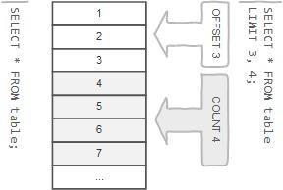
row limiting clause
LIMIT is applied after HAVING
Remember:
LIMIT enables you to pull a section of rows from the middle of a result set. Specify two values: The number of rows to skip at the beginning of the result set, and the number of rows to return.
Note:
Limit value are not to be given within ( . . . )
Limit takes one or two numeric arguments, which must both be non-negative integer value.

Slide 228
select - limit
SELECT A₁, A₂, A₃, . . . FROM r
[ LIMIT { [offset,] row_count | row_count OFFSET offset } ]
You can specify an offset using OFFSET from where SELECT will start returning records. By default offset is zero.
SELECT * FROM emp LIMIT 5 OFFSET 1;
READ
FROM
SELECT
LIMIT
1, 5 | 5 offset 1
output
emp
identifier.*
SELECT * FROM student LIMIT 5;
SELECT * FROM student LIMIT 1, 5;
SELECT * FROM student LIMIT 5 offset 1;
SELECT RAND(), student.* FROM student ORDER BY 1 LIMIT 1;
SELECT student.* FROM student ORDER BY RAND() LIMIT 1;

Slide 229
Nulls by default occur at the top, but you can use IsNull to assign default values, that will put it in the position you require. . The ISNULL() function tests whether an expression is NULL. If expression is a NULL value, the ISNULL() function returns 1. Otherwise, it returns 0.
SELECT id AS 'a' FROM tbl_name ORDER BY `a`;
SELECT id AS 'a' FROM tbl_name ORDER BY 'a';
order by clause
SQL allows the user to order the tuples in the result of a query by the values of one or more of the attributes that appear in the query result, by using the ORDER BY clause.
Remember:
The default sort order is ascending ASC, with smallest values first. To sort in descending (reverse) order, add the DESC keyword to the name of the column you are sorting by.
You can sort on multiple columns, and you can sort different columns in different directions.
If the ASC or DESC modifier is not provided in the ORDER BY clause, the results will be sorted by expression in ASC (ascending) order. This is equivalent to ORDER BY expression ASC.

Slide 230
select - order by
When doing an ORDER BY, NULL values are placed first if you do ORDER BY ... ASC and last if you do ORDER BY ... DESC.
SELECT A₁, A₂, A₃, A_{n} FROM r
[ORDER BY {A₁, A₂, A₃, . . . | expr | position} [ASC | DESC] , . . . ]
"Ordered by attributes A₁, A₂, A₃ …"
Tuples are sorted by specified attributes
Results are sorted by A₁ first
Within each value of A₁, results are sorted by A₂ then within each value of A₂, results are sorted by A₃
SELECT * FROM r ORDER BY key_part1, key_part2; // optimizer does not use the index.
SELECT key_part1, key_part2 FROM r ORDER BY key_part1, key_part2; // optimizer uses the index.

Slide 231
select - order by
The ORDER BY clause is used to sort the records in your result set.
SELECT A₁, A₂, A₃, A_{n} FROM r
[ORDER BY {A₁, A₂, A₃, . . . | expr | position} [ASC | DESC] , . . . ]
READ
FROM
SELECT
ORDER BY
identifier.job ASC, identifier.ename DESC
output
identifier.*
emp
READ
FROM
SELECT
ORDER BY
identifier.job DESC, identifier.ename ASC
output
identifier.ename, identifier.job
emp

Slide 232
Remember:
In WHERE clause operations can be performed using…
CONSTANTS
TABLE columns
FUNCTION calls (PRE-DEFINED / UDF)
In SQL, a logical expression is often called a predicate.
where clause
The WHERE Clause is used when you want to retrieve specific information from a table excluding other irrelevant data.
Note:
Expressions in WHERE clause can use.
Arithmetic operators
Comparison operators
Logical operators
Note:
All comparisons return FALSE when either argument is NULL, so no rows are ever selected.

Slide 233
select - where
We can use a conditional clause called WHERE clause to filter out results. Using WHERE clause, we can specify a selection criteria to select required records from a table.
SELECT A₁, A₂, A₃, . . . FROM r₁, r₂, r₃, . . . [ WHERE P ]
r_{i} are the relations (tables)
A_{i} are attributes (columns)
P is the selection predicate
SQL permits us to use the notation (v₁, v₂,...,v_{n}) to denote a tuple of arity (attribute) n containing values v₁, v₂,...,v_{n}.
WHERE (a₁, a₂) <= (b₁, b₂)
WHERE (EMP.DEPTNO, DNAME) = (DEPT.DEPTNO, 'SALES');
Remember:
A predicate is a condition expression that evaluates to a boolean value, either true or false.
Predicates can be used as follows: In a SELECT statement's WHERE clause or HAVING clause to determine which rows are relevant to a particular query.
A value of zero is considered false. Nonzero values are considered true.
SELECT true, false, TRUE, FALSE, True, False;

Slide 234
select - where
SELECT A₁, A₂, A₃, . . . FROM r₁, r₂, r₃, . . . [ WHERE P ]
comparison_operator:
= | <=> | >= | > | <= | < | <> | !=
logical_operators
{ AND | && } | { OR | || }
What will be the result of the query below?
SELECT 1 = 1;
SELECT True = 1;
SELECT True = 2;
SELECT True = True;
SELECT 0 = 0;
SELECT False = False;
SELECT False = 1;
SELECT 'a' = 1;
SELECT 'a' = 0;
SELECT * FROM emp WHERE ename = 0;
SELECT * FROM emp WHERE ename = 1;
SELECT * FROM emp WHERE ename = False;
SELECT * FROM emp WHERE ename = True;
SELECT * FROM emp WHERE True AND False;
SELECT * FROM emp WHERE True OR False;
SELECT * FROM emp WHERE True AND 1;
SELECT * FROM emp WHERE True OR 0;

Slide 235
boolean_ predicate:
IS [NOT] NULL
| expr <=> null
is null / is not null
"IS NULL" is the keyword that performs the Boolean comparison. It returns true if the supplied value is NULL and false if the supplied value is not NULL.
“IS NOT NULL" is the keyword that performs the Boolean comparison. It returns true if the supplied value is not NULL and false if the supplied value is null.
Note:
IS UNKNOWN is synonym of IS NULL.
IS NOT UNKNOWN is synonym of IS NOT NULL.

Slide 236
predicate:
expr [NOT] IN (expr1, expr2, . . . )
| expr [NOT] IN (subquery)
in
The IN statement is used in a WHERE clause to choose items from a set. The IN operator allows you to determine if a specified value matches any value in a set of values or value returned by a subquery.

Slide 237
in
syntax
column | expression IN ( v1, v2, v3, . . . )
column | expression IN (subquery)
Remember:
If a value in the column or the expression is equal to any value in the list, the result of the IN operator is TRUE.
The IN operator is equivalent to multiple OR operators.
To negate the IN operator, you use the NOT IN operator.

Slide 238
predicate:
expr [NOT] BETWEEN expr1 AND expr2
between
The BETWEEN operator is a logical operator that allows you to specify a range to test.

Slide 239
between
syntax
WHERE salary BETWEEN ( 20000 AND 30000 ) – Illegal
column | expression BETWEEN start_expression AND end_expression
Remember:
The BETWEEN operator returns TRUE if the expression to test is greater than or equal to the value of the start_expression and less than or equal to the value of the end_expression.
You can use the greater than or equal to (>=) and less than or equal to (<=) to substitute the BETWEEN operator.
Note:
if any input to the BETWEEN or NOT BETWEEN is NULL, then the result is UNKNOWN.

Slide 240
predicate:
expr [NOT] LIKE expr [ESCAPE char]
like
The LIKE operator is a logical operator that tests whether a string contains a specified pattern or not.

Slide 241
like - string comparison functions
syntax
column | expression LIKE 'pattern' [ESCAPE escape_character]
Remember:
% matches any number of characters, even zero characters.
_ matches exactly one character.
If we use default escape character '\', then don’t use ESCAPE keyword.
Note:
The ESCAPE keyword is used to escape pattern matching characters such as the (%) percentage and underscore (_) if they form part of the data.
If you do not specify the ESCAPE character, \ is assumed.

Slide 242
aggregate functions
SUM, AVG, MAX, MIN, COUNT, and GROUP_CONCAT
SELECT . . . . . FROM table_name WHERE <condition> / GROUP BY column_name
this is invalid
SUM(colNM) / AVG(colNM) / MAX(colNM)
MIN(colNM) / COUNT(*) / COUNT(colNM)

Slide 243
aggregate functions
Remember:
There are 3 places where aggregate functions can appear in a query.
in the SELECT-LIST/FIELD-LIST (the items before the FROM clause).
in the ORDER BY clause.
in the HAVING clause.
Note:
The aggregate functions allow you to perform the calculation of a set of rows and return a single value.
The WHERE clause cannot refer to aggregate functions. e.g. WHERE SUM(sal) = 5000 # Invalid, Error
The HAVING clause can refer to aggregate functions. e.g. HAVING SUM(sal) = 5000 # Valid, No Error
Nesting of aggregate functions are not allowed.
e.g.
SELECT MAX(COUNT(*)) FROM emp GROUP BY deptno;
Blank space between aggregate functions like (SUM, MIN, MAX, COUNT) are not allowed.
e.g.
SELECT SUM (sal) FROM emp;
The GROUP BY clause is often used with an aggregate function to perform calculation and return a single value for each subgroup.
To eliminate duplicates before applying the aggregate function is available by including the keyword DISTINCT.

Slide 244
aggregate functions
Things to… Remember:
TODO
AVG([DISTINCT] expr)
If there are no matching rows, AVG() returns NULL.
AVG() may take a numeric argument, and it returns a average of non-NULL values.
SUM([DISTINCT] expr)
If there are no matching rows, SUM() returns NULL.
SUM() may take a numeric argument , and it returns a sum of non-NULL values.
MAX([DISTINCT] expr)
If there are no matching rows, MAX() returns NULL.
MAX() may take a string, number, and date argument, and it returns a maximum of non-NULL values.
MIN([DISTINCT] expr)
If there are no matching rows, MIN() returns NULL.
MIN() may take a string, number, and date argument, and it returns a minimum of non-NULL values.

Slide 245
aggregate functions
Things to… Remember:
TODO
COUNT([DISTINCT] expr)
If there are no matching rows, COUNT() returns 0.
Returns a count of the number of non-NULL values.
COUNT (*) also considers Nulls and duplicates.

Slide 246

group by clause
Remember:
Standard SQL does not allow you to use an ALIAS in the GROUP BY clause, however, MySQL supports this.
Note:
DISTINCT (if used outside an aggregation function) that is superfluous.
e.g.
SELECT DISTINCT COUNT(ename) FROM emp;

Slide 247
select - group by
This function's will produce a single value for an entire group or a table.
You can use GROUP BY to group values from a column, and, if you wish, perform calculations on that column.
SELECT G₁, G₂, . . . , F₁(A₁), F₂(A₂), . . . FROM r₁, r₂, r₃ . . .
[GROUP BY {G₁, G₂, . . . | expr | position}, . . . [WITH ROLLUP]]

Slide 248
Remember:
The WHERE clause cannot refer to aggregate functions. [ WHERE SUM(sal) = 5000 # Error ]
The HAVING clause can refer to aggregate functions. [ HAVING SUM(sal) = 5000 # No Error ]
having clause
The MySQL HAVING clause is used in the SELECT statement to specify filter conditions for a group of rows. HAVING clause is often used with the GROUP BY clause. When using with the GROUP BY clause, we can apply a filter condition to the columns that appear in the GROUP BY clause.
Note:
Columns given in HAVING clause must be present in selection-list.
e.g.
SELECT COUNT(*) FROM emp HAVING deptno=10; *
SELECT deptno, COUNT(*) FROM emp GROUP BY deptno HAVING job='manager'; *
HAVING is merged with WHERE if you do not use GROUP BY or Aggregate Functions (COUNT(), . . .)
* ERROR: Unknown column '. . .' in 'having clause'

Slide 249
select - having
SELECT G₁, G₂, . . . , F₁(A₁), F₂(A₂), . . . FROM r₁, r₂, r₃ . . .
[GROUP BY {G₁, G₂, . . . | expr | position}, . . . [WITH ROLLUP]]
[ HAVING having_condition ]

Slide 250
Remember:
A subquery must be enclosed in parentheses.
Use single-row operators with single-row subqueries, and use multiple-row operators with multiple-row subqueries.
If a subquery (inner query) returns a null value to the outer query, the outer query will not return any rows when using certain comparison operators in a WHERE clause.
If ORDER BY occurs within a subquery and also is applied in the outer query, the outermost ORDER BY takes precedence.
If LIMIT occurs within a subquery and also is applied in the outer query, the outermost LIMIT takes precedence.
sub-queries
A subquery is a SELECT statement within another statement.
Note:
You may use comparison operators such as <>, <, >, <=, and >= with a single row subquery.
Multiple row subquery returns one or more rows to the outer SQL statement. You may use the IN, ANY, or ALL operator in outer query to handle a subquery that returns multiple rows.

Slide 251
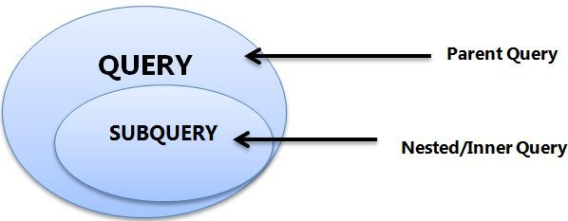
subqueries
A subquery is a SELECT statement within another statement.
INSERT . . . SELECT . . .
UPDATE . . . SELECT . . .
DELETE . . . SELECT . . .
CREATE TABLE . . . AS SELECT . . .
CREATE VIEW . . . AS SELECT . . .
DECLARE CURSOR . . . AS SELECT . . .
EXPLAIN SELECT . . .
Remember:
A subquery may occur in:
A SELECT clause
A FROM clause
A WHERE clause
A HAVING clause
Note:
A subquery's outer statement can be any one of:
SELECT
INSERT
UPDATE
DELETE
CREATE

Slide 252
types of subqueries
The Subquery as Scalar Operand – SELECT clause
Comparisons using Subqueries – WHERE / HAVING clause (Single row subquery)
Subqueries in the FROM Clause – INLINE VIEWS (Derived Tables)
Subqueries with ALL, ANY, IN, or SOME – WHERE / HAVING clause (Multiple row subquery)
Subqueries with EXISTS or NOT EXISTS
Row Subqueries

Slide 253
the subquery as scalar operand

Slide 254
the subquery as scalar operand
TODO
SELECT A₁, A₂, A₃, (subquery) as A₄, . . . FROM r
Remember:
A scalar subquery is a subquery that returns exactly one column value from one row.
A scalar subquery is a simple operand, and you can use it almost anywhere a single column value is legal.
Note:
If the subquery returns 0 rows then the value of scalar subquery expression is null.
if the subquery returns more than one row then MySQL returns an error.

Slide 255
subquery in the from clause

Slide 256
subqueries in the from clause
TODO
SELECT A₁, A₂, A₃, (subquery) as A₄, . . . FROM (subquery) [AS] name . . .
Note:
Every table in a FROM clause must have a name, therefore the [AS] name clause is mandatory.

Slide 257
comparisons using subquery

Slide 258
comparisons using subqueries
Comparison Operators like : =, !=/<>, >, >=, <, <= ,<=>
TODO
SELECT A₁, A₂, A₃, (subquery) as A₄, . . . FROM r WHERE p = (subquery)
Remember:
A subquery can be used before or after any of the comparison operators.
The subquery can return at most one value.
The value can be the result of an arithmetic expression or a function.

Slide 259
subquery with in, all, any, some

Slide 260
subqueries with in, all, any, some
operand comparison_operator ANY (subquery)
operand IN (subquery)
operand comparison_operator SOME (subquery)
operand comparison_operator ALL (subquery)
The word SOME is an alias for ANY.

Slide 261
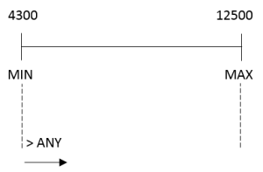
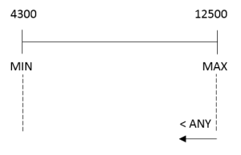
any / some
"x = ANY (...)": The value must match one or more values in the list to evaluate to TRUE.
"x != ANY (...)": The value must not match one or more values in the list to evaluate to TRUE.
"x > ANY (...)": The value must be greater than the smallest value in the list to evaluate to TRUE.
"x < ANY (...)": The value must be smaller than the biggest value in the list to evaluate to TRUE.
"x >= ANY (...)": The value must be greater than or equal to the smallest value in the list to evaluate to TRUE.
"x <= ANY (...)": The value must be smaller than or equal to the biggest value in the list to evaluate to TRUE.

Slide 262
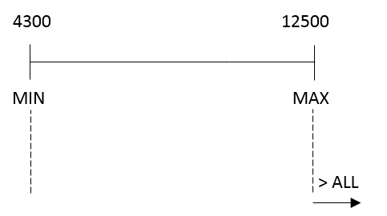
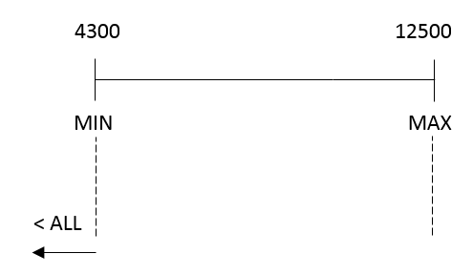
all
"x = ALL (...)": The value must match all the values in the list to evaluate to TRUE.
"x != ALL (...)": The value must not match any values in the list to evaluate to TRUE.
"x > ALL (...)": The value must be greater than the biggest value in the list to evaluate to TRUE.
"x < ALL (...)": The value must be smaller than the smallest value in the list to evaluate to TRUE.
"x >= ALL (...)": The value must be greater than or equal to the biggest value in the list to evaluate to TRUE.
"x <= ALL (...)": The value must be smaller than or equal to the smallest value in the list to evaluate to TRUE.

Slide 263
SELECT * FROM emp WHERE EXISTS (SELECT 1);
subquery with exists or not exists

Slide 264
subqueries with exists or not exists
The EXISTS operator tests for the existence of rows in the results set of the subquery. If a subquery row value is found, EXISTS subquery returns TRUE and in this case NOT EXISTS subquery will return FALSE.
SELECT A₁, A₂, A₃, A₄, . . . FROM r WHERE [NOT] EXISTS (subquery)
The records will be displayed from outer SELECT statement….
SELECT * FROM emp WHERE EXISTS (SELECT * FROM dept WHERE emp.deptno = dept.deptno);
SELECT * FROM dept WHERE NOT EXISTS (SELECT deptno FROM emp WHERE emp.deptno = dept.deptno);
SELECT * FROM emp m WHERE EXISTS (SELECT * FROM emp e WHERE e.mgr = m.empno);
SELECT * FROM emp m WHERE NOT EXISTS (SELECT * FROM emp e WHERE e.mgr = m.empno);
SELECT * FROM dept WHERE deptno IN (SELECT * FROM emp WHERE emp.deptno = dept.deptno);
SELECT * FROM dept WHERE deptno NOT IN (SELECT * FROM emp WHERE emp.deptno = dept.deptno);
SELECT * FROM emp f WHERE NOT EXISTS (SELECT * FROM emp m WHERE f.deptno = m.deptno AND gender = 'm');
SELECT * FROM emp m WHERE NOT EXISTS (SELECT true FROM emp f WHERE m.deptno = f.deptno AND f.gender = 'f');

Slide 265
IS NULL
NULL
joins

Slide 266
joins
JOINS are used to retrieve data from multiple tables.
JOIN is performed whenever two or more tables are joined in a SQL statement.

Slide 267
joins
Type of JOINS
Cartesian or Product Join – Cross Join
Equijoin – Inner Join
Natural Join
Simple Join
Outer Join – Right Outer Join, Left Outer Join
Self Join

Slide 268
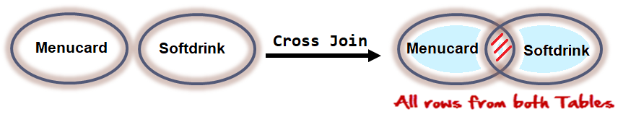

cartesian or product join
Cartesian/Product means Number of Rows present in Table 1 Multiplied by Number of Rows present in Table 2.
Cross Join in MySQL does not require any common column to join two table.
The result of R(A₁, A₂, . . . , A_{n}) × S(B₁, B₂, . . . , B_{m}) is a relation Q with degree n + m attributes Q(A₁, A₂, . . . , A_{n} , B₁, B₂, . . . , B_{m}), in that order.

Slide 269
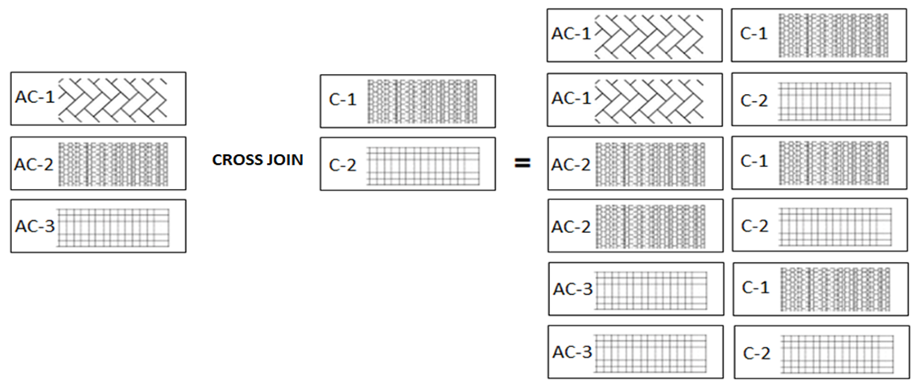
joins - cartesian or product
The CROSS JOIN gets a row from the first table (r₁) and then creates a new row for every row in the second table (r₂). It then does the same for the next row for in the first table (r₁) and so on.

Slide 270
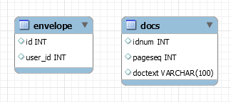


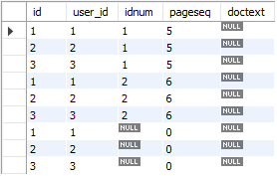
joins – cross join
The CROSS JOIN produced a result set which is the product of rows of two associated tables when no WHERE clause is used with CROSS JOIN. In this join, the result set appeared by multiplying each row of the first table with all rows in the second table if no condition introduced with CROSS JOIN.
SELECT A₁, A₂, A₃, . . . FROM r₁ CROSS JOIN r₂, . . .
envelope Table
docs Table
SELECT * FROM envelope CROSS JOIN docs;

Slide 271
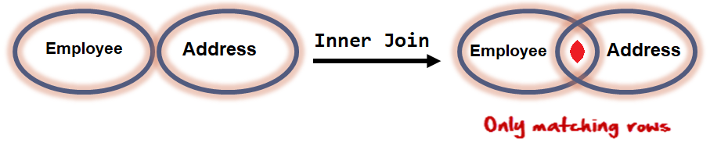
equi join
An equi join / Inner Join is a join with a join condition containing an equality operator. An equijoin returns only those rows that have equivalent values for the specified columns. Rows that match remain in the result, those that don't are rejected. The match condition is commonly called the join condition. equi join / Inner Join returns rows when there is at least one match in both tables.
The result of R(A₁, A₂, . . . , A_{n}) _{<join condition>} S(B₁, B₂, . . . , B_{m}) is a relation Q with degree n + m attributes Q(A₁, A₂, . . . , A_{n} , B₁, B₂, . . . , B_{m}), in that order. Q has one tuple for each combination of tuples—one from R and one from S—whenever the combination satisfies the join condition.

Slide 272
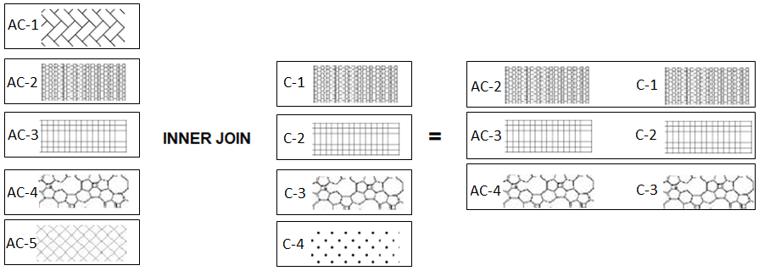
equi join example
The following table illustrates the inner join of two tables r₁(AC-1, AC-2, AC-3, AC-4, AC-5) and r₂(C-1, C-2, C-3, C-4). The result includes rows: (2,A), (3,B), and (4,C) as they have the same patterns.

Slide 273
inner join
The inner join is one of the most commonly used joins in SQL. The inner join clause allows you to query data from two or more related tables.

Slide 274

joins – inner join
INNER JOIN returns rows when there is at least one match in both tables.
The INNER JOIN selects all rows from both participating tables as long as there is a match between the columns. An SQL INNER JOIN is same as JOIN clause, combining rows from two or more tables.
SELECT A₁, A₂, A₃, . . . FROM r₁ [INNER] JOIN r₂ ON r₁. A₁ = r₂. A₁
SELECT * FROM employee emp INNER JOIN qualification quali ON emp.id = quali.employeeid;

Slide 275
natural join

Slide 276

joins – natural join
Joins two tables based on common column names. Hence one must confirm the common columns before using a NATURAL JOIN
The NATURAL JOIN is such a join that performs the same task as an INNER JOIN.
SELECT A₁, A₂, A₃, . . . FROM r₁ NATURAL [INNER] JOIN r₂ NATURAL [INNER] JOIN r₃ . . .
SELECT * FROM emp NATURAL JOIN dept;
The associated tables have one or more pairs of identically column-names.
The columns must be of the same name.
The columns datatype may differ.
Don't use ON / USING clause in a NATURAL JOIN.
When this join condition gets applied always the duplicates of the common columns get eliminated from the result.
A NATURAL JOIN can be used with a LEFT OUTER join, or a RIGHT OUTER join.
If the column-names are not same, then NATURAL JOIN will work as CROSS JOIN.

Slide 277
simple join
TODO

Slide 278
joins – simple join
The SIMPLE JOIN is such a join that performs the same task as an INNER JOIN.
SELECT A₁, A₂, A₃, . . . FROM r₁ SIMPLE JOIN r₂ USING (A₁, . . . )
SELECT * FROM emp SIMPLE JOIN dept USING(deptno)

Slide 279
outer joins
In an outer join, along with rows that satisfy the matching criteria, we also include some or all rows that do not match the criteria.

Slide 280
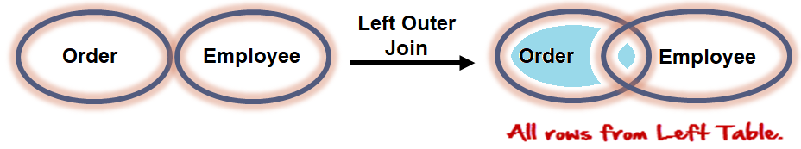
joins – left outer join
The LEFT JOIN keyword returns all rows from the left table (r₁), with the matching rows in the right table (r₂). The result is NULL in the right side when there is no match.
SELECT A₁, A₂, A₃, . . . FROM r₁ LEFT [OUTER ] JOIN r₂ ON r₁. A₁ = r₂. A₁
SELECT * FROM orders ord LEFT OUTER JOIN employee emp ON emp.id = ord.employeeid;

Slide 281
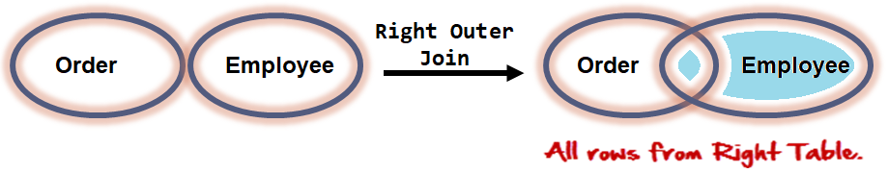
joins – right outer join
The RIGHT JOIN keyword returns all rows from the right table (r₂), with the matching rows in the left table (r₁). The result is NULL in the left side table when there is no match.
SELECT A₁, A₂, A₃, . . . FROM r₁ RIGHT [OUTER ] JOIN r₂ ON r₁. A₁ = r₂. A₁
SELECT * FROM orders ord RIGHT OUTER JOIN employee emp ON emp.id = ord.employeeid;

Slide 282
TODO
self joins
TODO

Slide 283
joins – self join
A SELF JOIN is a join in which a table is joined with itself (which is also called Unary relationships), especially when the table has a FOREIGN KEY which references its own PRIMARY KEY.
SELECT r_{x}.A₁, r_{x}.A₂, r_{y}.A₁, r_{y}.A₂, . . . FROM r₁ r_{x}, r₁ r_{y} WHERE r_{x}.A₁ = r_{y}.A₁

Slide 284
set operation in sql
Set operators are used to join the results of two (or more) SELECT statements.
Remember:
The result set column names are taken from the column names of the first SELECT statement.
SELECT statement should have the same data type. (Not in MySQL)

Slide 285
set operation
syntax
SELECT . . . UNION [ALL]
SELECT . . .
SELECT * FROM books UNION SELECT * FROM newbooks;
SELECT * FROM books UNION ALL SELECT * FROM newbooks;
syntax
SELECT . . . INTERSECT
SELECT . . .
SELECT * FROM books INTERSECT SELECT * FROM newbooks;
syntax
EXCEPT returns rows from first dataset, which are not available in the second dataset.
SELECT . . . EXCEPT
SELECT . . .
SELECT * FROM books EXCEPT SELECT * FROM newbooks;

Slide 286
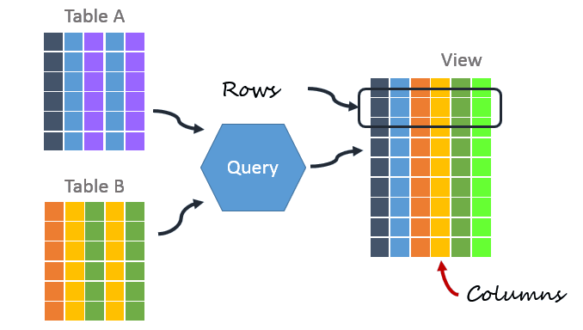
A VIEW in SQL as a logical subset of data from one or more tables. Views are used to restrict data access. A VIEW contains no data of its own but its like window through which data from tables can be viewed or changed. The table on which a View is based are called BASE Tables.
There are 2 types of Views in SQL:
Simple View : Simple views can only contain a single base table.
Complex View : Complex views can be constructed on more than one base table. In particular, complex views can contain: join conditions, a group by clause, a order by clause.
views

Slide 287
view
Views are not updatable in the following cases:
A table in the FROM clause is reference by a subquery in the WHERE statement.
There is a subquery in the SELECT clause.
The SQL statement defining the view joins tables.
One of the tables in the FROM clause is a non-updatable view.
The SELECT statement of the view contains an aggregate function such as SUM(), COUNT(), MAX(), MIN(), and so on.
The keywords DISTINCT, GROUP BY, HAVING clause, LIMIT clause, UNION, or UNION ALL appear in the defining SQL statement.

Slide 288
create view/ show create view
The select_statement is a SELECT statement that provides the definition of the view. The select_statement can select from base tables or other views.
CREATE [OR REPLACE] VIEW view_name [(column_list)]
AS select_statement [WITH CHECK OPTION]
SHOW CREATE VIEW view_name
show create VIEW v1;

Slide 289
alter / drop view
This statement changes the definition of a view, which must exist.
ALTER VIEW view_name [(column_list)]
AS select_statement
[WITH CHECK OPTION]
e.g.
ALTER VIEW studentview AS SELECT namefirst, namelast, emailid FROM student;
DROP VIEW removes one or more views.
DROP VIEW [IF EXISTS]
view_name [, view_name] ...
e.g.
DROP VIEW studentview;
DROP VIEW studentid10view, studentviewwithcheck;
DROP VIEW studentTotalMarksView, studentAddressView;

Slide 290
index
it is a schema object.
it is used by the server to speed up the retrieval of rows.
it reduces disk I/O(input/output) process.
it helps to speed up select queries where clauses, but it slows down data input, with the update and the insert statements.
it can be created or dropped with no effect on the data.
multiple columns index may consist of up to 16 columns.

Slide 291
index
Indexes are used to find rows with specific column values quickly. Without an index, MySQL must begin with the first row and then read through the entire table to find the relevant rows. If the table has an index for the columns in question, MySQL can quickly determine the position (from the index file) to seek to in the middle of the data file without having to look at all the data. This is much faster than reading every row sequentially.
To find the rows matching a WHERE clause quickly.
If the table has a multiple-column index, any leftmost prefix of the index can be used by the optimizer to look up rows. For example, if you have a three-column index on (col1, col2, col3), you have indexed search capabilities on (col1), (col1, col2), and (col1, col2, col3).
Note:
Index name can have max 64 char.
It is not possible to create an INDEX on a VIEW.
If we drop the BASE TABLE, the INDEX will be dropped automatically.

Slide 292
create index
Indexes are used to find rows with specific column values quickly.
CREATE [UNIQUE] INDEX index_name
ON tbl_name (index_col_name,...)
e.g.
CREATE INDEX indexOnName ON emp(ename);
CREATE INDEX indexOnUniversity ON student_qualifications(university);
CREATE UNIQUE INDEX uniqueIndexOnName ON emp(ename);

Slide 293
SHOW INDEX Syntax
To get the index of a table, you specify the table name after the FROM keyword. The statement will return the index information associated with the table in the current database.
SHOW {INDEX | INDEXES | KEYS}
{FROM | IN} tbl_name
[{FROM | IN} db_name]
[WHERE expr]
e.g.
SHOW INDEX FROM emp;
SHOW INDEX FROM student_qualifications;
SHOW INDEX returns table index information.

Slide 294
drop index
DROP INDEX drops the index named index_name from the table tbl_name.
DROP INDEX index_name ON tbl_name
e.g.
DROP INDEX indexOnName ON emp;
DROP INDEX indexOnUniversity ON student_qualifications;
DROP INDEX uniqueIndexOnName ON emp;

Slide 295
create user and grant/revoke privileges

Slide 296
create user
TODO
CREATE USER [IF NOT EXISTS] 'user_name' @'localhost' IDENTIFIED BY 'password'
SET PASSWORD FOR 'user_name'@'localhost' = 'auth_string'
DROP USER [IF EXISTS] 'user_name' @'localhost'
CREATE USER 'saleel'@'localhost' IDENTIFIED BY 'saleel';
SET PASSWORD FOR 'saleel'@'localhost' = 'sharmin';
DROP USER 'saleel'@'localhost';

Slide 297
grant/revoke privileges
Privilege | Privilege
ALL [PRIVILEGES] | SELECT
CREATE | INSERT
ALTER | UPDATE
DROP | DELETE
EXECUTE
TODO
GRANT priv_type ON object_type TO 'user_name'@'localhost'
REVOKE priv_type ON object_type FROM 'user_name'@'localhost'
GRANT ALL PRIVILEGES ON db1.* TO 'saleel'@'localhost';
GRANT ALL PRIVILEGES ON *.* TO 'saleel'@'localhost';
GRANT INSERT, UPDATE ON emp TO 'saleel';
REVOKE INSERT, UPDATE ON emp FROM 'saleel';

Slide 298
select ... into

Slide 299
select … into
An INTO clause should not be used in a nested SELECT because such a SELECT must return its result to the outer context.
The SELECT ... INTO form of SELECT enables a query result to be stored in variables or written to a file.
SELECT . . . INTO var_list
SELECT . . . INTO OUTFILE
SELECT . . . INTO DUMPFILE
Selects column values and stores them into variables.
Writes the selected rows to a file. Column and line terminators can be specified to produce a specific output format.
Writes a single row to a file without any formatting.

Slide 300
select ... into var_list

Slide 301
select … into var_list
The SELECT ... INTO form of SELECT enables a query result to be stored in variables or written to a file.
SELECT . . . INTO var_list
The selected values are assigned to the variables.
The number of variables must match the number of columns.
The query should return a single row.

Slide 302
+--------------------------+-----------------------------------------------------------------------+
| variable_name | value |
+--------------------------+-----------------------------------------------------------------------+
| secure_file_priv | C:/ProgramData/MySQL/MySQL Server 8.0/Uploads |
+--------------------------+-----------------------------------------------------------------------+
In this example, I can only read files from the / Uploads / directory.
select ... into outfile
If not working then do changes in my.ini file.
secure_file_priv = ""
SHOW VARIABLES LIKE "secure_file_priv";

Slide 303
select … into outfile
Writes the selected rows to a file. Column and line terminators can be specified to produce a specific output format.
SELECT . . . INTO OUTFILE
SELECT identifier.* FROM emp INTO OUTFILE "/tmp/emp.csv" ;
SELECT identifier.* FROM emp INTO OUTFILE "/tmp/emp.txt" ;
SELECT identifier.* FROM emp INTO OUTFILE "/tmp/emp.csv" FIELDS TERMINATED BY ',';
SELECT identifier.* FROM emp INTO OUTFILE "/tmp/emp.csv" FIELDS TERMINATED BY ',' LINES TERMINATED by '\n';
SELECT identifier.* FROM emp INTO OUTFILE "/tmp/emp.csv" FIELDS TERMINATED BY ',' OPTIONALLY ENCLOSED BY '"' LINES TERMINATED BY '\n';
SELECT "DEPT", "DNAME", "LOC", "PWD", "STARTEDON" UNION SELECT * FROM dept;
TABLE emp INTO OUTFILE "/tmp/emp.csv";
TABLE emp INTO OUTFILE "/tmp/emp.txt";

Slide 304
select ... into dumpfile

Slide 305
select … into dumpfile
If you use INTO DUMPFILE instead of INTO OUTFILE, MySQL writes only one row into the file, without any column or line termination and without performing any escape processing. This is useful if you want to store a BLOB value in a file.
SELECT . . . INTO DUMPFILE
SELECT identifier.* FROM emp WHERE empno = 7788 INTO DUMPFILE "/tmp/emp.txt";

Slide 306
pl/sql
PL/SQL is a procedural language extension to Structured Query Language (SQL). The purpose of PL/SQL is to combine database language and procedural programming language.

Slide 307
Note:
Statements that return a result set can be used within a STORED PROCEDURE but not within a STORED FUNCTION. This prohibition includes SELECT statements that do not have an INTO var_list clause.
DDL statements, such as CREATE, ALTER, and DROP etc. are permits STORED PROCEDURES, (but not in STORED FUNCTIONS).
ERROR 1314 (0A000): USE command is not allowed in stored procedures
Stored PROCEDURES and FUNCTIONS name can have max 64 char.
create procedure and
create function
GRANT EXECUTE ON [ PROCEDURE | FUNCTION ] object_name TO user;
REVOKE EXECUTE ON [ PROCEDURE | FUNCTION ] object_name FROM user;
SHOW CREATE PROCEDURE <routine_name>
SHOW CREATE FUNCTION <routine_name>

Slide 308
stored procedure and function
These statements create stored routines. By default, a routine is associated with the default database. To associate the routine explicitly with a given database, specify the name as db_name.sp_name when you create it.
CREATE PROCEDURE sp_name ([proc_parameter[,...]])
proc_parameter:
[ IN | OUT | INOUT ] param_name type
CREATE FUNCTION sp_name ([func_parameter[,...]])
RETURNS type
DETERMINISTIC
SELECT * FROM information_schema.parameters
WHERE SPECIFIC_NAME = 'pro1';
desc mysql.proc
DROP FUNCTION IF EXISTS functionname;
delimiter $$
CREATE FUNCTION functionname() RETURNS INT
DETERMINISTIC
begin
statements…….
return (something);
end $$
delimiter ;
DROP PROCEDURE IF EXISTS procedurename;
delimiter $$
CREATE PROCEDURE procedurename()
begin
statements…….
end $$
delimiter ;
Parameter: Is an unknown thing. Means it exists but don’t know it.
e.g. Blood sugar it exists but we don’t know it.

Slide 309
proc_parameter - out | inout param-name type
TODO.
CREATE PROCEDURE sp_name ([proc_parameter[,...]])
proc_parameter:
[ IN | OUT | INOUT ] param_name type
Note:
For each OUT or INOUT parameter, pass a user-defined variable in the CALL statement that invokes the PROCEDURE. So that you can obtain its value when the PROCEDURE returns.
If you are calling the PROCEDURE from within another stored PROCEDURE or FUNCTION, you can also pass a routine parameter or local routine variable as an OUT or INOUT parameter.

Slide 310
difference between stored procedure and function?

Slide 311
stored procedure and function
A FUNCTION always returns a value using the return statement. PROCEDURE may return one or more values through OUT parameter(s) or may not return any at all.
FUNCTIONS are normally used for computations where as PROCEDURES are normally used for executing business logic.
A FUNCTION returns 1 value only. PROCEDURE can return multiple values (max 1024).
A FUNCTION can be called directly by SQL statement like select func_name from dual while PROCEDURES cannot.
A FUNCTION dose not allow the use of DDL statements (like: CREATE, ALTER, DROP etc.) while PROCEDURE can.
The major difference is that UDFs can be used like any other expression within SQL statements, whereas stored procedures must be invoked using the CALL statement.
Note:
MySQL permits routines to contain DDL statements, such as CREATE, ALTER and DROP in stored procedure,
but DDL statements, such as CREATE, ALTER and DROP are not permits in stored function.

Slide 312
source and call stored procedure

Slide 313
source and call stored procedure
If you are already running mysql, you can execute an SQL script file using the source command or \. command
source file_name.sql
\. file_name.sql
MySQL> source pl1.sql;
MySQL> \. file_name.sql;
The CALL statement invokes a stored procedure that was defined previously with CREATE PROCEDURE. Stored procedures that take no arguments can be invoked without parentheses. That is, CALL sp_name and CALL sp_name() are equivalent.
CALL sp_name([parameter[,...]])
CALL sp_name[()]
MySQL> call sp_name;
MySQL> call sp_name();

Slide 314
delimiter - statement
By default, mysql itself recognizes the semicolon as a statement delimiter, so you must redefine the delimiter temporarily to cause mysql to pass the entire stored program definition to the server. To redefine the mysql delimiter, use the delimiter command.

Slide 315
DROP PROCEDURE IF EXISTS procedurename;
delimiter $$
CREATE PROCEDURE procedurename()
begin
statements…….
end $$
delimiter ;
DROP FUNCTION IF EXISTS functionname;
delimiter $$
CREATE FUNCTION functionname() RETURNS INT
DETERMINISTIC
begin
statements…….
return (something);
end $$
delimiter ;
begin ... end
compound-statement
A compound statement is a block that can contain:
other blocks
declarations of variables
declarations of cursors
declarations of exception handlers
compound statements
flow control constructs such as loops and conditional tests.

Slide 316
DECLARE variable_name datatype(size) [ DEFAULT default_value ];
Declaring variables
1. 2. 3. | declare x INT DEFAULT 0; SET x := 10; declare y INT; SET y := 10; SET x := (SELECT 1001)
DECLARE variable_name datatype(size)
Assigning variables
1 2 | DECLARE z INT; SET z = 10;
declare variables
Note:
DECLARE is permitted only inside a BEGIN ... END compound statement and must be at its start, before any other statements.
Only scalar values can be assigned. For example, a statement such as SET x = (SELECT 1, 2) is invalid.

Slide 317
local variable declare and user-defined variables
Local variables are declared within stored procedures and are only valid within the BEGIN…END block where they are declared. Local variables can have any SQL data type.
DECLARE var_name [, var_name] ... type [DEFAULT value]
User variables in MySQL stored procedures, user variables are referenced with an ampersand (@) prefixed to the user variable name.
SET @var_name = expr [, @var_name = expr] ...
DROP PROCEDURE IF EXISTS procedurename;
delimiter $$
CREATE PROCEDURE procedurename()
begin
declare x VARCHAR(12) default 'Infoway';
SELECT x;
end $$
delimiter ;
DROP PROCEDURE IF EXISTS procedurename;
delimiter $$
CREATE PROCEDURE procedurename()
begin
set @x = 'Infoway';
SELECT @x;
end $$
delimiter ;

Slide 318
local variable declare and user-defined variables
Local variables are declared within stored procedures and are only valid within the BEGIN…END block where they are declared. Local variables can have any SQL data type.
DECLARE var_name [, var_name] ... type [DEFAULT value]
User variables in MySQL stored procedures, user variables are referenced with an ampersand (@) prefixed to the user variable name.
SET @var_name = expr [, @var_name = expr] ...
DROP PROCEDURE IF EXISTS procedurename;
delimiter $$
CREATE PROCEDURE procedurename(x INT)
begin
SET x:= (SELECT 1001);
SET @y := (SELECT 2001);
end $$
delimiter ;
DROP FUNCTION IF EXISTS functionname;
delimiter $$
CREATE PROCEDURE functionname(x INT) RETURNS INT
begin
SET x := (SELECT 1002);
SET @y := (SELECT 2002);
return(x);
end $$
delimiter ;

Slide 319
delimiter problem
DROP PROCEDURE IF EXISTS procedurename;
delimiter$$
CREATE PROCEDURE procedurename(OUT para1 VARCHAR(100))
begin
SELECT "Hello World123" INTO para1;
end $$
delimiter;

Slide 320
if and loop label

Slide 321
if and loop
IF search_condition THEN statement_list
[ELSEIF search_condition THEN statement_list] ...
[ELSE statement_list]
END IF
ITERATE means "start the loop again."
LEAVE statement is used to exit the flow control construct that has the given label.
[begin_label:] LOOP
statement_list
END LOOP [end_label]
ITERATE label
LEAVE label

Slide 322
A procedure is a group of PL/SQL statements that you can call by name.
stored procedure
A procedure is a group of PL/SQL statements that you can call by name.
Remember:
It is not permitted to assign the value DEFAULT to stored PROCEDURE or FUNCTION parameters
e.g.
PROCEDURE procedurename(IN p_ID INT DEFAULT 10)
Or stored program local variables
e.g.
SET var_name = DEFAULT some_value.

Slide 323
stored procedure - examples
DROP PROCEDURE IF EXISTS procedurename;
delimiter $$
CREATE PROCEDURE procedurename()
begin
SELECT * FROM emp;
end $$
delimiter ;
DROP PROCEDURE IF EXISTS procedurename;
delimiter $$
CREATE PROCEDURE procedurename()
begin
declare x VARCHAR(12);
SELECT ename INTO x FROM emp WHERE empno = 7788;
SELECT x;
end $$
delimiter ;

Slide 324
stored procedure - examples
DROP PROCEDURE IF EXISTS procedurename;
delimiter $$
CREATE PROCEDURE procedurename(IN para1 INT)
begin
declare x VARCHAR(12);
SELECT ename INTO x FROM emp WHERE empno = para1;
SELECT x;
end $$
delimiter ;
DROP PROCEDURE IF EXISTS procedurename;
delimiter $$
CREATE PROCEDURE procedurename(IN para1 VARCHAR(15))
begin
declare x VARCHAR(12);
SELECT job INTO x FROM emp WHERE ename = para1;
SELECT x;
end $$
delimiter ;

Slide 325
stored procedure - examples
DROP PROCEDURE IF EXISTS procedurename;
delimiter $$
CREATE PROCEDURE procedurename(IN para1 VARCHAR(12))
begin
SELECT * FROM emp WHERE job = para1;
end $$
delimiter ;
DROP PROCEDURE IF EXISTS procedurename;
delimiter $$
CREATE PROCEDURE procedurename(IN para1 VARCHAR(12), OUT s INT, OUT j VARCHAR(12))
begin
SELECT para1, SUM(Sal) INTO varJob, varSumSal FROM emp WHERE job = para1;
end $$
delimiter ;

Slide 326
stored procedure - examples
DROP PROCEDURE IF EXISTS procedurename;
delimiter $$
CREATE PROCEDURE procedurename(IN para1 VARCHAR(12))
begin
if (SELECT true FROM dept WHERE deptno = x) then
SELECT * FROM emp WHERE deptno = x;
else
SELECT "Data Not Found";
end if;
end $$
delimiter ;

Slide 327
stored procedure - examples
DROP PROCEDURE IF EXISTS procedurename;
delimiter $$
CREATE PROCEDURE procedurename(IN p1 INT(2), IN p2 VARCHAR(12), IN p3 VARCHAR(10), IN p4 VARCHAR(20))
begin
INSERT into DEPT values (p1, p2, p3, p4);
end $$
delimiter ;
DROP PROCEDURE IF EXISTS procedurename;
delimiter $$
CREATE PROCEDURE myprocedure (INOUT p1 INT(2))
begin
set p1 = p1+2;
end $$
delimiter ;
mysql> SET @x = 10
mysql> CALL procudeureName(@x);
mysql> SELECT @x

Slide 328
stored procedure - examples
DROP PROCEDURE IF EXISTS procedurename;
delimiter $$
CREATE PROCEDURE procedurename()
begin
CREATE TABLE temp (IN col1 INT);
end $$
delimiter ;
DROP PROCEDURE IF EXISTS procedurename;
delimiter $$
CREATE PROCEDURE procedurename(IN v1 INT, IN v2 VARCHAR(20), IN v3 VARCHAR(20), IN v4 VARCHAR(20))
begin
INSERT INTO dept VALUES (v1, v2, v3, v4);
end $$
delimiter ;
DROP PROCEDURE IF EXISTS procedurename;
delimiter $$
CREATE PROCEDURE procedurename(IN var1 INT)
begin
SELECT * FROM emp LIMIT var1;
end $$
delimiter ;

Slide 329
stored procedure - examples
DROP PROCEDURE IF EXISTS procedurename;
delimiter $$
CREATE PROCEDURE procedurename()
begin
CREATE TABLE temp (col1 INT);
end $$
delimiter ;
DROP PROCEDURE IF EXISTS procedurename;
delimiter $$
CREATE PROCEDURE procedurename()
begin
#CREATE TABLE temp (col1 INT);
#ALTER TABLE temp ADD col2 INT;
#DROP TABLE temp;
end $$
delimiter ;

Slide 330
stored procedure - examples
DROP PROCEDURE IF EXISTS procedurename;
delimiter $$
CREATE PROCEDURE procedurename()
begin
declare exit handler for 1146 CREATE TABLE abc(id INT, ename VARCHAR(20));
SELECT * FROM abc;
end $$
delimiter ;

Slide 331
stored procedure - examples
DROP PROCEDURE IF EXISTS procedurename;
delimiter $$
CREATE PROCEDURE procedurename(IN x INT, IN y INT, OUT z INT, OUT z1 INT )
begin
set z = x + y;
set z1 = x * y;
end $$
delimiter ;
-----------------------------------------------------------------------------------------------
mysql> SET @a := 0;
mysql> SET @b := 0;
mysql> CALL pro1(5, 4, @a, @b);

Slide 332
A cursor is a temporary work area created in the system memory when a SQL statement is executed.
N
O
DECLARE
OPEN
FETCH
EMPTY
YES
CLOSE
cursor
A cursor allows you to iterate a set of rows returned by a query and process each row individually.
Remember:
Read only: Not updatable.
Nonscrollable: Can be traversed only in one direction and cannot skip rows.
Asensitive: there are two kinds of cursors: asensitive cursor and insensitive cursor. An asensitive cursor points to the actual data, whereas an insensitive cursor uses a temporary copy of the data. MySQL cursor is asensitive.
Note:
Cursor declarations must appear before handler declarations. Variable and condition declarations must appear before cursor or handler declarations.

Slide 333
cursor
STEPS:
DECLARE cursor_name CURSOR FOR select_statement
This statement declares a cursor and associates it with a SELECT statement that retrieves the rows to be traversed by the cursor.
OPEN cursor_name
This statement opens a previously declared cursor.
FETCH [[NEXT] FROM] cursor_name INTO var_name [, var_name] . . .
This statement fetches the next row for the SELECT statement associated with the specified cursor (which must be open), and advances the cursor pointer. If a row exists, the fetched columns are stored in the named variables. The number of columns retrieved by the SELECT statement must match the number of output variables specified in the FETCH statement.
If no more rows are available, a No Data condition.
CLOSE cursor_name
This statement closes a previously opened cursor.

Slide 334
cursor
Q1. Using cursor get all student details.
DROP PROCEDURE IF EXISTS getAllStudent;
delimiter $$
CREATE PROCEDURE getAllStudent()
begin
declare v_ID INT;
declare v_namefirst, v_namelast VARCHAR(45);
declare v_dob DATE;
declare v_emailID VARCHAR(128);
declare c1 CURSOR FOR SELECT * FROM student;
declare EXIT HANDLER FOR NOT FOUND SELECT "No more student found";
OPEN c1;
lbl: loop
FETCH c1 INTO v_ID, v_namefirst, v_namelast, v_dob, v_emailID;
SELECT v_ID, v_namefirst, v_namelast, v_dob, v_emailID;
end loop lbl;
CLOSE c1;
end $$
delimiter ;

Slide 335
cursor
DROP PROCEDURE IF EXISTS procedurename;
delimiter $$
CREATE PROCEDURE procedurename(_custID INT)
b1:begin
if (SELECT true FROM customer WHERE custid = _custID) then
b2: begin
declare _ordID INT;
declare _orderdate, _shipdate DATETIME;
declare _status, _commplan VARCHAR(45);
declare _total FLOAT(8,2);
declare c1 CURSOR for SELECT ordID, orderdate, commplan, shipdate, status, total FROM ord
WHERE custid = _custID;
OPEN c1;
lbl:loop
FETCH c1 INTO _ordID, _orderdate, _commplan, _shipdate, _status, _total;
select _ordid, _orderdate, _commplan, _shipdate, _status, _total;
end loop lbl;
CLOSE c1;
end b2;
end if;
end b1 $$
delimiter ;

Slide 336
cursor
DROP PROCEDURE IF EXISTS procedurename;
delimiter $$
CREATE PROCEDURE procedurename(_custID INT, _status VARCHAR(45))
b1: begin
if (SELECT true FROM customer WHERE custid= _custID) then
SELECT * FROM customer WHERE custid= _custID;
b2: begin
declare _ordID INT;
declare _orderdate, _shipdate DATETIME;
declare _commplan VARCHAR(45);
declare _total FLOAT(8,2);
declare c1 CURSOR for SELECT ordID, orderdate, commplan, shipdate, total FROM ord WHERE custid =
_custID and status= _status;
OPEN c1;
lbl:loop
FETCH c1 INTO _ordID, _orderdate, _commplan, _shipdate, _total;
SELECT _ordID, _orderdate, _commplan, _shipdate, _status _total;
end loop lbl;
CLOSE c1;
end b2;
end if;
end b1 $$
delimiter ;

Slide 337
cursor
Q2 Write a program to enter studentID and using cursor get his student qualification details.
DROP PROCEDURE if EXISTS getStudentQualification;
CREATE PROCEDURE getStudentQualification(v_ID INT)
b1:begin
declare x INT;
SELECT ID into x FROM student WHERE ID = v_ID;
if x is null then
SELECT "Student not found....";
else
b2: begin
declare v_name, v_college, v_university VARCHAR(128);
declare v_marks VARCHAR(45);
declare v_year INT;
declare c1 CURSOR for SELECT name, college, university, marks, year FROM student_qualifications where studentID = x;
declare EXIT HANDLER FOR NOT FOUND SELECT "Done";
OPEN c1;
lbl:loop
FETCH c1 INTO v_name, v_college, v_university, v_marks, v_year;
SELECT v_name, v_college, v_university, v_marks, v_year;
end loop lbl;
CLOSE c1;
end b2;
end if;
end b1 $$
delimiter ;

Slide 338
cursor
DROP PROCEDURE IF EXISTS procedurename;
delimiter $$
CREATE PROCEDURE procedurename(para1 VARCHAR(25))
begin
declare done TINYINT DEFAULT FALSE;
declare varempno INT;
declare varename VARCHAR(20);
declare c1 CURSOR FOR SELECT empno, ename FROM emp WHERE job = para1;
declare EXIT HANDLER FOR NOT FOUND set done=true;
OPEN c1;
lbl: loop
FETCH c1 INTO varempno, varename;
if done then
LEAVE loopLabel;
else
SELECT varempno as "Employee No.", varename as "Employee Name";
end if;
end loop lbl;
CLOSE c1;
end l$$
delimiter ;

Slide 339
cursor
DROP PROCEDURE IF EXISTS procedurename;
delimiter $$
CREATE PROCEDURE procedurename()
begin
declare x INT;
declare p, q, r VARCHAR(20);
declare c1 CURSOR FOR SELECT * FROM d;
declare EXIT HANDLER FOR 1329 SELECT "No More data to extract" as R1;
OPEN c1;
SELECT sleep(20);
lbl:loop
FETCH c1 INTO x, p, q, r;
SELECT x, p, q, r;
end loop;
CLOSE c1;
end $$
delimiter ;
USER root session 1
mysql> call pro1();
USER root session 2
mysql> INSERT INTO dept VALUES(1,1,1,1);
mysql> commit;

Slide 340
exception / signal

Slide 341
exception / signal
DROP PROCEDURE IF EXISTS procedurename;
delimiter $$
CREATE PROCEDURE procedurename()
begin
declare a INT DEFAULT 101;
declare myException CONDITION FOR SQLSTATE '45000';
/* declare EXIT HANDLER FOR 1146 SELECT 'table not found';
declare EXIT HANDLER FOR 1064
*/
if a = 10 then
SELECT 'ok';
else
SIGNAL myException
SET MESSAGE_TEXT = 'bad';
end if;
end $$
delimiter ;

Slide 342
A deterministic function always returns the same result for the same input parameters whereas a non-deterministic function returns different results for the same input parameters. If you don’t use DETERMINISTIC or NOT DETERMINISTIC , MySQL uses the NOT DETERMINISTIC option by default.
SET GLOBAL log_bin_trust_function_creators = 1;
Note:
By default, all parameters are IN parameters.
You cannot specify IN , OUT or INOUT modifiers to the parameters.
functions
The RETURNS clause may be specified only for a FUNCTION, for which it is mandatory. It indicates the return type of the function, and the function body must contain a RETURN value statement.
Remember:
ERROR 1415 (0A000): Not allowed to return a result set from a function
e.g.
SELECT "Hello World"; // will not work in FUNCTION
SELECT "Hello World" INTO x; // will work in FUNCTION
ERROR 1336 (0A000) : Dynamic SQL is not allowed in stored function or trigger.
ERROR 1422 (HY000) : Explicit or implicit commit is not allowed in stored function or trigger.

Slide 343
user defined function - examples
DROP FUNCTION IF EXISTS functionname;
delimiter $$
CREATE FUNCTION functionname() RETURNS INT
DETERMINISTIC
begin
declare x INT;
set x = 1001;
return (x);
end $$
delimiter ;
DROP FUNCTION IF EXISTS functionname;
delimiter $$
CREATE FUNCTION functionname(para1 VARCHAR(12)) RETURNS INT
DETERMINISTIC
begin
declare total INT default 0;
SELECT SUM(sal) INTO total FROM emp WHERE job=para1;
return (total);
end $$
delimiter ;

Slide 344
user defined function - examples
DROP FUNCTION IF EXISTS functionname;
delimiter $$
CREATE FUNCTION functionname() RETURNS INT
DETERMINISTIC
begin
return (SELECT MAX(deptno) + 1 FROM dept);
end $$
delimiter ;
DROP FUNCTION IF EXISTS functionname;
delimiter $$
CREATE FUNCTION functionname() RETURNS INT
DETERMINISTIC
begin
return CONCAT(UPPER(LEFT(x,1)), SUBSTR(LOWER(x), 2 ));
end $$
delimiter ;

Slide 345
user defined function - examples
DROP FUNCTION IF EXISTS functionname;
delimiter $
CREATE FUNCTION functionname() RETURNS VARCHAR(40)
deterministic
begin
declare x, y, z VARCHAR(40) default "";
declare cnt INT default 1;
lbl:loop
SELECT CAST(CHAR(FLOOR(65 + RAND() * 27)) as CHAR) INTO y;
SELECT CAST(CHAR(FLOOR( 97 + RAND() * 27)) as CHAR) INTO z;
SET x := CONCAT(x, y, z);
if cnt > 2 then
leave lbl;
end if;
SET cnt := cnt + 1;
end loop lbl;
return(x);
end $
delimiter ;

Slide 346
user defined function - examples
DROP FUNCTION IF EXISTS functionname;
delimiter $$
CREATE FUNCTION functionname(xx INT) RETURNS VARCHAR(50)
DETERMINISTIC
begin
declare x BOOL;
SELECT True INTO x FROM emp WHERE empno = xx;
if x then
return (SELECT CONCAT(ename, " ", job, " ", sal) FROM emp WHERE empno = xx);
else
return "deptno is not valid";
end if;
end $$
delimiter ;

Slide 347
user defined function - examples
DROP FUNCTION IF EXISTS functionname;
delimiter $$
CREATE FUNCTION functionname(no INT) RETURNS VARCHAR(20)
DETERMINISTIC
begin
declare x VARCHAR(20);
SELECT distinct 'Number present' INTO x FROM t1 WHERE c1 = no;
if x is not null then
return(x);
else
return(no);
end if;
end $$
delimiter ;

Slide 348
user defined function - examples
GITA | G,I,T,A
DROP FUNCTION IF EXISTS functionname;
delimiter $
CREATE FUNCTION functionname(x VARCHAR(1000)) RETURNS VARCHAR(1000)
DETERMINISTIC
begin
declare y INT default 0;
declare z VARCHAR(1000) default " ";
lbl:loop
set y := y+1;
set z := TRIM(CONCAT( z, SUBSTR( x, y,1 ), ',' ));
if y >= LENGTH(x) then
leave lbl;
end if;
end loop lbl;
return (SUBSTR( z, 1, LENGTH( z ) – 1 ));
end $
delimiter ;

Slide 349
user defined function - examples
6001GITA | GITA
DROP FUNCTION IF EXISTS functionname;
delimiter $
CREATE FUNCTION functionname( x VARCHAR(1000)) RETURNS VARCHAR(1000)
DETERMINISTIC
begin
declare y INT default 0;
declare z VARCHAR(1000) default " ";
lbl:loop
set y := y+1;
if ASCII(SUBSTR( x, y, 1 )) NOT BETWEEN 48 AND 57 then
set z := CONCAT( z, SUBSTR( x, y, 1 ));
end if;
if y > LENGTH(x) then
leave lbl;
end if;
end loop lbl;
return (SUBSTR(TRIM(z),1, LENGTH(z)));
end $
delimiter ;

Slide 350
user defined function - examples
GITA6001 | 6001
DROP FUNCTION IF EXISTS functionname;
delimiter $
CREATE FUNCTION functionname( x VARCHAR(1000)) RETURNS VARCHAR(1000)
DETERMINISTIC
begin
declare y INT default 0;
declare z VARCHAR(1000) default " ";
lbl:loop
set y := y+1;
if ASCII(SUBSTR( x, y, 1 )) NOT BETWEEN 65 AND 90 and ASCII(SUBSTR( x, y, 1 )) not between 97 AND 122 then
set z := CONCAT( z, SUBSTR( x, y, 1 ));
end if;
if y > LENGTH(x) then
leave lbl;
end if;
end loop lbl;
return (SUBSTR(TRIM(z),1, LENGTH(z)));
end $
delimiter ;

Slide 351
user defined function - examples
DROP FUNCTION IF EXISTS functionname;
delimiter $$
CREATE FUNCTION functionname() RETURNS VARCHAR(20)
DETERMINISTIC
begin
#CREATE TABLE temp (col1 INT);
#ALTER TABLE temp ADD col2 INT;
#DROP TABLE temp;
return "done";
end $$
delimiter ;
ERROR 1422 (HY000): Explicit or implicit commit is not allowed in stored function or trigger.

Slide 352
Triggers are mainly required for the following purposes:
To maintain complex integrity constraints
Auditing table information by recording the changes
Signaling other program actions when changes are made to the table
Enforcing complex business rules
Preventing invalid transactions
Triggers activate only for changes made to tables by SQL statements.
triggers
A trigger is a special type of stored procedure that automatically runs when an event occurs in the database server. DML triggers run when a user tries to modify data through a data manipulation language (DML) event. DML events are INSERT, UPDATE, or DELETE statements on a TABLE or VIEW.
Remember:
The trigger is always associated with the table named tbl_name, which must refer to a permanent table.
You cannot associate a trigger with a TEMPORARY table or a VIEW.
If you drop a table, any triggers for the table are also dropped.
ERROR 1415 (0A000): Not allowed to return a result set from a trigger.
It is possible to define multiple triggers for a given table that have the same trigger event and action time. For example, you can have two BEFORE UPDATE triggers for a table. By default, triggers that have the same trigger event and action time activate in the order they were created.

Slide 353
trigger
The trigger is always associated with the table named tbl_name, which must refer to a permanent table.
CREATE TRIGGER trigger_name
trigger_time trigger_event
ON tbl_name FOR EACH ROW
trigger_body
trigger_time: { BEFORE | AFTER }
trigger_event: { INSERT | UPDATE | DELETE }
SHOW CREATE TRIGGER trigger_name
DESC INFORMATION_SCHEMA.TRIGGERS

Slide 354
trigger
You put the trigger name after the CREATE TRIGGER statement. The trigger name should follow the naming convention [trigger time]_[table name]_[trigger event], for example before_employees_update.
Trigger activation time can be BEFORE or AFTER. You must specify the activation time when you define a trigger. You use the BEFORE keyword if you want to process action prior to the change is made on the table and AFTER if you need to process action after the change is made.
The trigger event can be INSERT, UPDATE or DELETE. This event causes the trigger to be invoked. A trigger only can be invoked by one event. To define a trigger that is invoked by multiple events, you have to define multiple triggers, one for each event.
A trigger must be associated with a specific table. Without a table trigger would not exist therefore you have to specify the table name after the ON keyword.
You place the SQL statements between BEGIN and END block. This is where you define the logic for the trigger.

Slide 355
what is trigger_time and trigger_event ?
trigger_time : trigger_time is the trigger action time. It can be BEFORE or AFTER to indicate that the trigger activates before or after each row to be modified.
trigger_event : trigger_event indicates the kind of operation that activates the trigger.
INSERT: The trigger activates whenever a new row is inserted into the table; for example, through INSERT statements.
UPDATE: The trigger activates whenever a row is modified; for example, through UPDATE statements.
DELETE: The trigger activates whenever a row is deleted from the table; for example, through DELETE and REPLACE statements.
Remember:
DROP TABLE and TRUNCATE TABLE statements on the table do not activate this trigger, because they do not use DELETE.
Dropping a partition does not activate DELETE triggers, either.

Slide 356
before and after
If a BEFORE trigger fails, the operation on the corresponding row is not performed.
A BEFORE trigger is activated by the attempt to insert or modify the row or delete the row, regardless of whether the attempt subsequently succeeds.
An AFTER trigger is executed only if any BEFORE triggers and the row operation execute successfully.
An error during either a BEFORE or AFTER trigger results in failure of the entire statement that caused trigger invocation.

Slide 357
new and old
The OLD and NEW keywords enable you to access columns in the rows affected by a trigger. OLD and NEW are MySQL extensions to triggers; they are not case sensitive.
A column named with OLD is read only. In a BEFORE trigger, you can also change its value with SET NEW.col_name = value.
In an INSERT trigger, only NEW.col_name can be used; there is no OLD row.
In a DELETE trigger, only OLD.col_name can be used; there is no NEW row.
In an UPDATE trigger, you can use OLD.col_name to refer to the columns of a row before it is updated and NEW.col_name to refer to the columns of the row after it is updated.
The trigger occurs. This can either be BEFORE or AFTER an INSERT, UPDATE or DELETE. A BEFORE trigger must be used if you need to modify incoming data. An AFTER trigger must be used if you want to reference the new/changed record as a foreign key for a record in another table.
A column named with OLD is read only.

Slide 358
NOTE
The trigger cannot use the CALL statement to invoke stored procedures that return data to the client or that use dynamic SQL. (Stored procedures are permitted to return data to the trigger through OUT or INOUT parameters.)

Slide 359
drop trigger
This statement drops a trigger. The schema (database) name is optional. If the schema is omitted, the trigger is dropped from the default schema.
DROP TRIGGER [IF EXISTS] [schema_name.]trigger_name
If you drop a table, any triggers for the table are also dropped.
As of MySQL 5.7.2, it is possible to define multiple triggers for a given table that have the same trigger event and action time. For example, you can have two BEFORE UPDATE triggers for a table. By default, triggers that have the same trigger event and action time activate in the order they were created.

Slide 360
example of trigger
DROP TRIGGER IF EXISTS triggername;
delimiter $$
CREATE TRIGGER triggername BEFORE INSERT ON dept FOR EACH ROW
begin
SELECT 'Hello World'; #error
end $$
delimiter ;
ERROR 1415 (0A000): Not allowed to return a result set from a trigger

Slide 361
example of trigger
DROP TRIGGER IF EXISTS triggername;
delimiter $$
CREATE TRIGGER triggername AFTER INSERT ON dept FOR EACH ROW
begin
INSERT INTO d1 VALUES (NEW.deptno, NEW.dname, NEW.loc, NEW.pwd);
end $$
delimiter ;
DROP TRIGGER IF EXISTS triggername;
delimiter $$
CREATE TRIGGER triggername AFTER UPDATE ON dept FOR EACH ROW
begin
INSERT INTO d1 VALUES(OLD.dname, NEW.dname);
end $$
delimiter ;
DROP TRIGGER IF EXISTS triggername;
delimiter $$
CREATE TRIGGER triggername AFTER DELETE ON dept FOR EACH ROW
begin
INSERT INTO d VALUES(OLD.deptno, OLD.dname, OLD.loc, OLD.pwd, now(), user());
end $$
delimiter ;

Slide 362
example of trigger
Difference between BEFORE and AFTER trigger.
DROP TRIGGER IF EXISTS triggername;
delimiter $$
CREATE TRIGGER triggername BEFORE INSERT ON dept FOR EACH ROW
begin
declare x INT;
SELECT COUNT(*) INTO x FROM dept;
if x > 4 then
signal sqlstate '42000' set message_text = 'error’;
end if;
end $$
delimiter ;
DROP TRIGGER IF EXISTS triggername;
delimiter $$
CREATE TRIGGER triggername AFTER INSERT ON dept FOR EACH ROW
begin
declare x INT;
SELECT COUNT(*) INTO x FROM dept;
if x > 4 then
signal sqlstate '42000' set message_text = 'error’;
end if;
end $$
delimiter ;

Slide 363
example of trigger
Difference between BEFORE and AFTER trigger.
CREATE TABLE temp(c1 INT PRIMARY KEY AUTO_INCREMENT, c2 INT);
CREATE TABLE temp1(c1 INT);
DROP TRIGGER IF EXISTS triggername;
delimiter $$
CREATE TRIGGER triggername BEFORE INSERT ON temp FOR EACH ROW
begin
INSERT INTO temp1 VALUES(NEW.c1);
end $$
delimiter ;
DROP TRIGGER IF EXISTS triggername;
delimiter $$
CREATE TRIGGER triggername AFTER INSERT ON temp FOR EACH ROW
begin
INSERT INTO temp1 VALUES(NEW.c1);
end $$
delimiter ;
INSERT INTO temp1 VALUES(DEFAULT, 100);
SELECT * FROM temp1;
INSERT INTO temp1 VALUES(DEFAULT, 100);
SELECT * FROM temp1;

Slide 364
example of trigger
DROP TABLE IF EXISTS dump, disk1, disk2, disk3;
CREATE TABLE dump(id INT primary key auto_increment, name VARCHAR(20), salary INT, isActive BOOL);
CREATE TABLE disk1(id INT, name VARCHAR(20), salary INT, isActive BOOL);
CREATE TABLE disk2(id INT, name VARCHAR(20), salary INT, isActive BOOL);
CREATE TABLE disk3(id INT, name VARCHAR(20), salary INT, isActive BOOL);
DROP TRIGGER IF EXISTS triggername;
delimiter $$
CREATE TRIGGER triggername AFTER INSERT ON dump FOR EACH ROW
begin
declare x INT;
set x = NEW.id mod 3;
if x = 0 then
INSERT INTO disk3 VALUES(NEW.id, NEW.name, NEW.salary, NEW.isActive);
elseif x = 2 then
INSERT INTO disk2 VALUES(NEW.id, NEW.name, NEW.salary, NEW.isActive);
elseif x = 1 then
INSERT INTO disk1 VALUES(NEW.id, NEW.name, NEW.salary, NEW.isActive);
end if;
end $$
delimiter ;

Slide 365
example of trigger
DROP TRIGGER IF EXISTS triggername;
delimiter $$
CREATE TRIGGER triggername AFTER INSERT ON dept FOR EACH ROW
begin
INSERT INTO d VALUES (NEW.deptno, NEW.dname, NEW.loc, NEW.pwd, now(), user());
end $$
delimiter ;
DROP TRIGGER IF EXISTS triggername;
delimiter $$
CREATE TRIGGER triggername AFTER INSERT ON dept FOR EACH ROW
begin
if DATE_FORMAT (now(), '%W') = 'Wednesday' then
signal sqlstate '42000' set message_text = 'Invalid';
end if;
end $$
delimiter ;

Slide 366
example of trigger
DROP TRIGGER IF EXISTS triggername;
delimiter $$
CREATE TRIGGER triggername BEFORE INSERT ON dept FOR EACH ROW
begin
declare msg VARCHAR(100);
if NEW.dname = 'A' then
set NEW.dname = 'Apple';
else
set msg = 'My error message';
signal sqlstate '42000' set message_text = msg;
end if;
end $$
delimiter ;
DROP TRIGGER IF EXISTS triggername;
delimiter $$
CREATE TRIGGER triggername BEFORE INSERT ON dept FOR EACH ROW
begin
if NEW.deptno < 50 then
signal sqlstate '42000' set message_text = 'Invalid department number';
end if;
end $$
delimiter ;

Slide 367
example of trigger
DROP TRIGGER IF EXISTS triggername;
delimiter $$
CREATE TRIGGER triggername BEFORE INSERT ON dept FOR EACH ROW
begin
if NEW.deptno < 50 then
signal sqlstate '42000' set message_text = 'Invalid department number';
end if;
end $$
delimiter ;
DROP TRIGGER IF EXISTS triggername;
delimiter $$
CREATE TRIGGER triggername BEFORE INSERT ON emp FOR EACH ROW
begin
if NEW.sal <= 0 then
set NEW.sal = 25000;
end if;
end $$
delimiter ;
ERROR 1362 (HY000): Updating of NEW row is not allowed in after trigger
mysql> INSERT INTO emp (empno, ename, sal, mgr, deptno) VALUES(1, ‘ abc', -10000, 7788, 10);

Slide 368
example of trigger
DROP TRIGGER IF EXISTS triggername;
delimiter $$
CREATE TRIGGER triggername BEFORE INSERT ON city FOR EACH ROW
begin
declare msg VARCHAR(100);
if NEW.c1 <> 'Pune' then
set msg = 'Invalid city name';
signal sqlstate '42000' set message_text = msg;
end if;
end $$
delimiter ;
DROP TRIGGER IF EXISTS triggername;
delimiter $$
CREATE TRIGGER triggername BEFORE INSERT ON dept FOR EACH ROW
begin
set NEW.dname = upper(NEW.dname);
end $$
delimiter ;
mysql> INSERT INTO dept VALUES(2, 'abc', 2, 2);

Slide 369
example of trigger
DROP TRIGGER IF EXISTS triggername;
delimiter $$
CREATE TRIGGER triggername BEFORE INSERT ON dept FOR EACH ROW
begin
declare x INT default 0;
SELECT MAX(id) + 1 INTO x FROM log;
INSERT INTO log VALUES(x, 'Data inserted', curdate(),curtime(), user());
end $$
delimiter ;
DROP TRIGGER IF EXISTS triggername;
delimiter $$
CREATE TRIGGER triggername BEFORE INSERT on dept FOR EACH ROW
begin
declare x INT;
set x = (SELECT MAX(deptno) + 1 FROM dept);
set NEW.deptno = x;
end $$
delimiter ;

Slide 370
example of trigger
CREATE TABLE tempCustomer(
customerID VARCHAR(45),
customerName VARCHAR(45)
);
INSERT INTO tempCustomer values('Cust-1001', 'saleel');
INSERT INTO tempCustomer values('Cust-2001', 'sharmin');
INSERT INTO tempCustomer values('Cust-003', 'ruhan');
INSERT INTO tempCustomer values('Cust-0075', 'sangita');
INSERT INTO tempCustomer values('Cust-75', 'bandish');
INSERT INTO tempCustomer values('Cust-5', 'vrushali');
DROP TRIGGER IF EXISTS triggerName;
delimiter $
CREATE TRIGGER triggerName BEFORE INSERT ON tempCustomer FOR EACH ROW
begin
declare x INT default 0;
SELECT MAX(CAST(SUBSTR(customerID, 6) AS signed)) + 1 INTO x FROM tempCustomer;
set NEW.customerID := concat('Cust-', x);
end $
delimiter ;

Slide 371
example of trigger
DROP TRIGGER IF EXISTS triggername;
delimiter $$
CREATE TRIGGER triggername BEFORE INSERT ON emp FOR EACH ROW
begin
declare x INT;
set x = (SELECT deptno FROM dept WHERE deptno = NEW.deptno);
if x is null then
signal sqlstate '42000' set message_text = 'error’;
end if;
end $$
delimiter ;
DROP TRIGGER IF EXISTS triggername;
delimiter $$
CREATE TRIGGER triggername BEFORE INSERT ON dept FOR EACH ROW
begin
declare x INT;
SELECT MAX(deptno) + 1 INTO x FROM dept;
set NEW.deptno := x;
end $$
delimiter ;

Slide 372
example of trigger
DROP TRIGGER IF EXISTS triggername;
delimiter $$
CREATE TRIGGER triggername BEFORE INSERT ON dept FOR EACH ROW
begin
set NEW.dname = TRIM(NEW.dname);
set NEW.loc = TRIM(NEW.loc);
set NEW.pwd = TRIM(NEW.pwd);
end $$
delimiter ;

Slide 373
item, warehouse , item_ordered, …
example of trigger
DROP TABLE IF EXISTS item;
DROP TABLE IF EXISTS warehouse;
DROP TABLE IF EXISTS item_in_warehouse;
DROP TABLE IF EXISTS item_ordered;
CREATE TABLE item(itemid INT, itemname VARCHAR(20));
CREATE TABLE warehouse(warehouse_id INT, warehouse_name VARCHAR(255), channel_id INT);
CREATE TABLE item_in_warehouse(id INT PRIMARY KEY AUTO_INCREMENT, item_id INT, warehouse_id INT, minimum_stock INT, rol INT, stock INT);
CREATE TABLE item_ordered(orderID INT, itemID INT, orderDate DATE, orderTime TIME, qty INT);

Slide 374
Item, warehouse , item_ordered, …
example of trigger
INSERT INTO item VALUES(1, 'SPORTS SHOES');
INSERT INTO item VALUES(2, 'CASUAL SHOES');
INSERT INTO item VALUES(3, 'T-SHIRTS');
INSERT INTO item VALUES(4, 'JEANS');
INSERT INTO item VALUES(5, 'JACKETS');
INSERT INTO item VALUES(6, 'SWEATERS');
INSERT INTO item VALUES(7, 'WATCHES’);
INSERT INTO warehouse VALUES( 143, 'AC Warehouse', 1);
INSERT INTO warehouse VALUES( 156, 'National', 2);
INSERT INTO warehouse VALUES( 231, 'Global', 3);
INSERT INTO warehouse VALUES( 254, 'NON-STOP', 2);
INSERT INTO warehouse VALUES( 321, 'Migrant System', 2);
INSERT INTO warehouse VALUES( 464, 'Blaze', 1);

Slide 375
Item, warehouse , item_ordered, …
example of trigger
INSERT INTO item_in_warehouse (item_id, warehouse_id) VALUES (1, 143);
INSERT INTO item_in_warehouse (item_id, warehouse_id) VALUES (2, 156);
INSERT INTO item_in_warehouse (item_id, warehouse_id) VALUES (3, 231);
INSERT INTO item_in_warehouse (item_id, warehouse_id) VALUES (5, 254);
INSERT INTO item_in_warehouse (item_id, warehouse_id) VALUES (3, 321);
INSERT INTO item_in_warehouse (item_id, warehouse_id) VALUES (1, 464);
INSERT INTO item_in_warehouse (item_id, warehouse_id) VALUES (6, 156);
INSERT INTO item_in_warehouse (item_id, warehouse_id) VALUES (1, 156);
INSERT INTO item_in_warehouse (item_id, warehouse_id) VALUES (7, 464);
INSERT INTO item_in_warehouse (item_id, warehouse_id) VALUES (6, 321);
INSERT INTO item_in_warehouse (item_id, warehouse_id) VALUES (5, 464);
INSERT INTO item_in_warehouse (item_id, warehouse_id) VALUES (4, 321);
INSERT INTO item_in_warehouse (item_id, warehouse_id) VALUES (3, 464);
INSERT INTO item_in_warehouse (item_id, warehouse_id) VALUES (6, 231);

Slide 376
Item, warehouse , item_ordered, …
example of trigger
DROP TRIGGER IF EXISTS insert_in_item_ordered;
delimiter $$
CREATE TRIGGER insert_in_item_ordered BEFORE INSERT ON item_ordered FOR EACH ROW
begin
declare x INT;
set NEW.orderDate := current_date();
set NEW.orderTime := current_time();
SELECT itemID INTO x FROM item WHERE itemID = NEW.itemID;
if x is null then
signal sqlstate '42000' set message_text = "Item not found in item table!";
end if;
end $$
delimiter ;

Slide 377
Item, warehouse , item_ordered, …
example of trigger
DROP TRIGGER IF EXISTS itemid_primarykey;
delimiter $$
CREATE TRIGGER itemid_primarykey AFTER INSERT ON item FOR EACH ROW
begin
declare x INT;
SELECT itemid INTO x FROM item WHERE itemid = NEW.itemid;
if x is null then
signal sqlstate '42000' set message_text = 'itemid already present, cannot insert duplicate itemid.';
end if;
end $$
delimiter ;
DROP TRIGGER IF EXISTS readOnlyItemName;
delimiter $$
CREATE TRIGGER readOnlyItemName AFTER UPDATE ON item FOR EACH ROW
begin
signal sqlstate '42000' set message_text = 'Product name is read-only and it can not be changed.';
end $$
delimiter ;

Slide 378
Item, warehouse , item_ordered, …
example of trigger
DROP TRIGGER IF EXISTS insert_item_in_warehouse;
delimiter $$
CREATE TRIGGER insert_item_in_warehouse BEFORE INSERT ON item_in_warehouse FOR EACH ROW
begin
declare itemNotFound BOOL default True;
declare warehouseNotFound BOOL default True;
SELECT False INTO warehouseNotFound FROM item WHERE itemid = NEW.item_id;
SELECT False INTO warehouseFound FROM warehouse WHERE warehouse_id = NEW.warehouse_id;
if itemNotFound then
signal sqlstate '42000' set message_text = 'Item not found!’;
end if;
if warehouseNotFound then
signal sqlstate '42000' set message_text = 'Warehouse not found!’;
end if;
end $$
delimiter ;

Slide 379
Item, warehouse , item_ordered, …
example of trigger
DROP TRIGGER IF EXISTS calculate_minimum_stock_ROL;
delimiter $$
CREATE TRIGGER calculate_minimum_stock_ROL BEFORE INSERT ON item_in_warehouse FOR EACH ROW
begin
declare _minimum_stock INT;
declare _ROL INT;
set _minimum_stock := NEW.stock / 2;
set _ROL := _minimum_stock * .25;
set NEW.minimum_stock := _minimum_stock;
set NEW.ROL := _ROL;
end $$
delimiter ;

Slide 380
Bank
example of trigger
DROP TABLE IF EXISTS customer_Account;
CREATE TABLE customer_Account (
accountID VARCHAR(20),
customerName VARCHAR(20),
account_Type VARCHAR(20),
openDate DATE,
phone_number VARCHAR(12)
);

Slide 381
Bank
example of trigger
DROP TRIGGER IF EXISTS customer_AccountID;
delimiter $$
CREATE TRIGGER customer_AccountID BEFORE INSERT ON customer_account FOR EACH ROW
begin
declare x int;
SELECT ifnull(max(cast(substr(accountID, 5) AS UNSIGNED)),0 ) + 1 INTO x FROM customer_account
WHERE account_Type = NEW.account_Type;
if NEW.account_Type = 'saving' then
set NEW.accountID = concat('S/A-', x);
elseif NEW.account_Type = 'current' then
set NEW.accountID = concat('C/A-', x);
else
signal sqlstate '42000' set message_text = "Invalid Account Type!";
end if;
end $$
delimiter ;

Slide 382
Bank
example of trigger
DROP TRIGGER IF EXISTS customer_phone;
delimiter $$
CREATE TRIGGER customer_phone BEFORE INSERT ON customer_account FOR EACH ROW
begin
set NEW.phone_number := rpad(left(NEW.phone_number, 4), 10, 'x');
end $$
delimiter ;
DROP TRIGGER IF EXISTS open_date;
delimiter $$
CREATE TRIGGER open_date BEFORE INSERT ON customer_account FOR EACH ROW
begin
if NEW.opendate > curDate() then
signal sqlstate '42000' set message_text = 'Invalid Opening Date!';
end if;
end $$
delimiter ;

Slide 383
Bank
example of trigger
DROP PROCEDURE IF EXISTS showCustomerAccount;
delimiter $$
CREATE PROCEDURE showCustomerAccount()
begin
SELECT * FROM customer_Account;
end $$
delimiter ;
DROP TRIGGER IF EXISTS lock_issue_card;
delimiter $$
CREATE TRIGGER lock_issue_card BEFORE INSERT ON credit_card FOR EACH ROW
begin
if @TRIGGER_DISABLED is False or cast(@TRIGGER_DISABLED as char) is null then
set @TRIGGER_DISABLED := True;
signal sqlstate '42000' set message_text = 'You cannot insert data in issue_card table';
end if;
end $$
delimiter ;

Slide 384
Bank
example of trigger
DROP TRIGGER IF EXISTS issue_card;
delimiter $$
CREATE TRIGGER issue_card BEFORE INSERT ON credit_card FOR EACH ROW
begin
declare x VARCHAR(20);
if @TRIGGER_DISABLED is True then
set @TRIGGER_DISABLED := False;
SELECT accountID INTO x FROM customer_Account WHERE accountID = NEW.accountID;
if x is null then
signal sqlstate '42000' set message_text = 'Invalid Account Number, card cannot be issued! "Contact customer care!“';
end if;
end if;
end $$
delimiter ;

Slide 385
Bank
example of trigger
DROP PROCEDURE IF EXISTS issueCard;
delimiter $$
CREATE PROCEDURE issueCard(in _accountID VARCHAR(20), _issueDate DATE, _pin INT, _isactive BOOL)
begin
if @TRIGGER_DISABLED is True then
INSERT INTO credit_card VALUES(_accountID, _issueDate, _pin, _isactive);
end if;
end $$
delimiter ;

Slide 386
TODO
SQL Injection

Slide 387
TODO
Injection in Insert/Update

Slide 388
TODO
Load- XML

Slide 389
XML file
XML File
<?xml version="1.0" encoding="utf-16"?>
<employees>
<employee>
<id> be129 </id>
<firstname> Jane </firstname>
<lastname> Doe </lastname>
<title> Engineer </title>
</employee>
<employee>
<id> be130 </id>
<firstname> William </firstname>
<lastname> Defoe </lastname>
<title> Accountant </title>
</employee>
</employees>

Slide 390
Table structure for XML file and load XML file.
Example:
CREATE TABLE `EMPLOYEE` (
`id` varchar (45) DEFAULT NULL,
`firstname` varchar (45) DEFAULT NULL,
`lastname` varchar (45) DEFAULT NULL,
`title` varchar (45) DEFAULT NULL
);
LOAD XML INFILE ‘C:\\EMPLOYEE.XML' INTO TABLE EMPLOYEE ROWS IDENTIFIED BY '<employee>';
SELECT * FROM EMPLOYEE;

Slide 391
Select data from XML using MySQL ExtractValue function
Example:
SELECT ExtractValue( '<?xml version="1.0" encoding="UTF-8"?>
<student>
<p1>
<id>1001</id>
<name> Saleel Bagde </name>
<email> saleelbagde@gmail.com </email>
<email> saleel.bagde@yahoomail.com </email>
</p1>
<p1>
<id>1002</id>
<name> Sharmin Bagde </name>
<email> sharminbagde@gmail.com </email>
</p1>
</student>', '//student//p1[$1]//email[$2]');

Slide 392
Inserting XML script in table.
Example:
CREATE TABLE `xmlTable` ( `xmlData` text);
INSERT INTO XMLTABLE VALUES (“
<Students>
<student1>
<RollNumber>1</RollNumber>
<Name> Saleel </Name>
<email> saleelbagde@gmail.com </email>
<email> saleelbagde@yahoomail.com </email> </student1>
<student2>
<RollNumber> 2 </RollNumber>
<Name> Vrushali </Name>
<email> vrushalibagde@gmail.com </email>
</student2>
<student3>
<RollNumber> 3 </RollNumber>
<Name> Sharmin </Name>
<email> sharminbagde@gmail.com </email>
</student3>
</Students>");

Slide 393
Select from XML script from table.
Example:
SELECT EXTRACTVALUE (xmlData,"//Students//student1//email[$2]") FROM XMLTABLE;

Slide 394
Inserting XML script in table.
Example:
CREATE TABLE `xmlTable` ( `xmlData` text);
INSERT INTO XMLTABLE VALUES (“
<Students>
<student>
<RollNumber>1</RollNumber>
<Name> Saleel </Name>
<email> saleelbagde@gmail.com </email>
<email> saleelbagde@yahoomail.com </email>
</student>
<student>
<RollNumber> 2 </RollNumber>
<Name> Vrushali </Name>
<email> vrushalibagde@gmail.com </email>
</student>
<student>
<RollNumber> 3 </RollNumber>
<Name> Sharmin </Name>
<email> sharminbagde@gmail.com </email>
</student>
</Students>");

Slide 395
Select from XML script from table.
Example:
SELECT EXTRACTVALUE(xmlData,"//Students//student[$1]//email[$2]") FROM XMLTABLE;

Slide 396
XML file
Employee.xml File
<?xml version="1.0" encoding="utf-16"?>
<employees>
<employee>
<id> be129 </id>
<firstname> Jane </firstname>
<lastname> Doe </lastname>
<title> Engineer </title>
</employee>
<employee>
<id> be130 </id>
<firstname> William </firstname>
<lastname> Defoe </lastname>
<title> Accountant </title>
</employee>
</employees>

Slide 397
Load and select data from external XML file
Example:
SET @xml = LOAD_FILE("E:/employee.xml");
SELECT CONVERT(EXTRACTVALUE(@xml,"//employee[$1]//firstname"), CHAR);

Slide 398
IMP SQL statements
Find 2nd highest salary.
SELECT MAX(sal) FROM emp WHERE sal < (SELECT MAX(sal) FROM emp);
2. Find 2nd lowest salary.
SELECT MIN(sal) FROM emp WHERE sal > (SELECT MIN(sal) FROM emp);
3. Find 2nd highest salary of each department.
SELECT MAX(sal) FROM emp WHERE sal NOT IN (SELECT MAX(sal) FROM emp GROUP BY deptno) GROUP BY deptno;
4. Find 2nd lowest salary of each department.
SELECT MIN(sal) FROM emp WHERE sal NOT IN (SELECT MIN(sal) FROM emp GROUP BY deptno) GROUP BY deptno;
5. Find top 3 highest paid salary
SELECT * FROM emp WHERE sal > (SELECT sal FROM emp GROUP BY sal ORDER BY sal DESC limit 3, 1) ORDER BY sal DESC;
6. Serial number jobwise.
SELECT @CNT := CASE WHEN job = @JB THEN @CNT + 1 ELSE 1 END R1, @JB := JOB FROM emp, (SELECT @CNT :=0, @JB := '') E ORDER BY job;

Slide 399
IMP SQL statements
6. Find only the duplicate records.
SELECT * FROM d1 WHERE c1 NOT IN (SELECT MIN(c1) FROM d1 GROUP BY deptno, dname, loc, walletid) ORDER BY deptno;
SELECT * FROM (SELECT @cnt1 := @cnt1+1 R1, duplicate.* FROM duplicate,(SELECT @cnt1:=0) t1) t2 WHERE t2.R1 NOT IN (SELECT MIN(@cnt := @cnt+1) R1 FROM duplicate, (SELECT @cnt:=0) t4 GROUP BY deptno, dname, loc, walletid) ORDER BY deptno;
7. Delete only the duplicate records.
DELETE FROM duplicate WHERE id NOT IN (SELECT * FROM (SELECT MIN(id) FROM duplicate GROUP BY deptno, dname, loc, walletid) d );
DELETE FROM duplicate WHERE id NOT IN (SELECT * FROM (SELECT id FROM duplicate GROUP BY deptno, dname, loc, walletid) t1 );
8. Display employee name with highest salary in each job.
SELECT ename, job, sal FROM emp WHERE (job, sal) IN (SELECT job, MAX(sal) FROM emp GROUP BY job) ORDER BY job;
9. Display employee having the same salary
SELECT distinct e1.* FROM emp e1 , emp e2 WHERE e1.sal = e2.sal AND e1.empno != e2.empno ORDER BY e1.sal;

Slide 400
Interview questions
What is the difference between CHAR and VARCHAR?
What is the difference between DELETE, DROP, AND TRUNCATE.
What is the difference between DELETE TABLE and TRUNCATE TABLE commands in MySQL?
What is the difference between Inner Join and Natural Join.
What are types of joins in MySQL?
What is the difference between primary key and unique key?
What do you mean my Joins and explain different types of MySQL Joins?
select count(*), e.* from e group by empno, ename, job, mgr, hiredate, sal, comm, deptno, bonusid, `user name`, pwd;
select * from plumber, service, plumber_service_map where pid = plumberId and serviceID = sid and pid in (select plumberid from plumber_service_map where serviceid in (1, 2, 7) group by plumberid having count(*) =(select max(R1) from (select plumberid, count(plumberid) R1 from plumber_service_map where serviceid in (1, 2, 7) group by plumberid) t1)) order by plumberid, serviceid;

Slide 401
IMP SQL statements
TABLET Table
Id | Name | Ingredient | Unit
1 | CROCIN | PARACETAMOL | 100mg
2 | COMBIFLAM | PARACETAMOL, IBUPROFEN | 25mg
3 | DIVON PLUS | PARACETAMOL, DICLOFENAC | 30mg
SYRUP Table
Id | Name | Ingredient | Unit
11 | BENADRYL | DIPHENHYDRAMINE | .7mg
12 | COMBIFLAM | PARACETAMOL, IBUPROFEN | 0.12mg
13 | COREX | CHLORPHENAMINE | 2.3mg
14 | DICLO | DICLOFENAC | 0.06mg
INJECTION Table
Id | Name | Ingredient | Unit
21 | BRUFEN | IBUPROFEN | 0.10mg
22 | CPM | CHLORPHENAMINE | 0.25mg
23 | VOVERAN | DICLOFENAC | 0.09mg

Slide 402
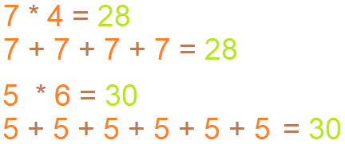
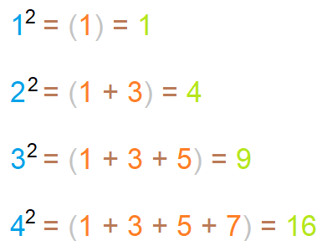
IMP
1. Think about how multiplication can be done without actually multiplying
2. Square

Slide 403

"Live as if you were to die tomorrow.
Learn as if you were to live forever"

Slide 404
shell commands
MySQL JS > function fn(x ,y) {
-> print(x + y);
-> }
->
MySQL JS > fn(10,20);
MySQL JS > \SQL
Switching to SQL mode... Commands end with ;
MySQL SQL > \connect root@localhost
Creating a session to 'root@localhost’
Please provide the password for 'root@localhost': ****
Save password for 'root@localhost'? [Y]es/[N]o/Ne[v]er (default No): n
Fetching global names for auto-completion... Press ^C to stop.
Your MySQL connection id is 18 (X protocol)
Server version: 8.0.31 MySQL Community Server - GPL
No default schema selected; type \use <schema> to set one.
MySQL localhost:33060+ ssl SQL > USE DB1;

Slide 405
select * from plumber, service, plumber_service_map where pid = plumberId and serviceID = sid and pid in (select plumberid from plumber_service_map where serviceid in (1,2,7) group by plumberid having count(*) =(select max(R1) from (select plumberid, count(plumberid) R1 from plumber_service_map where serviceid in (1, 2,7) group by plumberid) t1)) order by plumberid, serviceid;
Binary Numbers
1, 2, 4, 8, 16, 32, 64, 128, 256, 512, 1024, 2048, 4096, 8192, 16384, 32768, 65536, and so on.

Slide 406


Slide 407



Slide 409


